Slide 1

Creating an LGBTQ* Affirming Environment
*We support all sexual orientations and gender identities

Slide 2

Cultural Humility: Lifelong process of self-reflection and self-critique whereby the individual not only learns about another’s culture - but starts with an examination of their own beliefs and cultural identities.
Cultural Sensitivity: Learning about and understanding people who are different from ourselves, thereby becoming better able to serve them within their own communities

Slide 3
What are we doing at
Stony Brook Medicine?

Slide 4

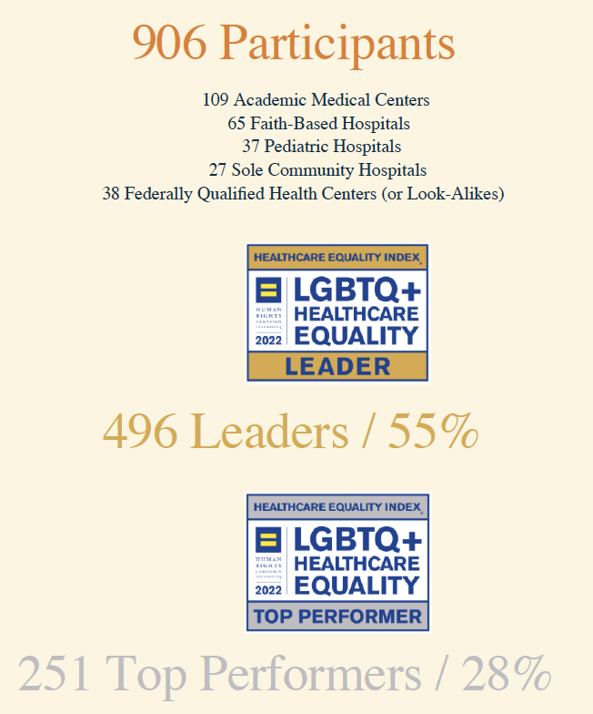
All Stony Brook Medicine Hospitals Receive Human Rights Campaign Designation: Health Care Equality Leader 2022-2024

Slide 5
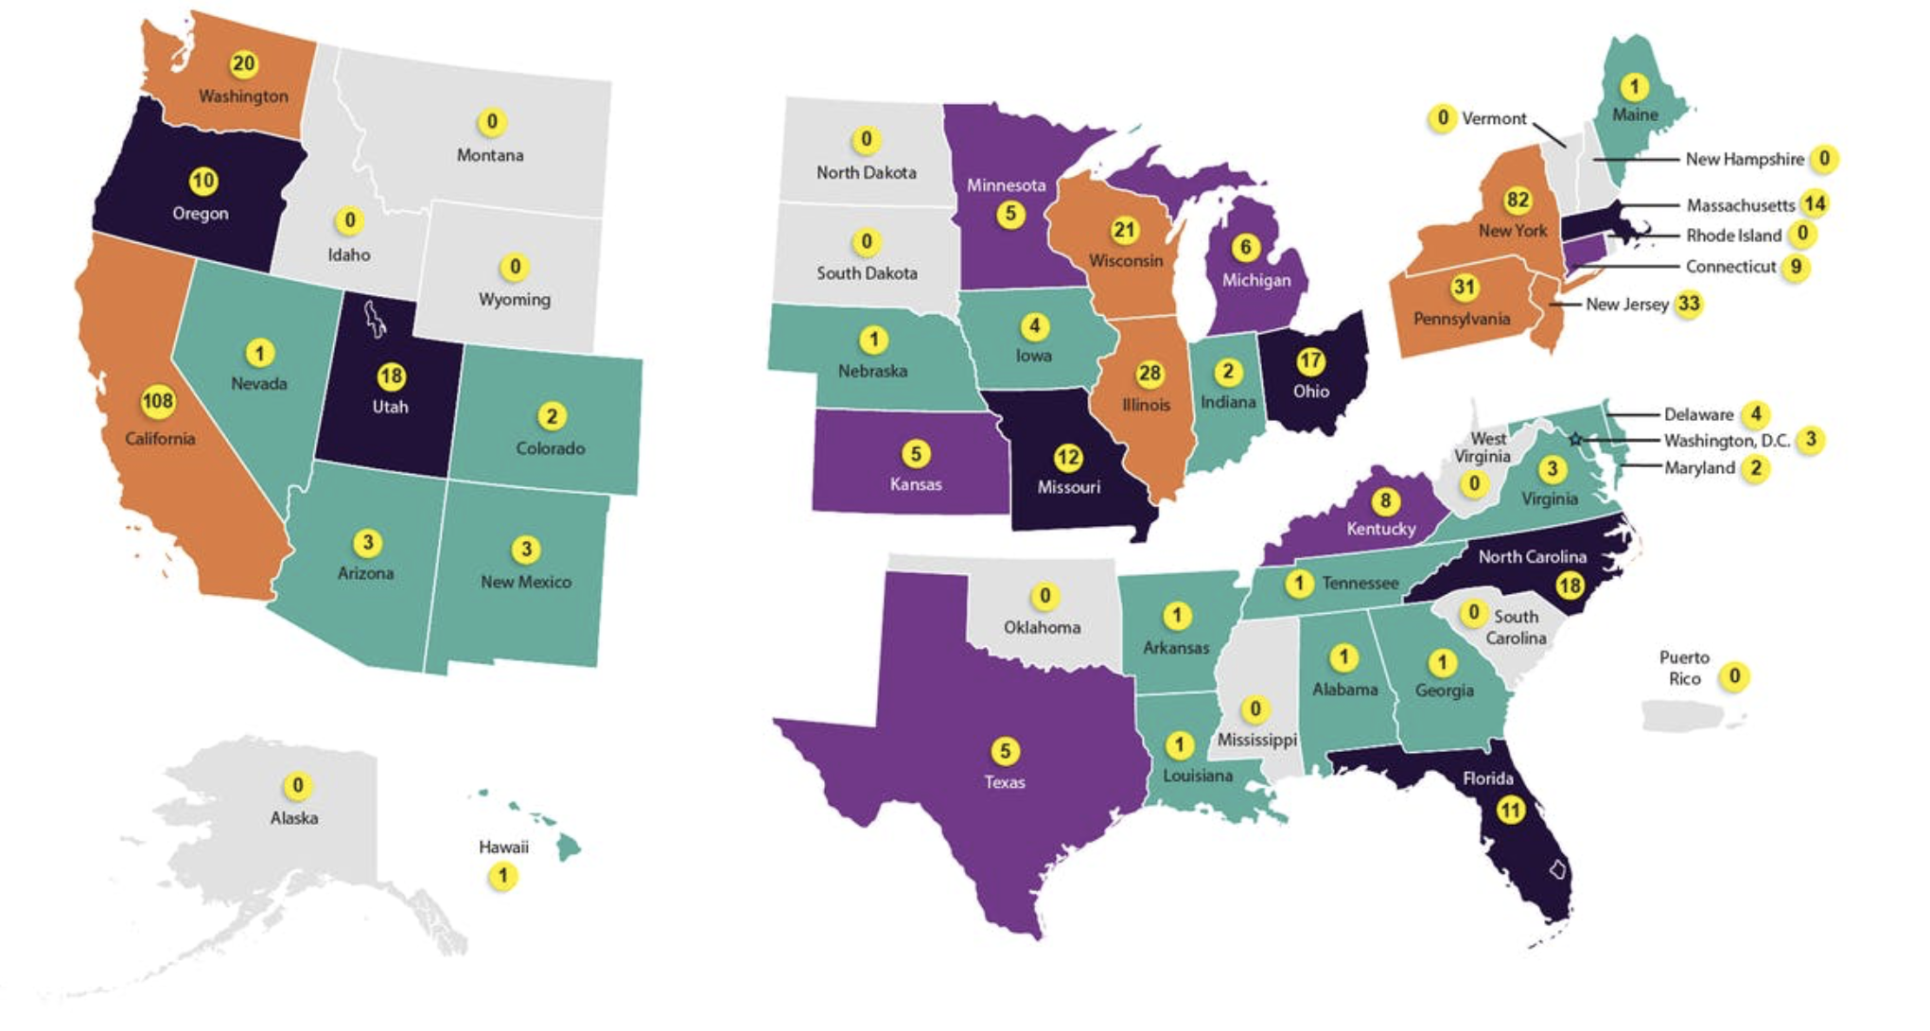
Health Equality Index 2022 National Participants

Slide 6
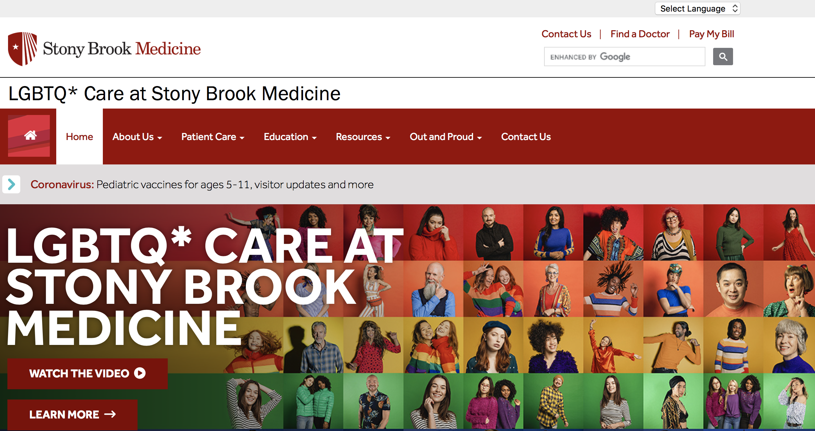
Stony Brook Medicine LGBTQ* Care Website
https://www.stonybrookmedicine.edu/LGBTQ

Slide 7
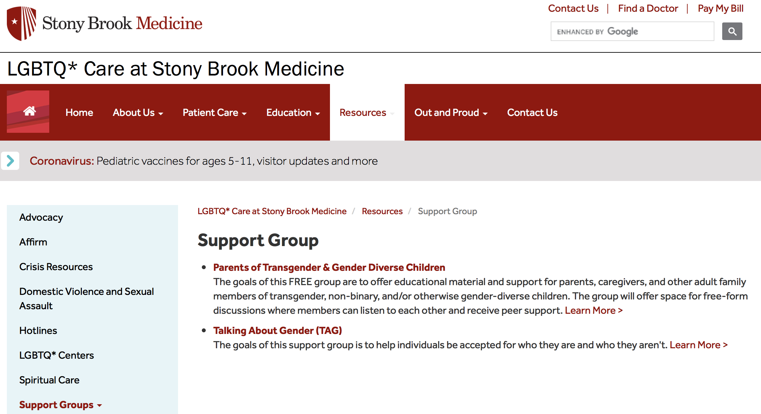
Stony Brook Medicine LGBTQ* Care Website

Slide 8
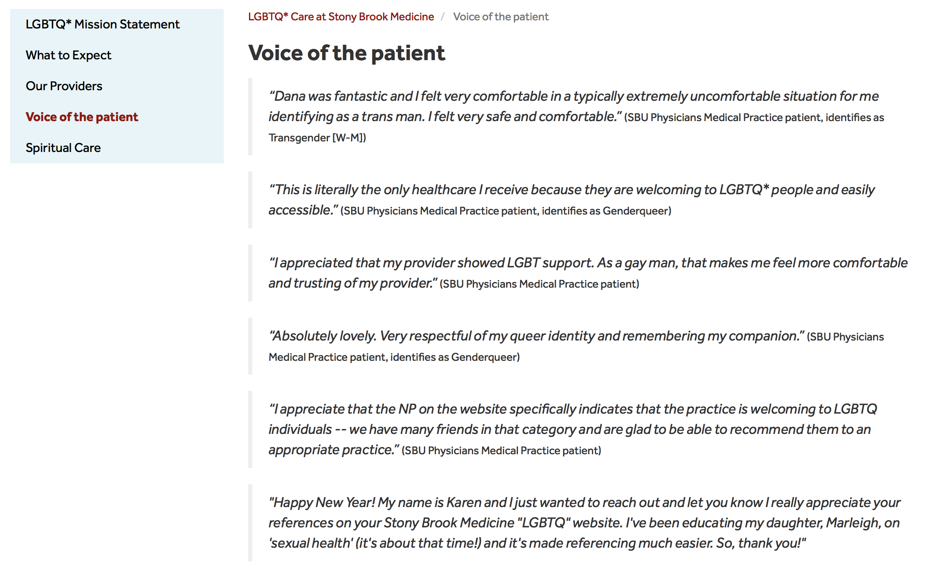
Stony Brook Medicine LGBTQ* Care Website

Slide 9
Additional LGBTQ* Updates:
Ongoing LGBTQ* Cultural Sensitivity Trainings
Collaboration with HR and Patient Experience teams to address employee and patient complaints
Development of LGBTQ* Adolescents and Older Adults Websites
Employee Resource page on Pulse
Collaborative work across hospitals for LGBTQ* pride and health fair events
Powerchart Updates
Chosen Name added to Ambulatory Schedule
Edie Windsor Healthcare Center Updates
-Development of collaborative LGBTQ* Care Providers Brochure
Welcome Sign: How would you like to be addressed?

Slide 10
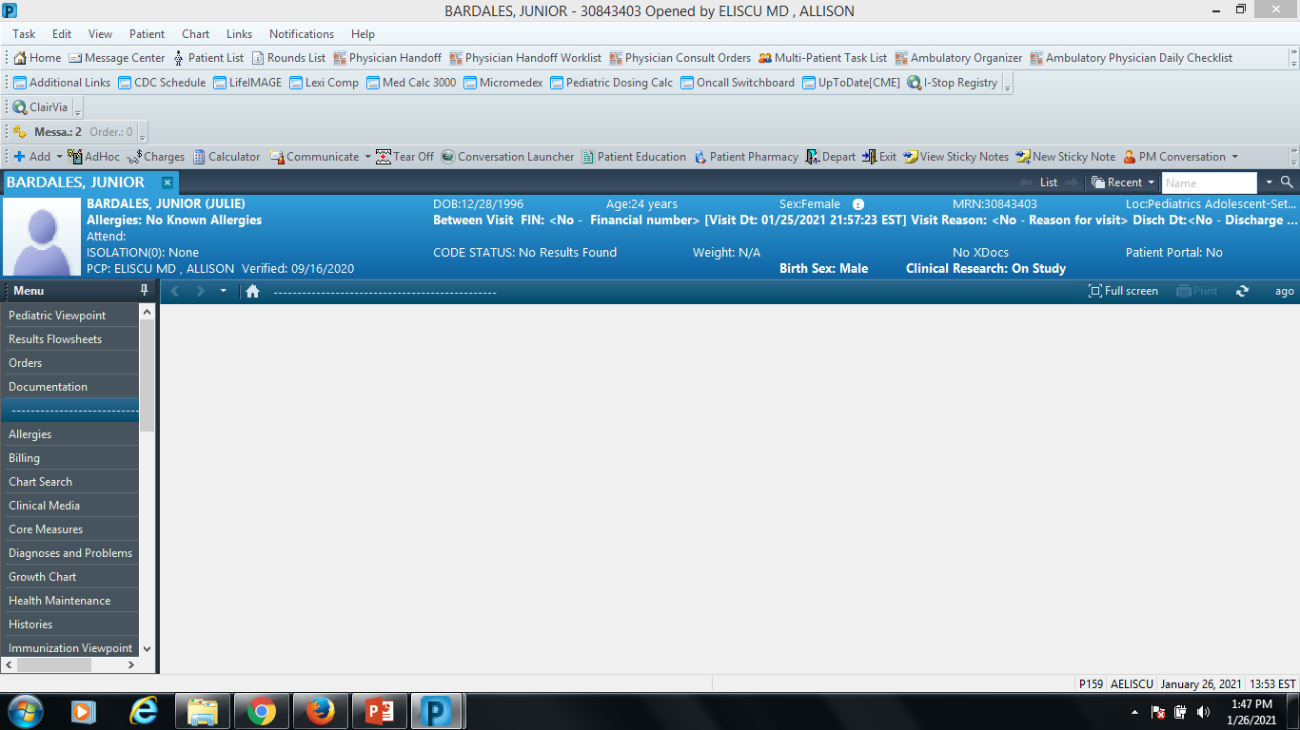
Powerchart Updates
Chosen/Preferred Name
Administrative Sex
Sex Assigned at Birth

Slide 11
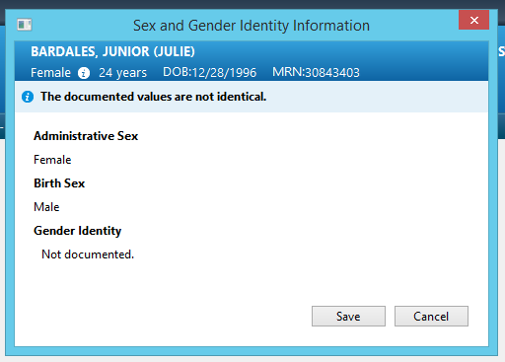
Powerchart Updates

Slide 12
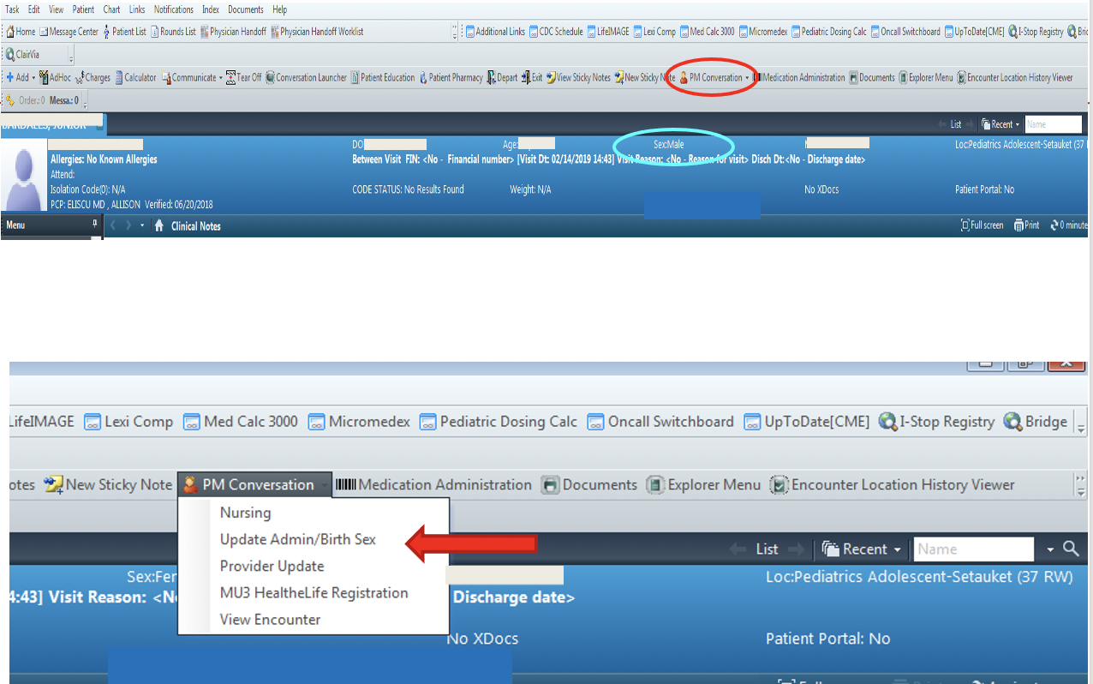
Powerchart Updates

Slide 13
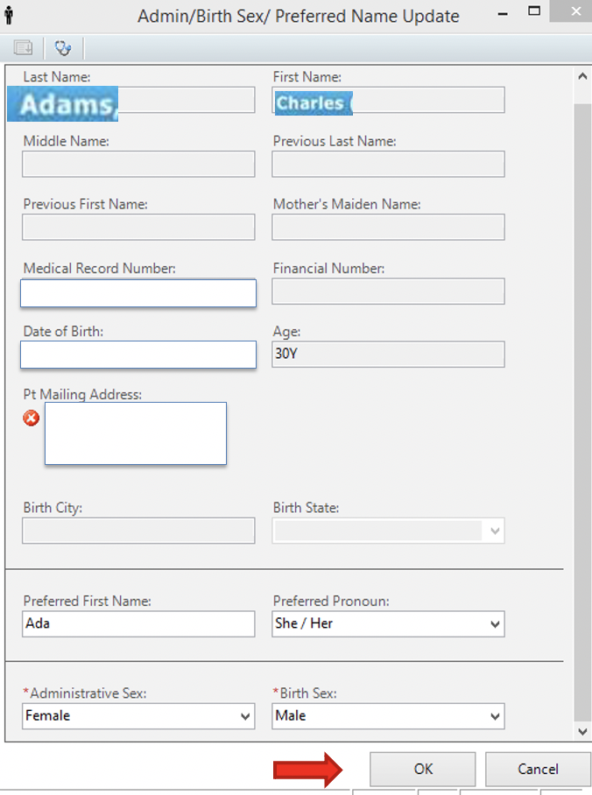
Powerchart Updates

Slide 14
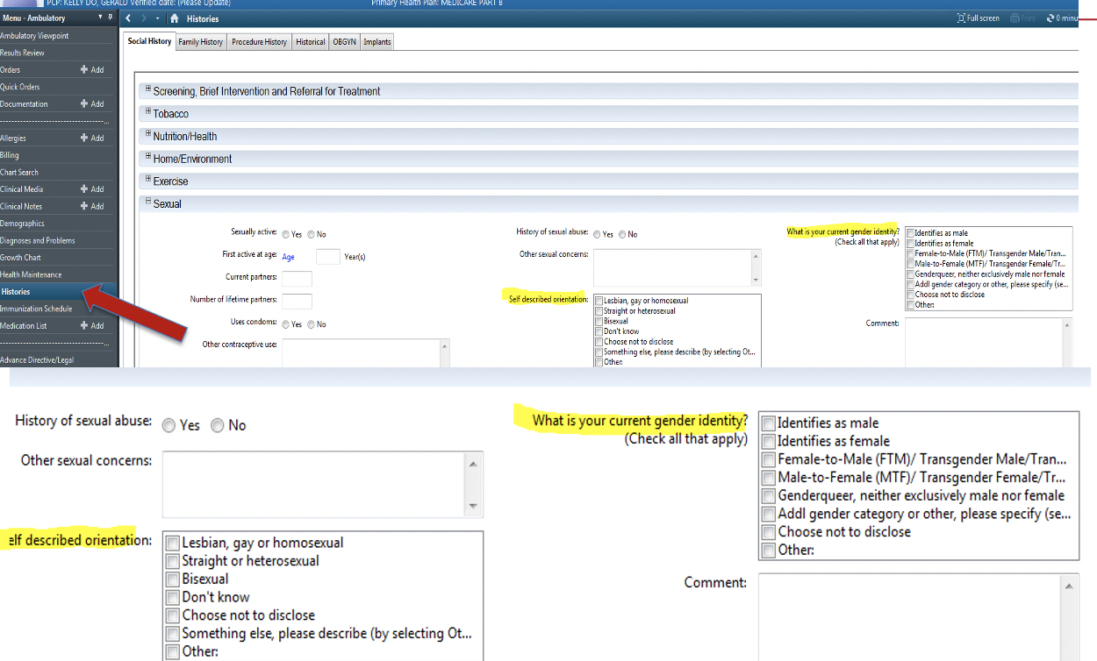
Powerchart Updates

Slide 15
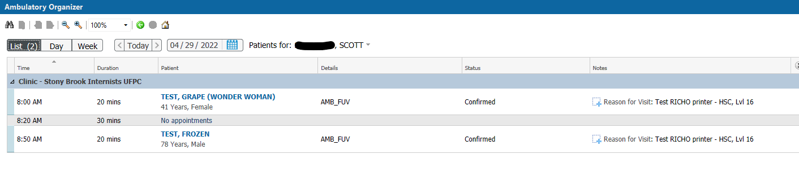
Ambulatory Schedule Example

Slide 16
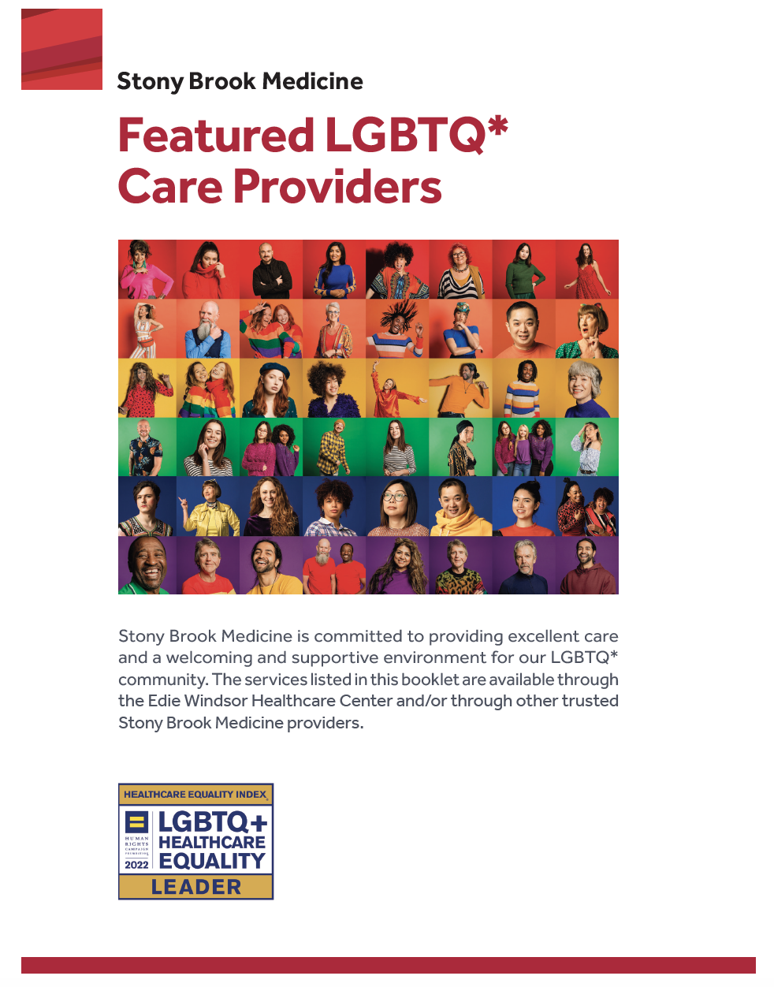
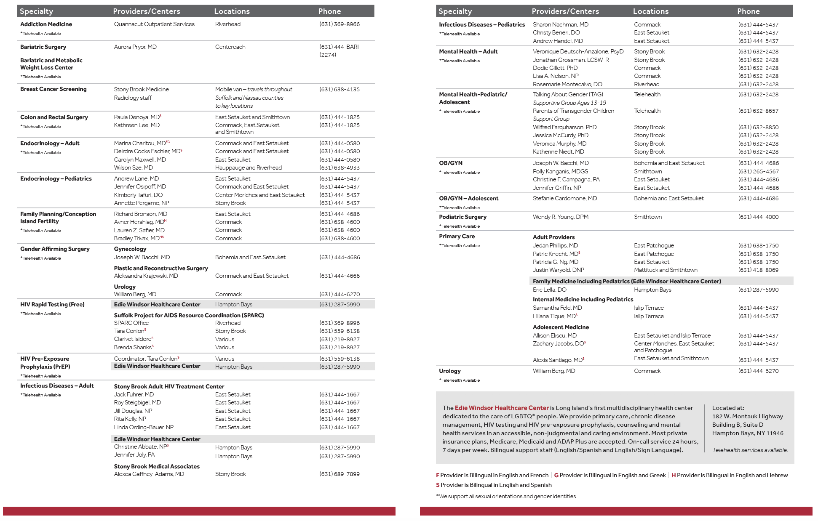
LGBTQ* Care Providers Brochure

Slide 17
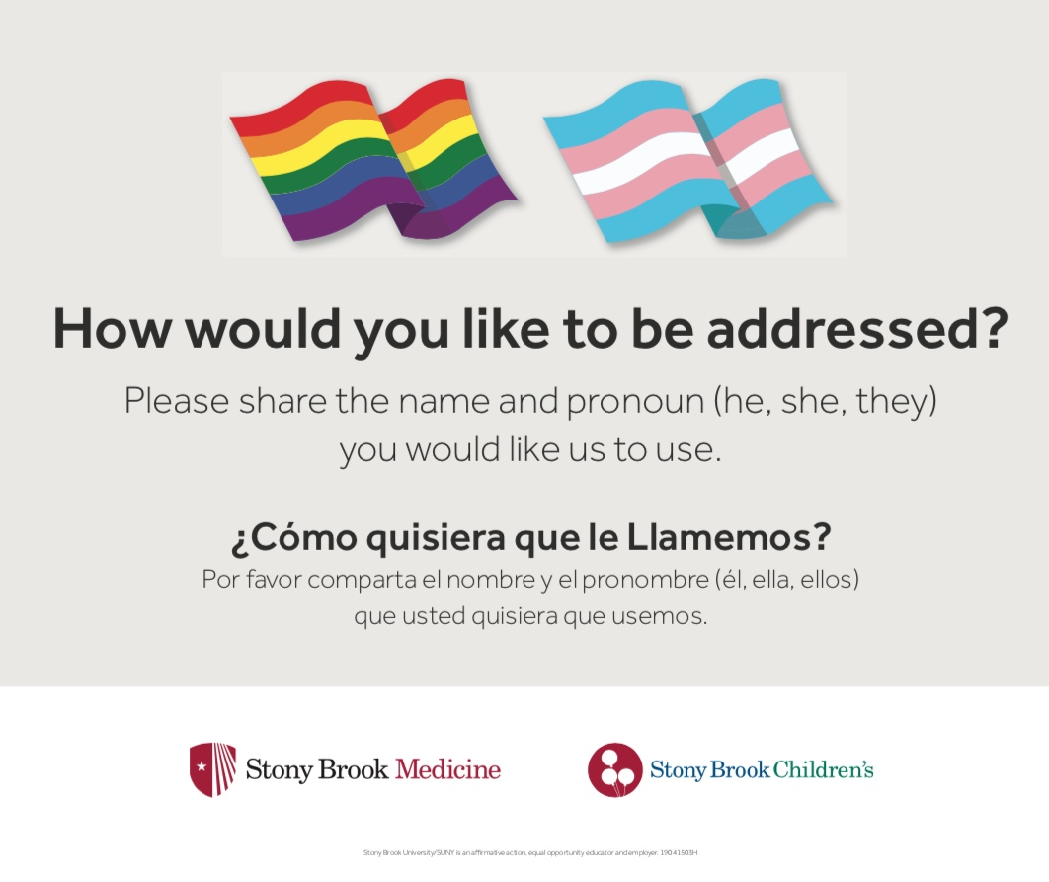
How would you like to be addressed?

Slide 18
How to handle questions about the sign?
Proposed scripting for waiting room questions about the sign
“We want everyone who needs our help to feel welcomed and respected. Addressing people by their chosen or preferred name and pronoun is one way we do that.”

Slide 19
Creating a Safe Space
    Rainbow stickers for ID badge and pins
“A 22yo female came in for a checkup who was new to me as a provider. When I asked her if she had any concerns or complaints she wanted to discuss, she hesitantly started talking about depression and her suicidal thoughts and a near attempt a few years ago. She said she never talked to anyone else about these issues but was really struggling. Towards the end of the discussion, I asked her why she decided to discuss it today. She said she came to the appt and wasn't sure she was going to talk about it, she even left the office before her appt and almost didn't come back. Then she said she saw a rainbow pin on my ID string and thought I'd be open to talking about it and nonjudgmental. She said it's such a small thing but it really helped her feel comfortable. ”

