Slide 1
Data Governance – A Primer Dr. Braden J. Hosch Associate Vice President for Institutional Research, Planning & Effectiveness November 3, 2019
Notes:
May be distributed – please cite.
Hosch, B. (2019) Data governance – A primer. North East Association for Institutional Research Annual Meeting, Newport, RI, November 3, 2019.

Slide 2
Overview
Data governance concepts and major aspects
Selling data governance to senior leadership
Characteristics of a data governance system
Maturity models
Change management in a college or university
Technological “solutions”

Slide 3
Outcomes for workshop participants
Define data governance as an activity that centers on human behavior more than data
Describe major components of data governance activities
Articulate challenges on their campus and how data governance will address these challenges
Assess their campus culture and organization with a data governance maturity model; select and modify a data governance maturity model for their campus
Identify characteristics of a data governance system; analyze where their own institution has gaps; and create an outline for how data governance could fit into existing organizational structures
Discuss how technology may assist but not perform data governance; describe major functions of data governance software applications or “solutions”
Explain principles of change management in higher education institutions and how they will enable development of data governance on their campuses
Construct an action plan for next steps on their own campus to advance data governance activities

Slide 4
What this workshop will not do
Design your data governance system for you
Promote specific technological solutions
Prescribe specific functions, operations, or organization
Identify how much money to spend

Slide 5
What is data governance?

Slide 6
Data Governance Definitions (Generic)
“the execution and enforcement of authority over the management of data and data-related assets” - R. Seiner (2014)
“specification of decision rights and an accountability framework to ensure appropriate behavior in the valuation, creation, storage, use, archiving and deletion of information” - Gartner IT Glossary
“a system of decision rights and accountabilities for information-related processes, executed according to agreed-upon models which describe who can take what actions with what information, and when, under what circumstances, using what methods” – Data Governance Institute (2014)
Notes:
Seiner, R. (2014) Non-invasive data governance: The path of least resistance and greatest success. Basking Ridge, NJ: Technics Publications
https://www.gartner.com/it-glossary/information-governance
http://www.datagovernance.com/adg_data_governance_definition/

Slide 7
Data Governance Definitions from Universities
“formalizes behavior around how data are defined, produced, used, stored, and destroyed in order to enable and enhance organizational effectiveness” – Stony Brook University (2016)
“adds value to our administrative and academic data systems by the establishment of standards that that promote data integrity and enables strategic integrations of information systems” – Vanderbilt University
“the discipline which provides all data management practices with the necessary structure, strategy, and support needed to ensure that data are managed and used as a critical University asset” – U of Rochester
Notes:
References
https://www.stonybrook.edu/commcms/irpe/about/data_governance/data_governance.php
https://www.vanderbilt.edu/datagovernance/
http://www.rochester.edu/provost/datagovernance/what-is-data-governance.html

Slide 8
The 5-second elevator definition
Data governance is …
a set of guidelines for how people behave and make decisions about data

Slide 9
Master data management is often confused with data governance
Master Data Management (MDM)
Comprehensive method to link all critical data to a common point of reference
Example:
Data Governance
Formalized system for how people make decisions about acquisition, production, storage, distribution, and analysis of data
Example:
All screens, documents and systems showing a student’s address derive from a common location.
Group decides on a definition for home address and agrees on a common source field

Slide 10
Important characteristics of DG definitions
Data governance IS | Data Governance IS NOT
More about people and behavior than data A system that requires and promotes shared agreement Formal (i.e. written down) Adds value by supporting institutional mission/goals | IT’s responsibility Solved by technology Equally applied across all data assets

Slide 11
Activity 1 – What data governance features do you have?
List formal and informal structures you have for promoting data governance
 | Formal | Informal
Policies/Practices
Groups
Roles
Responsibilities

Slide 12
Why do we need data governance?

Slide 13
Data governance is a strategic priority
Proliferation of data and applications
Privacy expectations/ regulations
Cloud data mobility
Fair and ethical use

Slide 14
Justifications for Data Governance
Justify data governance on your campus based on:
Value
Cost
Risk

Slide 15
Justifications for Data Governance - Value
EDUCAUSE identifies significant institutional value to higher education institutions from data governance:
Official vs. ad hoc data definitions
Clear responsibilities
Capacity for analytics
Competitive advantage
EDUCAUSE (2015). “The compelling case for data governance,” retrieved October 15, 2018 from
https://library.educause.edu/~/media/files/library/2015/3/ewg1501-pdf.pdf

Slide 16
Justifications for Data Governance – Cost (1)
A third of Fortune 100 organizations will experience “an information crisis, due to their inability to effectively value, govern and trust their enterprise information.”
Gartner. (2014). “Why data governance matters to your online business,” retrieved August 1, 2016
from http://www.gartner.com/newsroom/id/1898914s-why-data-governance-matters-to-your-online-business/

Slide 17
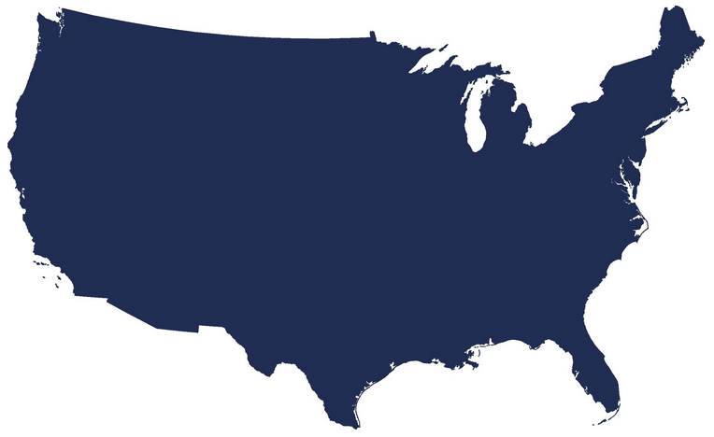
Justifications for Data Governance – Cost (2)
Poor data quality costs the US economy $3.1 trillion every year
$3.1
Trillion
IBM. (n.d.). “Extracting business value from the 4 V's of big data,” retrieved October 1, 2018 from
https://www.ibmbigdatahub.com/infographic/extracting-business-value-4-vs-big-data

Slide 18
Justifications for Data Governance – Cost (3)
The average financial impact of poor data quality on a typical businesses is $9.7 million per year. Opportunity costs, loss of reputation and low confidence in data may push these costs higher.
Forbes (2017). “Poor-quality data imposes costs and risks on businesses,” retrieved October 22, 2018 from https://www.forbes.com/sites/forbespr/2017/05/31/poor-quality-data-imposes-costs-and-risks-on-businesses-says-new-forbes-insights-report

Slide 19
Justifications for Data Governance - Risks
Fines Imposed by Federal Student Aid
Fiscal Year | Clery/Part 86 Imposed Fines | IPEDS Imposed Fines | Other Imposed Fines | Total Imposed Fines
2010 | $42,000 | $225,000 | $48,653,500 | $48,920,500
2011 | $195,000 | $144,500 | $4,868,500 | $5,208,000
2012 | $212,500 | $158,500 | $624,000 | $995,000
2013 | $812,000 | $56,000 | $5,204,137 | $6,072,137
2014 | $438,000 | $111,250 | $6,750 | $556,000
2015 | $500,000 | $39,250 | $14,130,000 | $14,669,250
2016 | $307,500 | $57,000 | $79,462,500 | $79,827,000
2017 | $2,542,500 | $1,500 | $382,500 | $2,926,500
2018 | $988,250 | $67,500 | $20,000 | $1,075,750
Source: Postsecondary Education Participants System (PEPS)

Slide 20
Data as an Asset
By 2020, Gartner predicts that 10% of organizations will have a highly profitable business unit specifically for productizing and commercializing their information assets.
By 2021 companies will be valued on their information portfolios: “Those in the business of valuing corporate investments, including equity analysts, will be compelled to consider a company’s wealth of information in properly valuing the company itself.”
Notes:
https://www.gartner.com/smarterwithgartner/treating-information-as-an-asset/
https://www.gartner.com/en/newsroom/press-releases/2017-02-08-gartner-says-within-five-years-organizations-will-be-valued-on-their-information-portfolios

Slide 21
Data as an Asset for Universities
Generic Example | At Colleges & Universities
web sites grant access in exchange for personal data (email address, etc.) – these data have value and can be leveraged or even sold | Data are purchased Names of prospective students Library databases Various datasets (U.S. News, Academic Analytics, etc.) Data are sold To vendors for discounts or services Lost data carry costs Data breaches

Slide 22
Who owns the data?
Consider carefully use of the word “ownership” with data
Often represents assignment of responsibility
Connotes individual control and property vs. caretaking of shared resource
Institutions own the data
Individuals provide stewardship

Slide 23
Activity 2 - Why do we need data governance?
Identify institution-specific examples that help make the case for data governance
Value – what could you do that you can’t do now?
Costs – what costs are you incurring because data are not well governed?
Risks – what risks are you taking because data are not well governed?
Notes:
Stony Brook examples:
Value – difficulty monitoring faculty load because data are not well structured, defined, and stored. Could increase equity and productivity with better governance
Costs – difficulty monitoring costs because of financial practices and coding. Could reduce cost overruns with real-time monitoring
Risks – disclosure and access risks inhere because risk levels not well communicated

Slide 24
Features of Data Governance

Slide 25
Key features of data governance systems
Documents
Charter / framework
Written & published policies
Groups
Policy council
Data steward council(s)
Individual roles
Data stewards
Data custodians/ caretakers
Data users
Principles & values
Purpose & scope
Roles & responsibilities
Data dictionaries
Communication strategies
Information security council/program
Senior leadership [buy-in]
Positions/office to support DG

Slide 26
Principles and values
Establishing principles and values for data governance assists with:
Initial design and implementation
Maintaining focus
Navigating difficult situations
Answering critics

Slide 27
Principles of Data Governance (Generic)
Consistency of data in its sourcing and in its vocabulary, definitions, and taxonomies
Quality which is proactively assessed and standards applied
Responsibility and accountability defined across the data lifecycle and recorded in the information asset register
Business alignment which ensures that data is regarded and treated as a key business asset
Access to relevant users, kept secure through access control
Providing trusted insight
Source: Carruthers, C. & Jackson, P. (2018). The chief data officer’s playbook, London: Facet, p. 145

Slide 28
Principles and Values – Example University of Wisconsin - Madison
Accountability | Determining who is responsible for the management of data at UW Madison as well as holding them to our outlined standards.
Agility | All of our processes should adapt when necessary
Change Management | New processes demand new and changing staff at UW. We’re committed to ensuring smooth transitions and well informed decisions.
Consistency | All decisions made will be applied consistently across campus.
Metrics Driven | We monitor ourselves against measurable goals on a regular basis and use the results to determine courses of action.
Stewardship | Determine formal roles for those in charge of data. This does not mean that everyone on campus is not responsible despite formal roles.
Transparency | We will make it clear how and when decisions are made and when processes are created. We also strive to ensure that decisions and processes are audited to support compliance based requirements.
Source: https://data.wisc.edu/data-governance/#principles

Slide 29
Principles and Values – Example Stony Brook University
Values
Shared Assets Data and information are shared organizational resources that constitute valuable assets. | Stewardship Employees of Stony Brook University have a responsibility for the curation of data. They serve as caretakers of data to ensure data are collected, stored, and maintained under the premise that others will access and use them over time |  |  | Quality To ensure data retain value, quality of data is actively monitored and maintained | Privacy & Confidentiality Maintenance of individual privacy and confidentiality of educational and personal records represent not only legal requirements but also primary outcomes of data management.
Principles for Data Governance
Organizational Effectiveness |  | Transparency | Communication |  | Compliance
Auditability |  | Integrity | Accountability |  | Standards
Source: https://www.stonybrook.edu/commcms/irpe/about/_files/DataGovFramework.pdf

Slide 30
Principles and Values – Example Mesa Community College
Accessibility
Security
Users have role appropriate access to data needed to make informed decisions.
Integrity
Data should be collected and maintained with reasonable assurances of its consistency, reliability, timeliness and accuracy.
Ethics
Sensitive data is protected from unauthorized access and improper disclosure.
The integrity of data is protected from malicious or accidental alteration.
Data is available with access granted according to the role of the user.
Processes are in place to ensure training and awareness.
Data is used in accordance with ethical principles, accepted best practices, and legal requirements.
Data is used to improve practices and further the College mission.
Data is available across platforms, on-site and remotely.
Individuals share responsibility and are accountable for their entry, use and access of the College’s data repository, requiring ongoing training on the part of those who enter, use, and care for it.
Source: https://www.brown.edu/about/administration/data-governance/introduction-data-governance-brown

Slide 31
Connect Data Governance to Mission
Data governance is a system to improve the effectiveness of the organization, not an activity for its own sake
Anchor data governance to mission when justifying need or presenting structure

Slide 32
Activity 3 - Distill university mission
Data governance should be established to support the institution’s mission and/or strategic goals. Colleges and universities have notoriously lengthy mission and goal statements, so it can be a challenge to distill them.
Summarize the main points of your institution’s mission, preferably so that it fits on a slide.

Slide 33
Example
Stony Brook’s framework for data governance outlines a set of principles, structures, roles, and responsibilities to improve the data infrastructure and to advance institutional goals
Stony Brook has a five-part mission to provide & carry-out:
Highest quality comprehensive education
Highest quality research and intellectual endeavors
Leadership for economic growth, technology, and culture
State-of-the-art innovative health care, with service to region and traditionally underserved
Diversity and positioning Stony Brook in global community

Slide 34
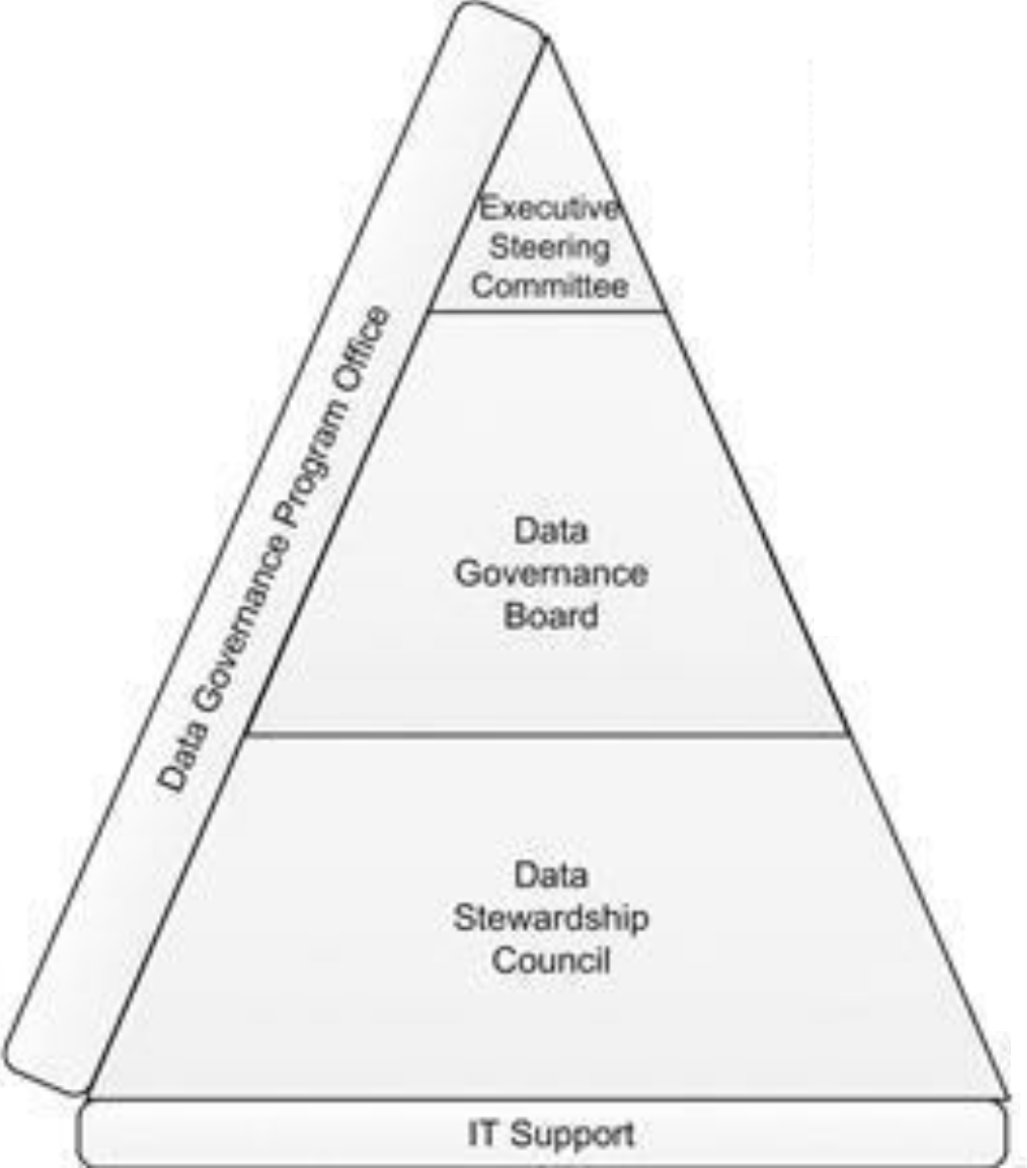
Structure – Generic Example
Executive Steering Committee
Authorized to change the organization
Drives cultural change
Supports the program enterprise-wide
Provides funding for the Data Governance Program
Data Governance Board
Made up of high-ranking representatives of data- owning business functions who can make decisions about data for the company
Assign members of the Data Stewardship Council
Approve decisions of the Data Stewardship Council
Approve data-related policies
Business Data Stewards
Experts on use of their data domain data
Able to reach out to SMEs to gather information and make decisions
Typically someone who others come to as the most knowledgeable about the meaning of the data (and how it is calculated)
Makes recommendations on data decisions and write data-related procedures
Plotkin (2014). Data stewardship: An actionable guide to effective data management

Slide 35
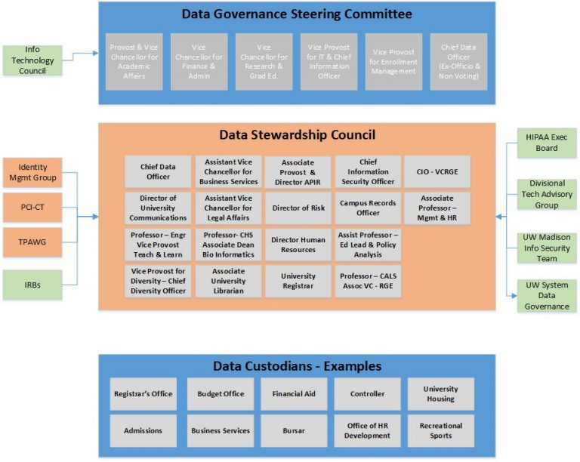
Structure – University of Wisconsin-Madison
Data Governance Steering Committee
provides executive level guidance to the program
promotes Data Governance across UW-Madison
allows for / facilitates data-driven decision making
determines priority and budget of major data-related projects.
Data Stewardship Council
determines operational structure of the program
drafts, communicates, and recommends approval of data-related policies
implements, budgets, and monitors data-related programs across UW-Madison.
Notes:
Wisconsin
https://data.wisc.edu/data-governance/#strucureimg
Data Governance Steering Committee
In aligning with the priorities established for the University of Wisconsin-Madison, the mission of the Data Governance Program is to allow for and facilitate data-driven decision making. The Data Governance Steering Committee has been established to sponsor and ensure the success of that program.
The Data Governance Steering Committee is responsible for providing executive level guidance to the program as well as promoting Data Governance across UW-Madison. They are also responsible for determining the priority and budget of major data-related projects.
Data Governance Stewardship Council
In aligning with the priorities established for the University of Wisconsin-Madison, the mission of the Data Governance Program is to allow for and facilitate data-driven decision making. The Data Stewardship Council has been established to determine the operational structure of the program.
The Data Governance Stewardship Council is responsible for drafting, communicating, and recommending for approval data related policies. They are also responsible for implementing, budgeting, and monitoring data-related programs across UW-Madison.
Stanford
https://web.stanford.edu/dept/pres-provost/cgi-bin/dg/wordpress/dg-structure/
Stanford University Data Stewards Groups (SUDS)
Data Stewardship groups are made up of subject matter experts whose primary focus is defining reporting terms and gathering metadata associate with their reporting environment. The subject matter experts are individuals who enter the data, who perform analytics on the data or interacts with the data in some way on a daily basis. The SUDS mission is to provide the metadata infrastructure to support improved decision-making, ensure information integrity, build data knowledge, and meet compliance requirements university-wide, enabling our partners to excel at teaching, learning and research.
Data Governance Committee (DG Committee)
The DG Committee is a cross functional group comprised of the lead steward from each of the SUDS group and representatives from several additional units and schools who have a vested interest in the university’s data governance program. The charge of the DG Committee is developing, setting and incorporating data governance policies, standards, procedures, and roles and responsibilities.
Business Intelligence Competency Center- Steering Committee (BICC-SC)
The BICC SC is a senior leadership team that provides cross-functional oversight and envisions and communicates the long-term value of the BI program, helps achieve buy-in from peers, and strives to effect change in business processes and data quality within their units. The BICC Steering Committee members all serve as data governance adopters and champions of the use of data governance in decision-making and provide strategic oversight of the data governance program in order to ensure that the programs aligns with the university data goals.

Slide 36
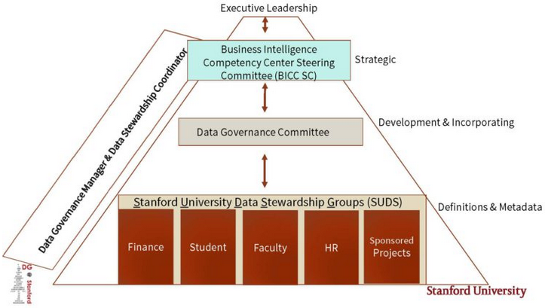
Structure – Stanford University
BI Competency Ctr. Steering Committee
Cross-functional oversight & communicates long-term value of BI program
Achieves peer buy-in, and effects change in business process and data quality
DG adopters and champions
Ensures alignment of DG with university goals
Data Governance Committee
Sets & incorporates DG policies, standards, procedures, roles & responsibilities
Includes lead steward from each of the data steward groups, plus reps from additional units
Data Stewardship Groups
Provide metadata infrastructure to support improved decision-making university-wide
Ensure information integrity
Build data knowledge
Meet compliance requirements
SMEs who define reporting terms and gather metadata associated with their reporting environment
Notes:
Stanford
https://web.stanford.edu/dept/pres-provost/cgi-bin/dg/wordpress/dg-structure/
Stanford University Data Stewards Groups (SUDS)
Data Stewardship groups are made up of subject matter experts whose primary focus is defining reporting terms and gathering metadata associate with their reporting environment. The subject matter experts are individuals who enter the data, who perform analytics on the data or interacts with the data in some way on a daily basis. The SUDS mission is to provide the metadata infrastructure to support improved decision-making, ensure information integrity, build data knowledge, and meet compliance requirements university-wide, enabling our partners to excel at teaching, learning and research.
Data Governance Committee (DG Committee)
The DG Committee is a cross functional group comprised of the lead steward from each of the SUDS group and representatives from several additional units and schools who have a vested interest in the university’s data governance program. The charge of the DG Committee is developing, setting and incorporating data governance policies, standards, procedures, and roles and responsibilities.
Business Intelligence Competency Center- Steering Committee (BICC-SC)
The BICC SC is a senior leadership team that provides cross-functional oversight and envisions and communicates the long-term value of the BI program, helps achieve buy-in from peers, and strives to effect change in business processes and data quality within their units. The BICC Steering Committee members all serve as data governance adopters and champions of the use of data governance in decision-making and provide strategic oversight of the data governance program in order to ensure that the programs aligns with the university data goals.

Slide 37
Structure – Stony Brook University
Data Governance Council
Finance
Student
Human Resources
Data Stewards
Data Stewards
Data Stewards
VP Council
VP Council (Project 50 Forward SteerCo)
Executive sponsors of project
Establishes authority and purview of data governance system
Data Governance Council
Recommends and implements institutional policy for data governance
Sets priority for
Functional data governance committees
Functional Data Governance Committees
Implements institutional policy for data governance
Recommends solutions to specific data issues
Considers and approve changes to code sets, additions to tables
Develops solutions to data governance issues
Communicates with data caretakers in their areas
Notes:
Stony Brook
https://www.stonybrook.edu/commcms/irpe/about/_files/DataGovFramework.pdf
Data Governance Council (DGC)
Role: Recommend and implement institutional policy for data governance in PeopleSoft and the Data Warehouse, including for how data are defined, produced, used, stored, and destroyed
Responsibilities
Develop and follow procedures for internal council operation, officers, meetings, workflow, and voting
Develop, recommend and evaluate effectiveness of policies, procedures, and processes for data management, data quality, and data use
Elevate to the Project 50 Forward Steering Committee issues of institutional policy or practice that require resolution or additional resources
Set priorities for preserving and increasing value of data assets
Oversee data quality monitoring and improvement
Set standards for data dictionaries and definitions, reporting conventions
Coordinate cross-functional collaboration among Functional Data Governance Committees (FDGCs)
Ensures representation in FDGCs
Ensure compliance and coordination with security policy
Functional Data Governance Committees (FDGCs)
Role: FDGCs are specialized groups with cross-functional membership that oversee management of data assets in respective functional areas, including data steward coordination, data quality monitoring & improvement, and interfacing between data stewards and DGC
Responsibilities
Coordinate data stewards in related area
Respond to inquiries about process, content, limitations and uses of data, especially in cross-functional settings
Consider and approve changes to code sets, additions to tables
Elevate to DGC issues that require resolution beyond the purview of the FDGC
Review data quality in functional area; identify practices promoting data quality identify areas for improvement and monitor improvements
Ensure dictionary standards are followed in area
Evaluate effectiveness of data governance policies within functional area
Recommend to DGC changes in policies, procedures, and processes to improve effectiveness
Communicate proceedings, including notice of changes and decisions, to DGC.

Slide 38
Structure – Bowdoin College
Division/Department | Position
Permanent members
IR, Analytics & Consulting | Vice President*
Information Technology | IT Security Officer
Information Technology | SVP and CIO
Office of the Registrar | Registrar
Treasurer's Office | Legal & Asst Scrtry of Coll
IR, Analytics & Consulting | Dir. BI & Data Warehouse**
Data Stewards
Academic Affairs | Assoc Dean
Admissions and Student Aid | Mgr of Tech. & Marketing
Comm. and Public Affairs | Exec. Director
Dev. and Alumni Relations | Asst Vice President
Finance and Administration | Vice President HR
President's Office | SP & Special Asst. to Pres.
Student Affairs | Assoc Dean
Bowdoin College’s Data Governance Committee includes stewards from seven of the College's divisions, as well as permanent members and committee staff. There may be multiple Stewards within a single division, but only one serves on the Committee at a time
* Committee chair
** Committee staff
Source: https://www.bowdoin.edu/data-governance/committee/index.html

Slide 39
Policy-Making Body - Data Governance Council
Prioritizes decisions regarding data to address most relevant needs of organization
Reviews, evaluates, and reports on data governance performance and effectiveness
Ensures that annual performance measures align with data governance and business objectives
Reviews and approves data governance policies and goals
Ultimately is accountable for business data use, data quality, and prioritization of issues
Makes strategic and tactical decisions
Defines data strategy based on business strategy and requirements
Plotkin (2014). Data stewardship: An actionable guide to effective data management

Slide 40
Data Governance Council Membership Examples
UW-Madison | Stony Brook
Chief Data Officer Director of Univ. Communications VP for Teaching & Learning VP for Diversity AVC Business Services AVC Legal Affairs Assoc. Dean Biomedical Informatics VP Libraries CISO Campus Records Officer Assoc. Dean Education Faculty/Dean Representation | Chief Institutional Research Officer Analytics and Enterprise Data Officer University Controller Chief Enrollment Management Officer University Registrar Chief Financial Aid Officer Provost’s Office designee VP Student Affairs designee VP Administration designee VP Human Resources designee VP Information Technology designee VP Research designee SVP Health Sciences Designee University Senate designee Chairs & Vice Chairs of FDGCs (6 people)

Slide 41
Data Stewardship Definitions
Data stewardship is the most common label to describe accountability and responsibility for data and processes that ensure effective control and use of data assets. – Knight (2017)
Data stewardship is the operational aspect of an overall Data Governance program, where the actual day-to-day work of governing the enterprise’s data gets done. –Plotkin (2014)
Data Stewardship is concerned with taking care of data assets that do not belong to the stewards themselves. Data Stewards represent the concerns of others. Some may represent the needs of the entire organization. Others may be tasked with representing a smaller constituency: a business unit, department, or even a set of data themselves. – Data Governance Institute (n.d.)
Notes:
Knight, M. (2017) “What is data stewardship?” http://www.dataversity.net/what-is-data-stewardship/
Plotkin, D. (2014) Data Stewardship: An Actionable Guide to Effective Data Management and Data Governance. ISBN: 978-0-12-410389-4
Van den Hoven, John (1999). “Information Resource Management: Stewards of Data,” Information Systems Management doi: 10.1201/1078/43187.16.1.19990101/31167.13
http://www.datagovernance.com/adg_data_governance_governance_and_stewardship/

Slide 42
Types of Data Stewards
Business Data Steward
Accountable for data owned by business area
Technical Data Steward
Provide expertise on applications, ETL, data stores, and other links in information chain
Work with stakeholders to make recommendations on data issues
Manage metadata for their data
Champion data stewardship for their areas
Assigned by IT leadership to support data governance
Domain Data Steward
Business steward for widely shared data
Work with business stewards as stakeholders to achieve consensus
Project Data Steward
Represent data stewardship on projects
Funded by projects
Work with business data stewards to obtain info and make recommendations about data stewarded by business stewards
Notify business data stewards about data issues raised by the project
Operational Data Steward
Provide support to business data stewards
Recommend changes to improve data quality
Help enforce business rules for the data they use
Plotkin (2014). Data stewardship: An actionable guide to effective data management

Slide 43
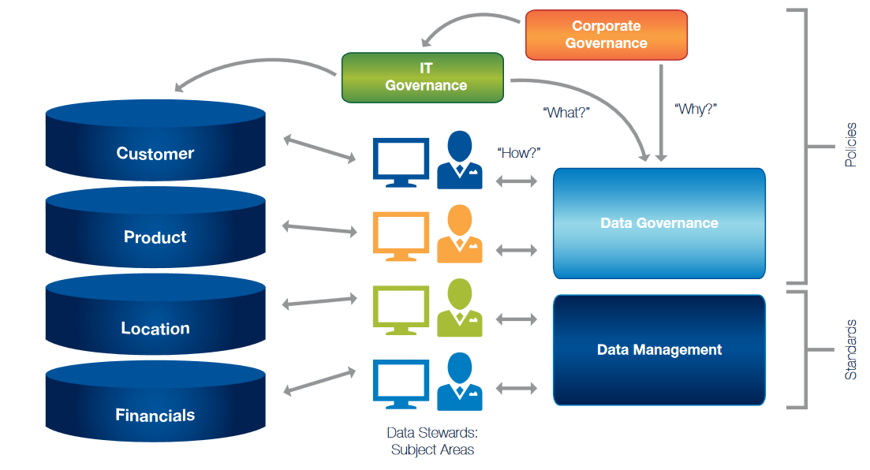
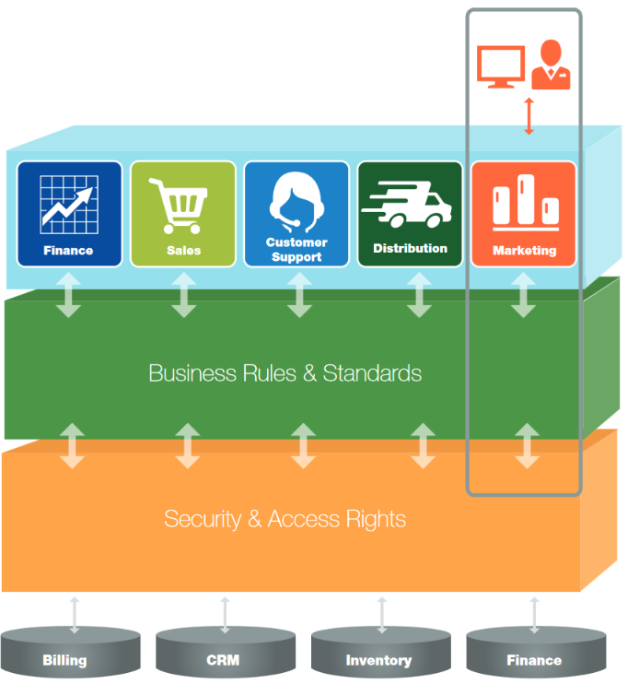
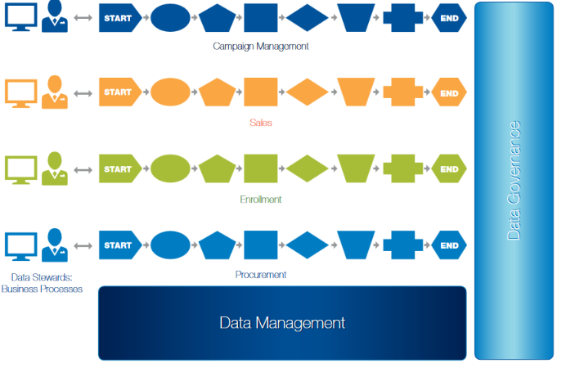
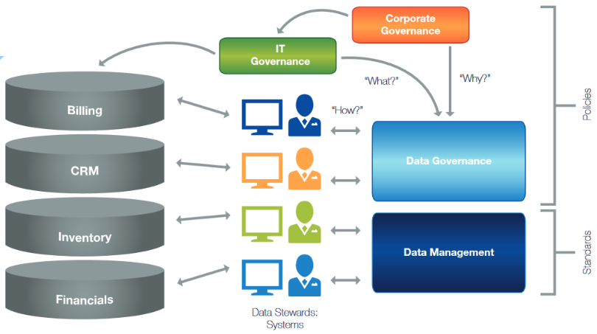
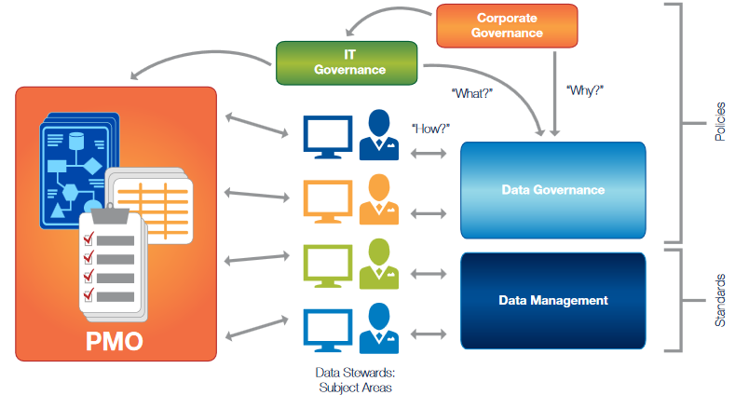
Alternative models for types of data stewards
Data Stewards by Subject Area
Data Stewards by Function
Data Stewards by Process
Data Stewards by System
Data Stewards by Project
Dyché & Polsky (2014). “Five models for data stewardship” SAS Whitepaper
Notes:
https://www.sas.com/content/dam/SAS/en_au/doc/whitepaper1/5%20Models%20Data%20Stewardship%20White%20Paper.pdf

Slide 44
Data Steward Responsibilities
Oversee management of selected data assets
Participate in data governance and carry out decisions
Assist in creation and maintenance of data dictionaries, metadata
Document rules, standards, procedures, and changes
Ensure data quality and manage specific issues
Communicate appropriate use and changes
Manage access and security
Notes:
http://www.stanford.edu%2Fdept%2Fpres-provost%2Fcgi-bin%2Fdg%2Fwordpress%2Fwp-content%2Fuploads%2F2012%2F01%2FDG-Data-Stewardship.doc&usg=AOvVaw1bVAl3vVR0sBVD4Zn2hBnD

Slide 45
Data Stewardship Council/Committee(s) (Functional)
Coordinate data stewards in related area
Set and review definitions, data quality rules, creation/usage rules, determines official version of metadata
Consider and approve changes & additions to code sets
Ensure dictionary standards are followed in area
Review data quality in functional area; identify practices promoting data quality identify areas for improvement and monitor improvements
Respond to inquiries about process, content, limitations and uses of data, especially in cross-functional settings
Elevate issues that require resolution
Communicate proceedings, including notice of changes and decisions
Notes:
Data stewardship: An actionable guide to effective data management

Slide 46
Stony Brook Roles and Responsibilities Matrix
 | Data Governance Council | Functional Data Governance Cmtes | Data Stewards
Standards and Policies | Define, Establish, Monitors, Audit, Verify, Develop, Revise | Cross functional implementation, coordination | Functional implementation
Data Quality | Identify, Adopt enterprise-wide DQ tool Big picture | Prioritize levels Monitor area Identify needs | Review audit reports, Coordinate clean-up, Initial prioritization
Metadata | Establish standards | Ensure cross-functional alignment | Implement Maintain
Metrics | Review, Identify, Monitor | Monitor area Identify are priorities | Monitor Remediate
B
46

Slide 47
Data users
Often not considered in data governance systems but should be
Example formal responsibilities (Stony Brook)
Recognize that institutional data and information derived from it are potentially complex. Make efforts to understand the source, meaning and proper use of the data through training sessions, utilizing data dictionaries and knowledge of supporting system processes.
Include information about the data source and criteria when distributing data, reports and ad hoc analytics to guard against misinterpretations of data.
Respect the privacy of individuals whose records they may access. Unauthorized disclosure or misuse of institutional information stored on any device is prohibited
Ensure that passwords or other security mechanisms are used for sensitive data
Report data quality issues to appropriate data steward

Slide 48
Administrative Office / Positions Supporting Data Governance
In general, offices and positions dedicated to supporting data governance are still emerging in higher education
Chief Data Officer | Data Governance Program Manager
Purdue University University of Florida System University of South Carolina – Columbia University of Rochester University of Wisconsin - Madison | Purdue University Stanford University
Pomerantz, J. (2017) IT leadership in higher education: The chief data officer. Educause.
Research Report. Louisville, CO:ECAR.
Notes:
References:
https://library.educause.edu/~/media/files/library/2017/8/ers1702cdo.pdf

Slide 49
Maturity Models

Slide 50
Assess your current state of data governance
To implement data governance, if not to sell it to senior leadership, assessment of the current state is important.
Extends beyond the informal list we made in Activity 1
Uses a maturity model to quantify the existing state; allows for measurement of progress in a future state

Slide 51
Activity 4: Data Governance Maturity Model
 | Level 1 | Level 2 | Level 3 | Level 4 | Level 5
 | Informal | Developing | Adopted and Implemented | Managed and Repeatable | Integrated and Optimized
Organizational Structures | Attention to Data Governance is informal and incomplete. There is no formal governance process. | Data Governance Program is forming with a framework for purpose, principles, structures and roles. | Data Governance structures, roles and processes are implemented and fully operational. | Data Governance structures, roles and processes are managed and empowered to resolve data issues. | Data Governance Program functions with proven effectiveness.
Culture | Limited awareness about the value of dependable data. | General awareness of the data issues and needs for business decisions. | There is active participation and acceptance of the principles, structures and roles required to implement a formal Data Governance Program. | Data is viewed as a critical, shared asset. There is widespread support, participation and endorsement of the Data Governance Program. | Data governance structures and participants are integral to the organization and critical across all functions.
Data Quality | Limited awareness that data quality problems affect decision-making. Data clean-up is ad hoc. | General awareness of data quality importance. Data quality procedures are being developed. | Data issues are captured proactively through standard data validation methods. Data assets are identified and valuated. | Expectations for data quality are actively monitored and remediation is automated. | Data quality efforts are regular, coordinated and audited. Data are validated prior to entry into the source system wherever possible.
Communication | Information regarding data is limited through informal documentation or verbal means. | Written policies, procedures, data standards and data dictionaries may exist but communication and knowledge of it is limited. | Data standards and policies are communicated through written policies, procedures and data dictionaries. | Data standards and policies are completely documented, widely communicated and enforced. | All employees are trained and knowledgeable about data policies and standards and where to find this information.
Roles & Responsibilities | Roles and responsibilities for data management are informal and loosely defined. | Roles and responsibilities for data management are forming. Focus is on areas where data issues are apparent. | Roles and responsibilities are well-defined and a chain of command exists for questions regarding data and processes. | Expectations of data ownership and valuation of data are clearly defined. | Roles, responsibilities for data governance are well established and the lines of accountability are clearly understood.

Slide 52
Activity 4: Data Governance Maturity Model
 | Enter rating 1 through 5 based on maturity model rubric
 | Finance data | Student data | HR data | Research data | Facilities data | Overall
Organizational Structures
Culture
Data Quality
Communication
Roles & Responsibilities

Slide 53
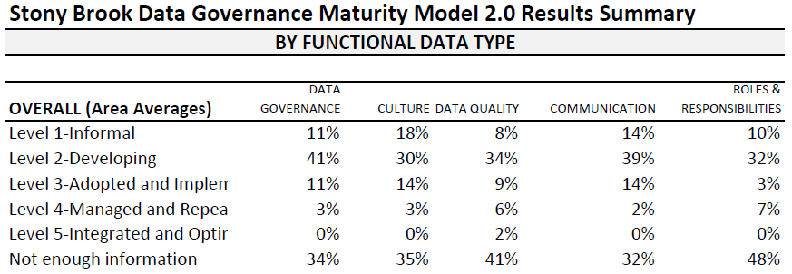
Stony Brook Data Governance Maturity Model Initial Results – Spring 2016

Slide 54
Baseline
Target
2017
Current
2015
Dimensions
Maturity
Data Governance
Culture
Data Quality
Communication
Roles & Responsibilities
Integrated & Optimized
Managed & Repeatable
Adopted & Implemented
Developing
Informal
K
54

Slide 55
Change Management in Higher Education

Slide 56
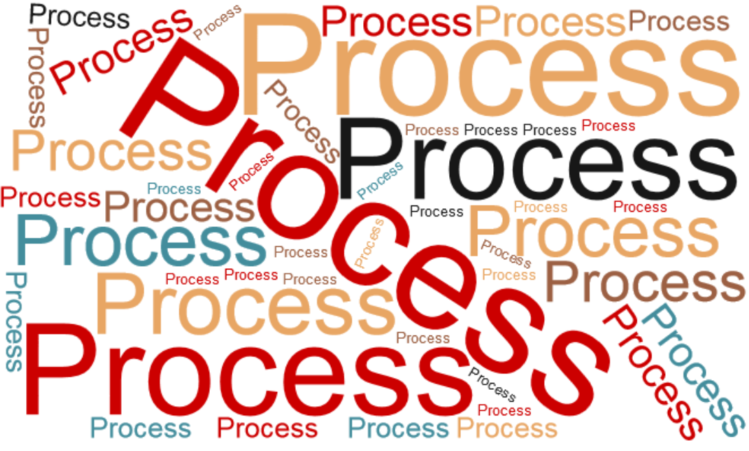

Slide 57
Elements to change management
Initiative
Process Representation Deliberation
Executive sponsors Mission alignment Project mgmt./timeline
Problem statement Research/environ. Scan Ideas for solutions
Interested allies Interest mapping Advocacy from others

Slide 58
Activity 5 – Assemble your group
Data governance requires support of senior leadership and functional leadership
Identify
Senior leaders who will sponsor
Functional leaders and their potential for collaboration (includes available bandwidth, interest, capability, willingness)

Slide 59
Case Study – Stony Brook University
Initiative to strengthen university data infrastructure (Jan 2015-Sept. 2016). Charge to examine:
Data governance
Data quality
Communication

Slide 60
Charge for data governance (first 9 months)
Examine existing governance structures active and inactive groups and lines of responsibility existing processes, practices and procedures that significantly impact data management and stakeholders. | Identify and articulate Roles of cross-functional groups Functional roles in business units (e.g. data owner, data custodian, report owner) will also be identified and articulated.
Draft formal governance structure for university data management Principles, mission, and goals Post on a website to codify roles and responsibilities. | Formalize a process for prioritization

Slide 61
Charge for data quality improvement
Examine existing practices for ensuring data quality within the Data Warehouse and may extend to quality assurance practices in functional systems. | Articulate and publish practices for developing, maintaining, and communicating data definitions (such as robust data dictionaries) transparent source information update schedules error check practices and clean-up procedures

Slide 62
Charge for training and communication
Develop a communication plan for How new capabilities for business intelligence go beyond initial reporting functionality. Availability Use limitations, and opportunities including needs identification for documentation, training, workshops, etc.
Develop, document, and adopt reporting standards

Slide 63
Example initial process for data collection
With broadly representative planning group (~20 people), conduct focus group with notecards and flipchart
list three current data governance mechanisms at our [INSTITUTION], the systems or applications they cover
list three aspects of data governance that are absent at [INSTITUTION] or need to be strengthened
list three things that data governance at [INSTITUTION] should accomplish
FOCUS GROUP ACTIVITY
list three roles or structures that should be included in [INSTITUTION’S] data governance system.

Slide 64
Activity 6 – Draft input for planning process
Using the framework below, draft useful responses to be incorporated into local planning
list three current data governance mechanisms
list three aspects of data governance that are absent
list three things that data governance should accomplish
list three roles or structures that should be included
[Anticipate responses that may be counterproductive]
E.g. “IT should control data governance”

Slide 65
Technological “Solutions”

Slide 66
Technology applications for data governance
Technology can support data governance
Data dictionary management
Data quality analysis
Master data management
Issue and process management
Technology will not
Build organizational structures, responsibilities, accountabilities
Mend dysfunctional organizations
Implement organizational or cultural change

Slide 67
Data governance applications / vendors
Data Cookbook (iData)
Collibra
Melissa Data
Technikes
Allows management of data definitions
Manages metadata within reporting environments
Online service to communicate and define reporting terms
Allows users to view definitions and terminology in reports
Data quality tool only
No metadata management
Full suite of metadata management and data quality tools
Issue resolution workflow functionality
Some users report complexity and not making use of full functionality
Metadata management tool only.
No data quality validation or profiling tools
Integration with reporting tools, website search and manage data definitions.
Integrated with active directory security

Slide 68
Issues to consider when selecting technology
Initial cost and annual cost
Alignment with needs
Metadata mgt.
Integration w/ reporting tools
Data quality
Security roles
User community
Ease of implement-ation

Slide 69
Final Thoughts

Slide 70
Takeaways
Data governance is more about people than data
All higher ed change management principals apply
Process, written documents, and structures are essential
Software can help, but it won’t fix broken processes or organizations
Starting data governance is hard work; sustaining it is harder

Slide 71
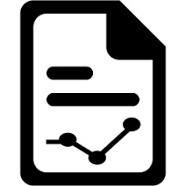
Data governance is only one part of a data strategy
A data strategy is a larger vision for how your organization will work with data.
Data acquisition | Data usage & literacy
Data governance | Data extraction & reporting
Data quality | Data analytics
Data access

