Slide 1
Data Governance: A Primer
Braden J. Hosch, Ph.D.
Asst. Vice President for Institutional Research, Planning & Effectiveness
Stony Brook University
Notes:
© Braden J. Hosch 2019
© Association for Institutional Research 2019
Dr. Hosch and AIR share equal co‐ownership of the copyright and related intellectual ownership (to the extent to AIR’s and the presenter’s lawful claim to the same) of any of the content and materials presented, utilized, and distributed in the workshop. The parties expressly state that they do not intend to create a partnership whereby any co‐owner shall be liable for the act of any other co‐owner. AIR and the contractor have the continuing right to use workshop materials. AIR and the contractor agree to include appropriate copyright with any additional use of these materials.
Suggested citation: Hosch, B. (2019, May 27). Data governance: A primer. Workshop conducted at the Association for Institutional Research Annual Forum, Denver, CO.

Slide 2
Overview
Data governance concepts and major aspects
Selling data governance to senior leadership
Characteristics of a data governance system
Maturity models
Change management in a college or university
Technological “solutions”
Notes:
This is a three-hour basic workshop for individuals and institutions just getting started with data governance. It assumes that participants have some knowledge of how their organizations use data, including strengths and limitations of current practice, but it does not assume prior experience with data governance. Participants involved in mature data governance processes may still takeaway valuable understanding about first principles and justifications, but may find that workshop material does not assist with some of the issues in mature environments.
As such, the workshop offers an over of what data governance is and is not and then provides some talking points and justifications to promote buy-in from senior leadership to invest political capital, human capital, and eventually economic capital in data governance. The workshop discusses in detail more common structures in data governance systems in higher education environments and offers several maturity model approaches for assessing data governance back at a home institution. Importantly, because data governance is more about people than about data,

Slide 3
Outcomes for workshop participants
Define data governance as an activity that centers on human behavior more than data
Describe major components of data governance activities
Articulate challenges on their campus and how data governance will address these challenges
Assess their campus culture and organization with a data governance maturity model; select and modify a data governance maturity model for their campus
Identify characteristics of a data governance system; analyze where their own institution has gaps; and create an outline for how data governance could fit into existing organizational structures
Discuss how technology may assist but not perform data governance; describe major functions of data governance software applications or “solutions”
Explain principles of change management in higher education institutions and how they will enable development of data governance on their campuses
Construct an action plan for next steps on their own campus to advance data governance activities
Notes:
Don’t read outcomes but highlight major points:
When participants have completed the workshop, they should be able to repeat a quick answer about what is data governance? And then explain it is about how people behave more than data. They will be able to discuss structural components observed in many data governance systems in universities and how and why they work. They will be able to undertake an analysis of college/university culture, including an appetite and readiness for data governance, as well as construct an action plan, some of which will be done in workshop.

Slide 4
What this workshop will not do
Design your data governance system for you
Promote specific technological solutions
Prescribe specific functions, operations, or organization
Identify how much money to spend
Notes:
It is important to highlight that this workshop won’t do it for participants. There is no such thing as data governance in a box, any more than there is institutional effectiveness in a box. Structure and mission have to be contextually appropriate. The workshop decidedly does not pitch technology as the solution to data governance, although as the system matures technology can help. And it doesn’t articulate how much to invest (or not) in DG.

Slide 5
What is data governance?
Notes:
Transitional slide. Depending on presenter comfort and audience level and size, this can be a point for discussion:
Do you have data governance on your campus? What does it consist of?
Is it possible not to have data governance? (This is a leading question – ultimately all institutions have a system for governing data, but developing or informal systems struggle as the volume, frequency, and importance of data increase)

Slide 6
Data Governance Definitions (Generic)
“the execution and enforcement of authority over the management of data and data-related assets” - R. Seiner (2014)
“specification of decision rights and an accountability framework to ensure appropriate behavior in the valuation, creation, storage, use, archiving and deletion of information” - Gartner IT Glossary
“a system of decision rights and accountabilities for information-related processes, executed according to agreed-upon models which describe who can take what actions with what information, and when, under what circumstances, using what methods” – Data Governance Institute (2014)
Notes:
The three definitions provided here are from recent literature on data governance. They make specific and relevant points, but not all are appropriate or even useful for higher education. The Seiner definition, for instance, contains a number of words that present challenges in higher education environments, given the collaborative structures and shared governance
Seiner
Execution – this is meant in the sense of “carrying out” but the valences of executive function and connotations of power can place higher education constituencies on the defensive
Enforcement, Authority, Management – see above
Assets – data are valuable
Gartner
Decision rights – this is important in highlighting that data governance articulates who has responsibility for making decisions about data
Behavior – this emphasizes that DG is about how people act, not how data exist
Data Governance Institute
Decision rights – see above
Agreed-upon – this is particularly important. If people in the organization do not agree on the same decision rights or process, then the DG system will fail.
References
Seiner, R. (2014) Non-invasive data governance: The path of least resistance and greatest success. Basking Ridge, NJ: Technics Publications
https://www.gartner.com/it-glossary/information-governance
http://www.datagovernance.com/adg_data_governance_definition/

Slide 7
Data Governance Definitions from Universities
“formalizes behavior around how data are defined, produced, used, stored, and destroyed in order to enable and enhance organizational effectiveness” – Stony Brook University (2016)
“adds value to our administrative and academic data systems by the establishment of standards that that promote data integrity and enables strategic integrations of information systems” – Vanderbilt University
“the discipline which provides all data management practices with the necessary structure, strategy, and support needed to ensure that data are managed and used as a critical University asset” – U of Rochester
Notes:
Discuss the importance of highlighted words
Stony Brook
Formalized = authorized, agreed upon, written down, and published.
Enhance org effectiveness = DG has a purpose for improvement; it is not an end in its own right
Vanderbilt
Adds value = DG should offer a return on investment. The value of data and downstream reports should increase because of higher data quality and higher confidence
Data integrity = DG improves the soundness of data in other words its quality
Strategic integrations = Not all systems need to be integrates in their entirety. Integrations should be deliberately made to answer questions of value.
Rochester
Discipline = Both “area of study” and “regulated behavior”
Practices = how actions are carried out in the real world. Practice differs from policy
University asset = something of value and implies ownership by the institution, not a person or unit.
References
https://www.stonybrook.edu/commcms/irpe/about/data_governance/data_governance.php
https://www.vanderbilt.edu/datagovernance/
http://www.rochester.edu/provost/datagovernance/what-is-data-governance.html

Slide 8
The 5-second elevator definition
Data governance is …
a set of guidelines for how people behave and make decisions about data
Notes:
What’s particularly important about this definition is that it is simple and it’s easy to remember.
It also provides opportunity for the immediate follow-up that data governance is about people more than data. Specifically, it is about how people act or do things. Successful data governance requires action.

Slide 9
Master data management is often confused with data governance
Master Data Management (MDM)
Comprehensive method to link all critical data to a common point of reference
Example:
Data Governance
Formalized system for how people make decisions about acquisition, production, storage, distribution, and analysis of data
Example:
All screens, documents and systems showing a student’s address derive from a common location.
Group decides on a definition for home address and agrees on a common source field
Notes:
These two concepts are often confused, in part because vendors will argue that MDM tools promote data governance and vice versa. More simply put, MDM is both the rules for where to source data as well as the technological system to enforce a particular sourcing or treatment of the data. Data governance sets forth rules for how people will produce, interact with, and destroy data.

Slide 10
Important characteristics of DG definitions
Data governance IS | Data Governance IS NOT
More about people and behavior than data A system that requires and promotes shared agreement Formal (i.e. written down) Adds value by supporting institutional mission/goals | IT’s responsibility Solved by technology Equally applied across all data assets
Notes:
This is a good place to stop for discussion.
If you have developing data governance on your campus, is it centered around IT or business units? Why is this and how might institutional history or agendas of various officers shape how data governance works on the campus?
Is there an expectation on the campus that purchasing a piece of software will solve the data governance problem, if the problem is even recognized?
Is there an expectation that all data will be subject to a single governance system? What types of data does the institution have to manage (and how do you even know what you have)?

Slide 11
Activity 1 – What data governance features do you have?
List formal and informal structures you have for promoting data governance
 | Formal | Informal
Policies/Practices
Groups
Roles
Responsibilities
Notes:
Activity 1 – What data governance features do you have?
5 minutes for activity, 5 minutes for discussion
This activity is designed to start participants to think in a structured way about how people behave and make decisions about data on their campuses now. Some institutions will have committees or processes. Many in the early development stages will have ad hoc procedures, e.g. when we see a problem with a student records, we contact Jane in the Registrar’s Office.
Following the 5 minutes of participants writing down their brief inventory of practices, lead a brief discussion.
Who has a committee in place to do this? Who is on it? How often do they meet? Are they accountable to anyone?
For campuses that have few formal procedures, what informal practices do you have? That is, how do you proceed when decisions need to be made about data?

Slide 12
Why do we need data governance?
Notes:
Transitional slide
Assume that participants have already placed some value on data governance or they would not be in the workshop -- this section of the presentation is designed to make the sale to senior leadership that data governance is needed. Encourage participants to re-purpose slides or integrate them into their own presentations to illustrate the value of data governance.

Slide 13
Justifications for Data Governance
Justify data governance on your campus based on:
Value
Cost
Risk
Notes:
This framework can really be used to justify any new process or activity.
Value – what additional revenue, return, or other reputational value may accrue to the institution by participating in data governance?
Cost – what is the cost of not doing the activity well or at all?
Risk - what are the risks of not doing the activity well or at all?
Here is the VCR framework applied to IPEDS completion for instance:
The value in using best practices to complete IPEDS is that the work put into constructing clean data sets that align with federal definitions can be re-purposed to accomplish other tasks on campus.
The costs of not doing IPEDS well results in an opportunity cost – that time could be spent doing something else.
The risks include heavy fines for not submitting surveys and could result in loss of Title IV funds. There are also reputational risks

Slide 14
Justifications for Data Governance - Value
Educause identifies significant institutional value to higher education institutions from data governance:
Official vs. ad hoc data definitions
Clear responsibilities
Capacity for analytics
Competitive advantage
Educause (2015). “The compelling case for data governance,” retrieved October 15, 2018 from https://library.educause.edu/~/media/files/library/2015/3/ewg1501-pdf.pdf
Notes:
Educause is the professional association for higher education IT professionals and it will carry some weight with CIOs. It is somewhat theoretical in nature but illustrates the advantages of an effective data governance system. Increased capacity for analytics and clear responsibilities will be attractive to CIOs and competitive advantage will be attractive to senior administrators as they position the university.
Discuss with participants other ways to justify value on your campus. What could you do better than would generate revenue (increased enrollment, retention, research success) that data governance would facilitate?

Slide 15
Justifications for Data Governance – Cost (1)
A third of Fortune 100 organizations will experience “an information crisis, due to their inability to effectively value, govern and trust their enterprise information.”
Gartner. (2014). “Why data governance matters to your online business,” retrieved August 1, 2016
from http://www.gartner.com/newsroom/id/1898914s-why-data-governance-matters-to-your-online-business/
Notes:
This is the first in a series of cost justifications. Most are focused on industry but will again resonate with executive constituencies. The phrase “information crisis” is particularly compelling as most CEOs have had multiple experiences in which they have asked questions of their direct reports and received inadequate or contradictory responses as well as the reply that the organization is simply unable to answer the question.

Slide 16
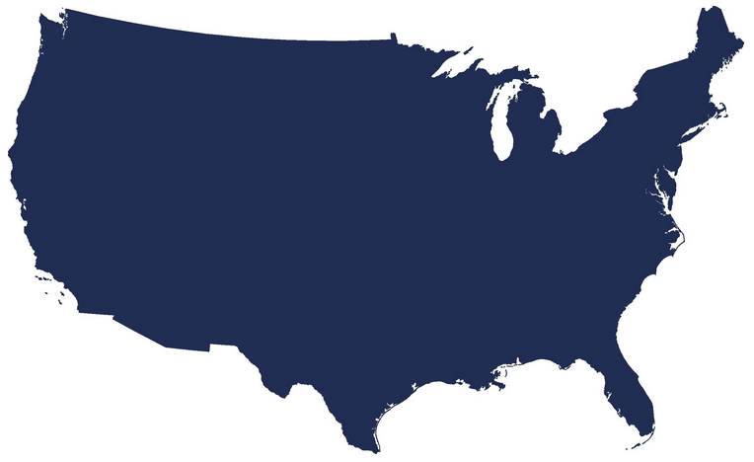
Justifications for Data Governance – Cost (2)
Poor data quality costs the US economy $3.1 trillion every year
$3.1
Trillion
IBM. (n.d.). “Extracting business value from the 4 V's of big data,” retrieved October 1, 2018 from
https://www.ibmbigdatahub.com/infographic/extracting-business-value-4-vs-big-data
Notes:
This figure is a national figure of $3 trillion is likely inflated (total Gross Domestic Product in the U.S. in 2018 was about $20.5 trillion).

Slide 17
Justifications for Data Governance – Cost (3)
The average financial impact of poor data quality on businesses is $9.7 million per year. Opportunity costs, loss of reputation and low confidence in data may push these costs higher.
Forbes (2017). “Poor-quality data imposes costs and risks on businesses,” retrieved October 22, 2018 from https://www.forbes.com/sites/forbespr/2017/05/31/poor-quality-data-imposes-costs-and-risks-on-businesses-says-new-forbes-insights-report
Notes:
This figure is an average cost to each business of $9.7 million per year. The cost would obviously be larger for larger organizations and smaller for smaller ones. Still, the source and the feel of the claim will resonate with leadership as a potential driver of costs on the campus.

Slide 18
Justifications for Data Governance - Risks
Fines Imposed by Federal Student Aid
Fiscal Year | Clery/Part 86 Imposed Fines | IPEDS Imposed Fines | Other Imposed Fines | Total Imposed Fines
2010 | $42,000 | $225,000 | $48,653,500 | $48,920,500
2011 | $195,000 | $144,500 | $4,868,500 | $5,208,000
2012 | $212,500 | $158,500 | $624,000 | $995,000
2013 | $812,000 | $56,000 | $5,204,137 | $6,072,137
2014 | $438,000 | $111,250 | $6,750 | $556,000
2015 | $500,000 | $39,250 | $14,130,000 | $14,669,250
2016 | $307,500 | $57,000 | $79,462,500 | $79,827,000
2017 | $2,542,500 | $1,500 | $382,500 | $2,926,500
Source: Postsecondary Education Participants System (PEPS)
Notes:
This slide on risks illustrates potential fines for missing deadlines or providing incorrect information to the federal government. Other potential risks are associated with poorly governed data, including mis-awarding of financial aid, reputational impacts for public errors or disclosures, and making poor decisions because of data quality issues or unavailability of data.

Slide 19
Data as an Asset
By 2020, Gartner predicts that 10% of organizations will have a highly profitable business unit specifically for productizing and commercializing their information assets.
By 2021 companies will be valued on their information portfolios: “Those in the business of valuing corporate investments, including equity analysts, will be compelled to consider a company’s wealth of information in properly valuing the company itself.”
Notes:
This slide and the next one discuss the notion of data as an asset – data used to be considered a by-product of operations. Now they have inherent value. The second quotation is particularly compelling that the scope and quality of a company’s data assets will become part of its net assets.
Sources
https://www.gartner.com/smarterwithgartner/treating-information-as-an-asset/
https://www.gartner.com/en/newsroom/press-releases/2017-02-08-gartner-says-within-five-years-organizations-will-be-valued-on-their-information-portfolios

Slide 20
Data as an Asset for Universities
Generic Example | At Colleges & Universities
Web sites grant access in exchange for personal data (email address, etc.). These data have value and can be leveraged or even sold. | Data are purchased Names of prospective students Library databases Various datasets (U.S. News, Academic Analytics, etc.) Data are sold To vendors for discounts or services Lost data carry costs Data breaches
Notes:
An example of how data have evolved from by-product to asset that is close to home to the IR community is the transformation of publishers like US News and Times Higher Education from rankings outlets to data companies. Another germane example is how colleges and universities used to sell the names of students to credit card companies to promote special rates. Effectively, their enrollment rosters were valuable lists of potential customers for other businesses in just the same way that the names of students who take the SAT are monetized by the College Board by selling those names to colleges who want to recruit those students.

Slide 21
Who owns the data?
Consider carefully use of the word “ownership” with data
Often represents assignment of responsibility
Connotes individual control and property vs. caretaking of shared resource
Institutions own the data
Individuals provide stewardship
Notes:
This slide offers explodes the language that there are “data owners” on the campus. Offices and people do not own the data, the institution does. Data may be under the purview or stewardship of an office, but they serve as caretakers, not owners of the data. Discuss briefly with participants how this notion of ownership may exist on their campuses and ways to begin to change mindsets.

Slide 22
Activity 2 - Why do we need data governance?
Identify institution-specific examples that help make the case for data governance
Value – what could you do that you can’t do now?
Costs – what costs are you incurring because data are not well governed?
Risks – what risks are you taking because data are not well governed?
Notes:
Activity 2 – Why do we need data governance?
Participants should take 5 minutes to complete this activity to justify data governance to senior leadership based on value, costs, and risks. Have a very brief discussion. Examples from Stony Brook appear below. Presenters will be well served to prepare examples from their own institutions
Value If our data governance were stronger, we would be able to generate value by ….
Stony Brook: difficulty monitoring faculty load because data are not well structured, defined, and stored. Could increase equity and productivity with better governance
Costs If our data governance were stronger, we would be able to reduce costs by …
Stony Brook: difficulty monitoring costs because of financial practices and coding. Could reduce cost overruns with real-time monitoring
Risk If our data governance were stronger, we would be able to reduce the risk of …
Stony Brook: disclosure and access risks inhere because risk levels not well communicated

Slide 23
Features of Data Governance
Notes:
Transition Slide – ask participants if there are any features of data governance that they have or they know they should have. This section gets into the meat of structure and function of data governance systems in the higher ed environment

Slide 24
Key features of data governance systems
Documents
Charter / framework
Written & published policies
Groups
Policy council
Data steward council(s)
Individual roles
Data stewards
Data custodians/ caretakers
Data users
Principles & values
Purpose & scope
Roles & responsibilities
Data dictionaries
Communication strategies
Information security council/program
Senior leadership [buy-in]
Positions/office to support DG
Notes:
These key features appear in many data governance systems. Not all systems will have all features but mature systems will typically include or address all of these in some ways. The written and published aspects of policies, procedures, dictionaries, etc. are of particular initial importance. If they are not published (preferably on a web page), they are secret procedures and will not be widely adopted.

Slide 25
Principles and values
Establishing principles and values for data governance assists with:
Initial design and implementation
Maintaining focus
Navigating difficult situations
Answering critics
Notes:
This slide discusses the importance of first principles. By establishing some principles for data governance, colleges and universities build important directional beacons for the staff and faculty charged with day-to-day implementation of data governance.

Slide 26
Principles of Data Governance (Generic)
Consistency of data in its sourcing and in its vocabulary, definitions, and taxonomies
Quality which is proactively assessed and standards applied
Ownership and accountability defined across the data lifecycle and recorded in the information asset register
Business alignment which ensures that data is regarded and treated as a key business asset
Access to relevant users, kept secure through access control
Providing trusted insight
Source: Carruthers, C. & Jackson, P. (2018). The chief data officer’s playbook, London: Facet, p. 145
Notes:
This set of principles is grounded in the literature, and derives from organizational models employing a chief data officer (CDO – not to be confused on college campuses with the Chief Diversity Officer). These are shown in the order in which they were published – in some ways the business alignment is most important, followed by providing trusted insight. Others are also significant but derivative from these purposes, which DG is intended to enable.

Slide 27
Principles and Values – Example University of Wisconsin - Madison
Accountability | Determining who is responsible for the management of data at UW Madison as well as holding them to our outlined standards.
Agility | All of our processes should adapt when necessary
Change Management | New processes demand new and changing staff at UW. We’re committed to ensuring smooth transitions and well informed decisions.
Consistency | All decisions made will be applied consistently across campus.
Metrics Driven | We monitor ourselves against measurable goals on a regular basis and use the results to determine courses of action.
Stewardship | Determine formal roles for those in charge of data. This does not mean that everyone on campus is not responsible despite formal roles.
Transparency | We will make it clear how and when decisions are made and when processes are created. We also strive to ensure that decisions and processes are audited to support compliance based requirements.
Source: https://data.wisc.edu/data-governance/#principles
Notes:
Have group discuss how institution has highlighted specific principles and how that may influence structure and operation of DG system.

Slide 28
Principles and Values – Example Stony Brook University
Values
Shared Assets Data and information are shared organizational resources that constitute valuable assets. | Stewardship Employees of Stony Brook University have a responsibility for the curation of data. They serve as caretakers of data to ensure data are collected, stored, and maintained under the premise that others will access and use them over time |  |  | Quality To ensure data retain value, quality of data is actively monitored and maintained | Privacy & Confidentiality Maintenance of individual privacy and confidentiality of educational and personal records represent not only legal requirements but also primary outcomes of data management.
Principles for Data Governance
Organizational Effectiveness |  | Transparency | Communication |  | Compliance
Auditability |  | Integrity | Accountability |  | Standards
Source: https://www.stonybrook.edu/commcms/irpe/about/_files/DataGovFramework.pdf
Notes:
Have group discuss how institution has highlighted specific principles and how that may influence structure and operation of DG system.

Slide 29
Principles and Values – Example Brown University
Guiding Principles of Data Governance at Brown
Institutional data are valuable assets and must be treated as such
Access to accurate and consistent data is essential to informed decision making across the University
Data usage and access rules will be articulated and followed
Data standards can and should be defined and monitored
The security of institutional data is essential, as is appropriate and timely access
The privacy of an individual's information will be protected
Source: https://www.brown.edu/about/administration/data-governance/introduction-data-governance-brown
Notes:
Have group discuss how institution has highlighted specific principles and how that may influence structure and operation of DG system. Words are highlighted that related to earlier discussions.

Slide 30
Connect Data Governance to Mission
Data governance is a system to improve the effectiveness of the organization, not an activity for its own sake
Anchor data governance to mission when justifying need or presenting structure
Notes:
In many respects, any activity at a college or university should enable or advance the mission. It is of some importance to articulate the how and why data governance will help advance the mission of the institution, lest the data governance system lapse into DG for the sake of DG, and priorities may get lost.

Slide 31
Activity 3 - Distill university mission
Data governance should be established to support the institution’s mission and/or strategic goals. Colleges and universities have notoriously lengthy mission and goal statements, so it can be a challenge to distill them.
Summarize the main points of your institution’s mission, preferably so that it fits on a slide.
Notes:
Activity 3 – Distill University Mission
Participants should take five minutes to review their institutional mission statement (usually published on the web) and extract the main points. Because higher ed mission statements are notoriously long, this can be a challenging task for some participants. In these instances, highlight the importance of a thumbnail sketch of the mission to help align DG structures and activities as they are developed and carried out.

Slide 32
Example
Stony Brook’s framework for data governance outlines a set of principles, structures, roles, and responsibilities to improve the data infrastructure and to advance institutional goals
Stony Brook has a five-part mission to provide & carry-out:
Highest quality comprehensive education
Highest quality research and intellectual endeavors
Leadership for economic growth, technology, and culture
State-of-the-art innovative health care, with service to region and traditionally underserved
Diversity and positioning Stony Brook in global community
Source: https://www.stonybrook.edu/commcms/pres/vision/mission.php
Notes:
This is a distillation of Stony Brook University’s mission statement (which is actually on the short side for most higher ed institutions)

Slide 33
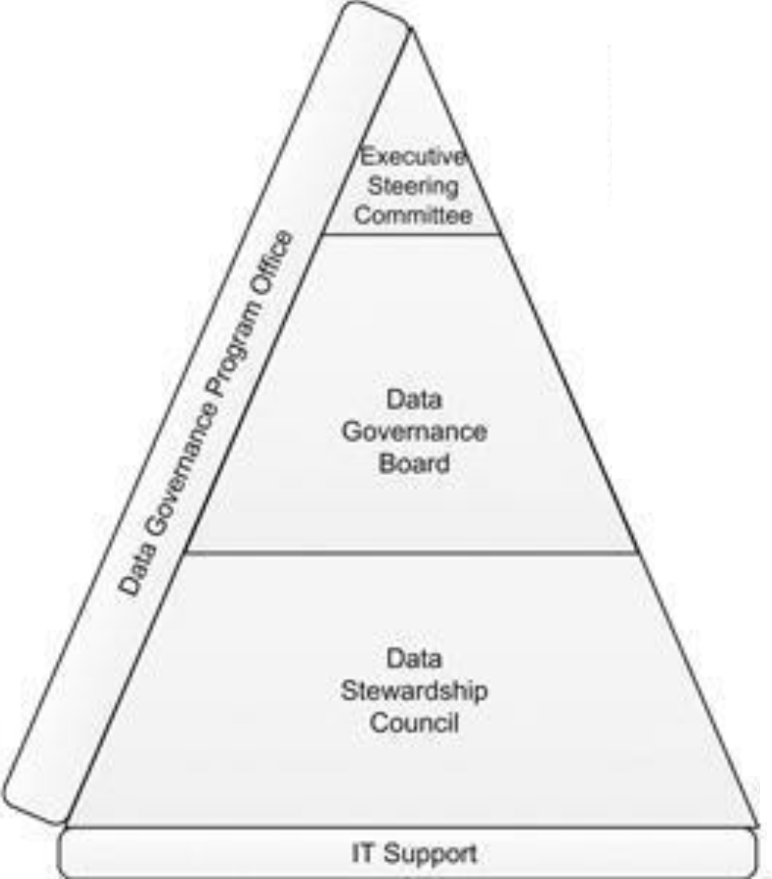
Structure – Generic Example
Executive Steering Committee
Authorized to change the organization
Drives cultural change
Supports the program enterprise-wide
Provides funding for the Data Governance Program
Data Governance Board
Made up of high-ranking representatives of data- owning business functions who can make decisions about data for the company
Assign members of the Data Stewardship Council
Approve decisions of the Data Stewardship Council
Approve data-related policies
Business Data Stewards
Experts on use of their data domain data
Able to reach out to SMEs to gather information and make decisions
Typically someone who others come to as the most knowledgeable about the meaning of the data (and how it is calculated)
Makes recommendations on data decisions and write data-related procedures
Plotkin (2014). Data stewardship: An actionable guide to effective data management
Notes:
This graphic from David Plotkin becomes important in later slides. Spend some time discussing levels and roles. Theoretically, an executive group authorized data governance, and mid- to senior group sets policy and procedure, and mid-level administrators serve as stewards to do the hard work of building dictionaries, resolving issues, and addressing problems.
The box on the left of the pyramid – the Data Governance Office – is important. Many participants will ignore it or report they have no resources for it. Discuss why it is important to have a coordinator of DG functions. This office can reasonably fit under IR, IT, or somewhere else.

Slide 34
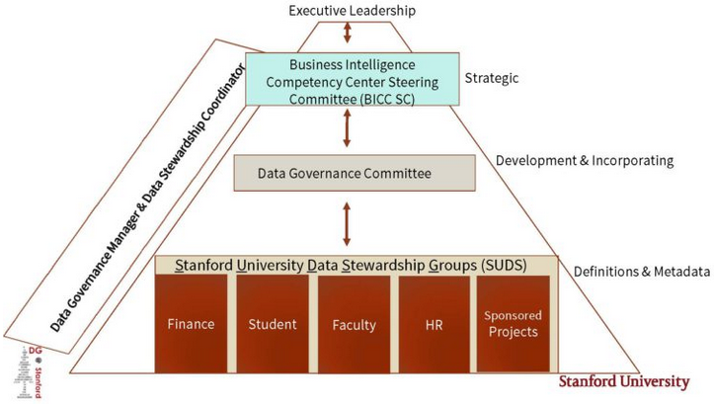
Structure – Stanford University
BI Competency Ctr. Steering Committee
Cross-functional oversight & communicates long-term value of BI program
Achieves peer buy-in, and effects change in business process and data quality
DG adopters and champions
Ensures alignment of DG with university goals
Data Governance Committee
Sets & incorporates DG policies, standards, procedures, roles & responsibilities
Includes lead steward from each of the data steward groups, plus reps from additional units
Data Stewardship Groups
Provide metadata infrastructure to support improved decision-making university-wide
Ensure information integrity
Build data knowledge
Meet compliance requirements
SMEs who define reporting terms and gather metadata associated with their reporting environment
Notes:
Stanford
https://web.stanford.edu/dept/pres-provost/cgi-bin/dg/wordpress/dg-structure/
Stanford University Data Stewards Groups (SUDS)
Data Stewardship groups are made up of subject matter experts whose primary focus is defining reporting terms and gathering metadata associate with their reporting environment. The subject matter experts are individuals who enter the data, who perform analytics on the data or interacts with the data in some way on a daily basis. The SUDS mission is to provide the metadata infrastructure to support improved decision-making, ensure information integrity, build data knowledge, and meet compliance requirements university-wide, enabling our partners to excel at teaching, learning and research.
Data Governance Committee (DG Committee)
The DG Committee is a cross functional group comprised of the lead steward from each of the SUDS group and representatives from several additional units and schools who have a vested interest in the university’s data governance program. The charge of the DG Committee is developing, setting and incorporating data governance policies, standards, procedures, and roles and responsibilities.
Business Intelligence Competency Center- Steering Committee (BICC-SC)
The BICC SC is a senior leadership team that provides cross-functional oversight and envisions and communicates the long-term value of the BI program, helps achieve buy-in from peers, and strives to effect change in business processes and data quality within their units. The BICC Steering Committee members all serve as data governance adopters and champions of the use of data governance in decision-making and provide strategic oversight of the data governance program in order to ensure that the programs aligns with the university data goals.

Slide 35
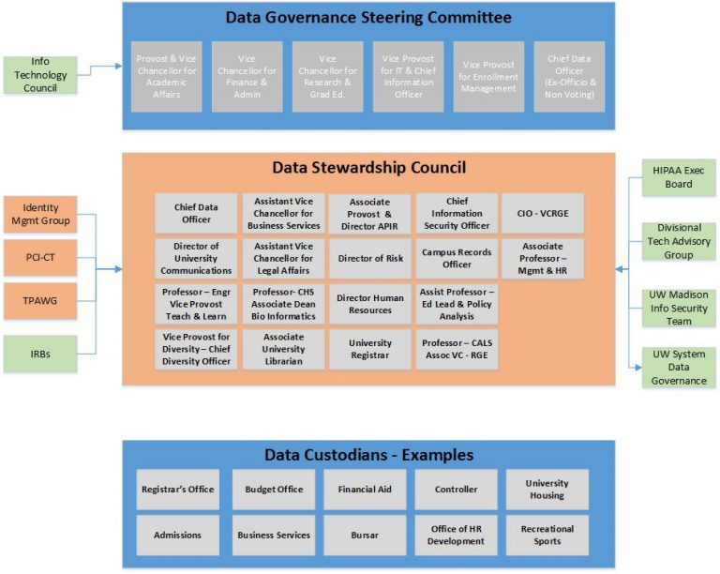
Structure – University of Wisconsin-Madison
Data Governance Steering Committee
provides executive level guidance to the program
promotes Data Governance across UW-Madison
allows for / facilitates data-driven decision making
determines priority and budget of major data-related projects.
Data Stewardship Council
determines operational structure of the program
drafts, communicates, and recommends approval of data-related policies
implements, budgets, and monitors data-related programs across UW-Madison.
Notes:
Wisconsin
https://data.wisc.edu/data-governance/#strucureimg
Data Governance Steering Committee
In aligning with the priorities established for the University of Wisconsin-Madison, the mission of the Data Governance Program is to allow for and facilitate data-driven decision making. The Data Governance Steering Committee has been established to sponsor and ensure the success of that program.
The Data Governance Steering Committee is responsible for providing executive level guidance to the program as well as promoting Data Governance across UW-Madison. They are also responsible for determining the priority and budget of major data-related projects.
Data Governance Stewardship Council
In aligning with the priorities established for the University of Wisconsin-Madison, the mission of the Data Governance Program is to allow for and facilitate data-driven decision making. The Data Stewardship Council has been established to determine the operational structure of the program.
The Data Governance Stewardship Council is responsible for drafting, communicating, and recommending for approval data related policies. They are also responsible for implementing, budgeting, and monitoring data-related programs across UW-Madison.
Stanford
https://web.stanford.edu/dept/pres-provost/cgi-bin/dg/wordpress/dg-structure/
Stanford University Data Stewards Groups (SUDS)
Data Stewardship groups are made up of subject matter experts whose primary focus is defining reporting terms and gathering metadata associate with their reporting environment. The subject matter experts are individuals who enter the data, who perform analytics on the data or interacts with the data in some way on a daily basis. The SUDS mission is to provide the metadata infrastructure to support improved decision-making, ensure information integrity, build data knowledge, and meet compliance requirements university-wide, enabling our partners to excel at teaching, learning and research.
Data Governance Committee (DG Committee)
The DG Committee is a cross functional group comprised of the lead steward from each of the SUDS group and representatives from several additional units and schools who have a vested interest in the university’s data governance program. The charge of the DG Committee is developing, setting and incorporating data governance policies, standards, procedures, and roles and responsibilities.
Business Intelligence Competency Center- Steering Committee (BICC-SC)
The BICC SC is a senior leadership team that provides cross-functional oversight and envisions and communicates the long-term value of the BI program, helps achieve buy-in from peers, and strives to effect change in business processes and data quality within their units. The BICC Steering Committee members all serve as data governance adopters and champions of the use of data governance in decision-making and provide strategic oversight of the data governance program in order to ensure that the programs aligns with the university data goals.

Slide 36
Structure – Stony Brook University
Data Governance Council
Finance
Student
Human Resources
Data Stewards
Data Stewards
Data Stewards
VP Council
VP Council (Project 50 Forward SteerCo)
Executive sponsors of project
Establishes authority and purview of data governance system
Data Governance Council
Recommends and implements institutional policy for data governance
Sets priority for
Functional data governance committees
Functional Data Governance Committees
Implements institutional policy for data governance
Recommends solutions to specific data issues
Considers and approve changes to code sets, additions to tables
Develops solutions to data governance issues
Communicates with data caretakers in their areas
Notes:
Stony Brook
https://www.stonybrook.edu/commcms/irpe/about/_files/DataGovFramework.pdf
Data Governance Council (DGC)
Role: Recommend and implement institutional policy for data governance in PeopleSoft and the Data Warehouse, including for how data are defined, produced, used, stored, and destroyed
Responsibilities
Develop and follow procedures for internal council operation, officers, meetings, workflow, and voting
Develop, recommend and evaluate effectiveness of policies, procedures, and processes for data management, data quality, and data use
Elevate to the Project 50 Forward Steering Committee issues of institutional policy or practice that require resolution or additional resources
Set priorities for preserving and increasing value of data assets
Oversee data quality monitoring and improvement
Set standards for data dictionaries and definitions, reporting conventions
Coordinate cross-functional collaboration among Functional Data Governance Committees (FDGCs)
Ensures representation in FDGCs
Ensure compliance and coordination with security policy
Functional Data Governance Committees (FDGCs)
Role: FDGCs are specialized groups with cross-functional membership that oversee management of data assets in respective functional areas, including data steward coordination, data quality monitoring & improvement, and interfacing between data stewards and DGC
Responsibilities
Coordinate data stewards in related area
Respond to inquiries about process, content, limitations and uses of data, especially in cross-functional settings
Consider and approve changes to code sets, additions to tables
Elevate to DGC issues that require resolution beyond the purview of the FDGC
Review data quality in functional area; identify practices promoting data quality identify areas for improvement and monitor improvements
Ensure dictionary standards are followed in area
Evaluate effectiveness of data governance policies within functional area
Recommend to DGC changes in policies, procedures, and processes to improve effectiveness
Communicate proceedings, including notice of changes and decisions, to DGC.

Slide 37
Policy-Making Body - Data Governance Council
Prioritizes decisions regarding data to address most relevant needs of organization
Reviews, evaluates, and reports on data governance performance and effectiveness
Ensures that annual performance measures align with data governance and business objectives
Reviews and approves data governance policies and goals
Ultimately is accountable for business data use, data quality, and prioritization of issues
Makes strategic and tactical decisions
Defines data strategy based on business strategy and requirements
Plotkin (2014). Data stewardship: An actionable guide to effective data management
Notes:
A Data Governance Council that establishes policy and oversees data governance is common to most data governance systems. This group should not be discussing data elements or specific problems (other than as examples) but rather should be setting policy and establishing guidelines and standards.

Slide 38
Data Governance Council Membership Examples
UW-Madison | Stony Brook
Chief Data Officer Director of Univ. Communications VP for Teaching & Learning VP for Diversity AVC Business Services AVC Legal Affairs Assoc. Dean Biomedical Informatics VP Libraries CISO Campus Records Officer Assoc. Dean Education Faculty/Dean Representation | Chief Institutional Research Officer Analytics and Enterprise Data Officer University Controller Chief Enrollment Management Officer University Registrar Chief Financial Aid Officer Provost’s Office designee VP Student Affairs designee VP Administration designee VP Human Resources designee VP Information Technology designee VP Research designee SVP Health Sciences Designee University Senate designee Chairs & Vice Chairs of FDGCs (6 people)
Notes:
In both examples membership consists of mid-upper level administration but not C-suite (direct reports to CEO). In constructing membership lists, an institution should consider both organizational structure as well as the incumbents in various positions and the value they will add to the Data Governance Council..

Slide 39
Data Stewardship Definitions
Data stewardship is the most common label to describe accountability and responsibility for data and processes that ensure effective control and use of data assets. – Knight (2017)
Data stewardship is the operational aspect of an overall Data Governance program, where the actual day-to-day work of governing the enterprise’s data gets done. –Plotkin (2014)
Data Stewardship is concerned with taking care of data assets that do not belong to the stewards themselves. Data Stewards represent the concerns of others. Some may represent the needs of the entire organization. Others may be tasked with representing a smaller constituency: a business unit, department, or even a set of data themselves. – Data Governance Institute (n.d.)
Notes:
Data stewards play an essential role in data governance, although many colleges and universities have no formal descriptions or written sets of expectations, activities, or deliverables for these positions. Data stewards conduct the day-to-day business of data governance and are accountable for effective control and use of data
References
Knight, M. (2017) “What is data stewardship?” http://www.dataversity.net/what-is-data-stewardship/
Plotkin, D. (2014) Data Stewardship: An Actionable Guide to Effective Data Management and Data Governance. ISBN: 978-0-12-410389-4
Van den Hoven, John (1999). “Information Resource Management: Stewards of Data,” Information Systems Management doi: 10.1201/1078/43187.16.1.19990101/31167.13
http://www.datagovernance.com/adg_data_governance_governance_and_stewardship/

Slide 40
Types of Data Stewards
Business Data Steward
Accountable for data owned by business area
Technical Data Steward
Provide expertise on applications, ETL, data stores, and other links in information chain
Work with stakeholders to make recommendations on data issues
Manage metadata for their data
Champion data stewardship for their areas
Assigned by IT leadership to support data governance
Domain Data Steward
Business steward for widely shared data
Work with business stewards as stakeholders to achieve consensus
Project Data Steward
Represent data stewardship on projects
Funded by projects
Work with business data stewards to obtain info and make recommendations about data stewarded by business stewards
Notify business data stewards about data issues raised by the project
Operational Data Steward
Provide support to business data stewards
Recommend changes to improve data quality
Help enforce business rules for the data they use
Plotkin (2014). Data stewardship: An actionable guide to effective data management
Notes:
Different types of data stewards may exist depending upon role and function in the organization. Some discussion of how these definitions intersect higher education should occur in presentation of this slide. For participants who have data stewards, which type are they? It is not necessary to explicitly identify stewards for all of these functions, but rather to recognize that various functions of stewardship may be carried out by individuals in an organization.

Slide 41
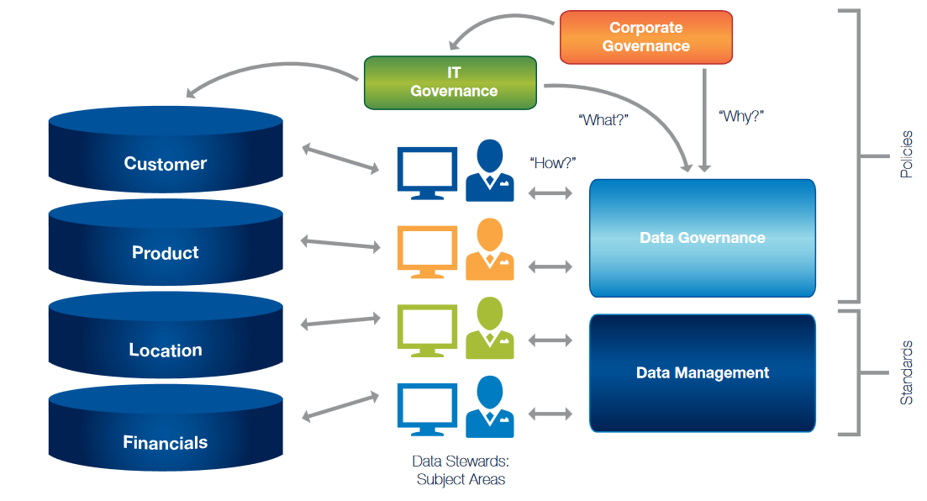
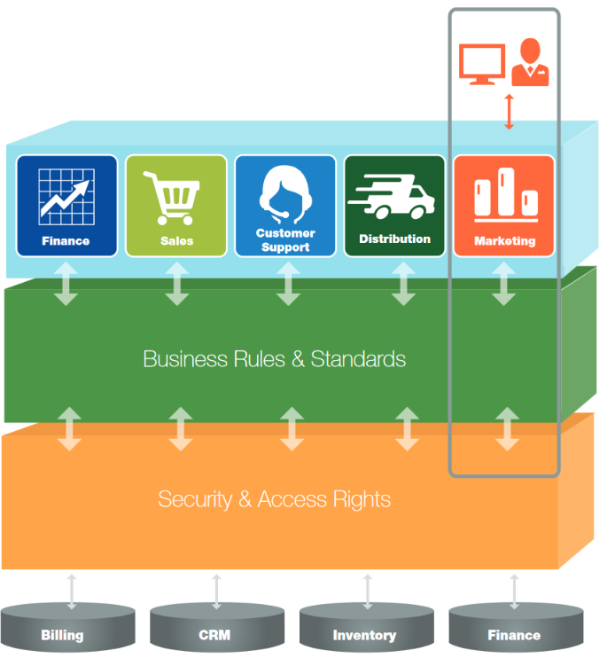
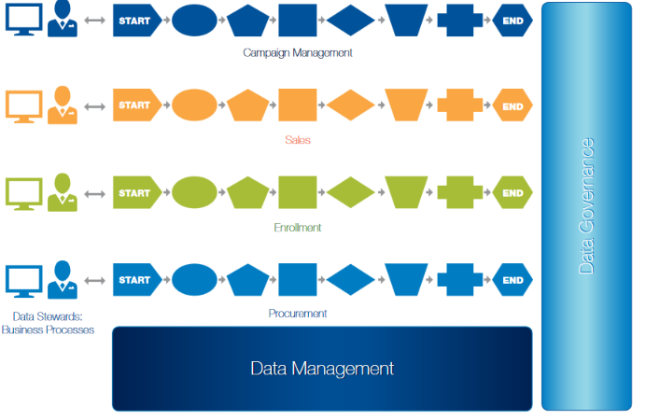
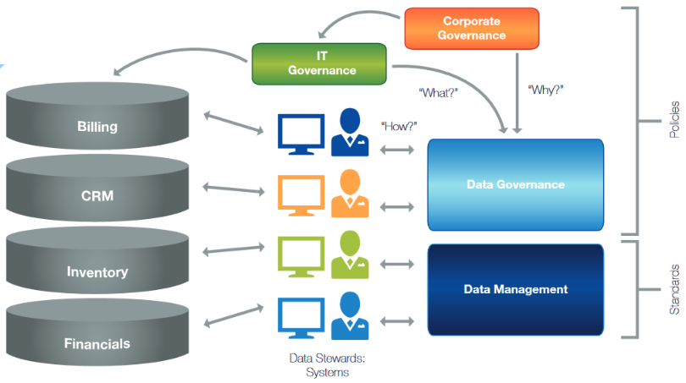
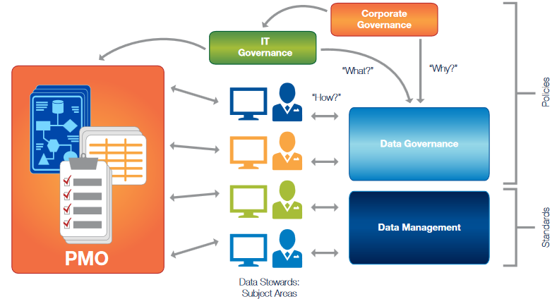
Alternative models for types of data stewards
Data Stewards by Subject Area
Data Stewards by Function
Data Stewards by Process
Data Stewards by System
Data Stewards by Project
Dyché & Polsky (2014). “Five models for data stewardship” SAS Whitepaper
Notes:
The graphics on this slide require the presenter to magnify various portions of the slide.
Reference
https://www.sas.com/content/dam/SAS/en_au/doc/whitepaper1/5%20Models%20Data%20Stewardship%20White%20Paper.pdf

Slide 42
Data Steward Responsibilities
Oversee management of selected data assets
Participate in data governance and carry out decisions
Assist in creation and maintenance of data dictionaries, metadata
Document rules, standards, procedures, and changes
Ensure data quality and manage specific issues
Communicate appropriate use and changes
Manage access and security
Notes:
Specific responsibilities of data stewards are listed here. It is useful for institutions to articulate these responsibilities for each data steward. Mature organizations that take data governance seriously may insert such responsibilities into position descriptions or employee performance programs so as to formalize the employee’s responsibility to carry out these functions as part of their normal job.
Reference
http://www.stanford.edu%2Fdept%2Fpres-provost%2Fcgi-bin%2Fdg%2Fwordpress%2Fwp-content%2Fuploads%2F2012%2F01%2FDG-Data-Stewardship.doc&usg=AOvVaw1bVAl3vVR0sBVD4Zn2hBnD

Slide 43
Functional Data Stewardship Council/Committees
Coordinate data stewards in related area
Set and review definitions, data quality rules, creation/usage rules, determines official version of metadata
Consider and approve changes & additions to code sets
Ensure dictionary standards are followed in area
Review data quality in functional area; identify practices promoting data quality identify areas for improvement and monitor improvements
Respond to inquiries about process, content, limitations and uses of data, especially in cross-functional settings
Elevate issues that require resolution
Communicate proceedings, including notice of changes and decisions
Notes:
Data stewards will meet regularly in a formal group or groups to establish shared procedures, definitions, etc., since often data issues require cross-functional input. Institutions ay have one or more functional data governance committees to carry these functions out. Often these groups are domain specific, depending on how the institution has organized its data. Ex.:
Student/academics committee
Finance committee
HR committee
Source: Stony Brook Data Governance Framework
https://www.stonybrook.edu/commcms/irpe/about/_files/DataGovFramework.pdf

Slide 44
Stony Brook Roles and Responsibilities Matrix
 | Data Governance Council | Functional Data Governance Cmtes | Data Stewards
Standards and Policies | Define, Establish, Monitors, Audit, Verify, Develop, Revise | Cross functional implementation, coordination | Functional implementation
Data Quality | Identify, Adopt enterprise-wide DQ tool Big picture | Prioritize levels Monitor area Identify needs | Review audit reports, Coordinate clean-up, Initial prioritization
Metadata | Establish standards | Ensure cross-functional alignment | Implement Maintain
Metrics | Review, Identify, Monitor | Monitor area Identify area priorities | Monitor Remediate
B
44
Notes:
This matrix offers a single slide that provides an overview of the relative distribution of functions and responsibilities in Stony Brook’s data governance system. It offers a useful single-slide summary of scope and functions.

Slide 45
Data users
Often not considered in data governance systems (but should be).
Example formal responsibilities (Stony Brook)
Recognize that institutional data and information derived from it are potentially complex. Make efforts to understand the source, meaning and proper use of the data through training sessions, utilizing data dictionaries and knowledge of supporting system processes.
Include information about the data source and criteria when distributing data, reports and ad hoc analytics to guard against misinterpretations of data.
Respect the privacy of individuals whose records they may access. Unauthorized disclosure or misuse of institutional information stored on any device is prohibited
Ensure that passwords or other security mechanisms are used for sensitive data
Report data quality issues to appropriate data steward
Notes:
Stony Brook added a set of responsibilities for data users to its data governance system to acknowledge that each member of the community is a data citizen who also play a part in data governance
Make an effort to understand reports and the complexities of definitions and structures
Document sources and provide interpretation
Protect privacy and guard against disclosure
Secure sensitive data
If you see something, say something

Slide 46
Administrative Office / Positions Supporting Data Governance
In general, offices and positions dedicated to supporting data governance are still emerging in higher education
Chief Data Officer | Data Governance Program Manager
Purdue University University of Florida System University of South Carolina – Columbia University of Rochester University of Wisconsin - Madison | Purdue University Stanford University Yale University
Pomerantz, J. (2017) IT leadership in higher education: The chief data officer. Educause.
Research Report. Louisville, CO:ECAR.
Notes:
Maturing data governance systems have been adding staff to oversee the organization and execution of the functions described thus far. (refer to slide 33 where Plotkin shows a Data
Governance Office on the left side of the pyramid).
References:
https://library.educause.edu/~/media/files/library/2017/8/ers1702cdo.pdf

Slide 47
Maturity Models
Notes:
This section of the presentation provides and overview of how to measure the maturity of data governance on campus and allows participants an opportunity to rate their own maturity. Stony Brook is used as an example.

Slide 48
Assess your current state of data governance
Formal assessment of current data governance practices
Assists with senior leadership buy-in
Identifies gaps and important implementation considerations
Extends beyond the informal list we made in Activity 1
Uses a maturity model to quantify the existing state; allows for measurement of progress in a future state
Notes:
Effective processes include some form of assessment and the maturity model allows for organizations to characterize the level at which their data governance systems function across multiple domains. For colleges and universities just developing formal data governance, early application of a maturity model can provide a baseline from which to measure future progress. It can also highlight to senior leadership how the organization should be functioning but does not yet function in an optimal state.

Slide 49
Activity 4: Data Governance Maturity Model
 | Level 1 | Level 2 | Level 3 | Level 4 | Level 5
 | Informal | Developing | Adopted and Implemented | Managed and Repeatable | Integrated and Optimized
Data Governance | Attention to Data Governance is informal and incomplete. There is no formal governance process. | Data Governance Program is forming with a framework for purpose, principles, structures and roles. | Data Governance structures, roles and processes are implemented and fully operational. | Data Governance structures, roles and processes are managed and empowered to resolve data issues. | Data Governance Program functions with proven effectiveness.
Culture | Limited awareness about the value of dependable data. | General awareness of the data issues and needs for business decisions. | There is active participation and acceptance of the principles, structures and roles required to implement a formal Data Governance Program. | Data is viewed as a critical, shared asset. There is widespread support, participation and endorsement of the Data Governance Program. | Data governance structures and participants are integral to the organization and critical across all functions.
Data Quality | Limited awareness that data quality problems affect decision-making. Data clean-up is ad hoc. | General awareness of data quality importance. Data quality procedures are being developed. | Data issues are captured proactively through standard data validation methods. Data assets are identified and valuated. | Expectations for data quality are actively monitored and remediation is automated. | Data quality efforts are regular, coordinated and audited. Data are validated prior to entry into the source system wherever possible.
Communication | Information regarding data is limited through informal documentation or verbal means. | Written policies, procedures, data standards and data dictionaries may exist but communication and knowledge of it is limited. | Data standards and policies are communicated through written policies, procedures and data dictionaries. | Data standards and policies are completely documented, widely communicated and enforced. | All employees are trained and knowledgeable about data policies and standards and where to find this information.
Roles & Responsibilities | Roles and responsibilities for data management are informal and loosely defined. | Roles and responsibilities for data management are forming. Focus is on areas where data issues are apparent. | Roles and responsibilities are well-defined and a chain of command exists for questions regarding data and processes. | Expectations of data ownership and valuation of data are clearly defined. | Roles, responsibilities for data governance are well established and the lines of accountability are clearly understood.
Notes:
Activity 4
Have participants complete Activity 4 for their own institution. This should take five minutes. When engaging in this exercise back on campus, multiple stakeholders should be involved. Participants have a version of this maturity model in their exercise packet – the slide itself may be too small to read.

Slide 50
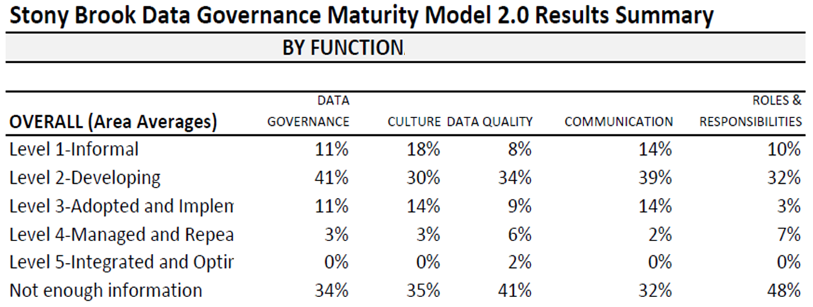
Stony Brook Data Governance Maturity Model Initial Results – Spring 2016
Notes:
These results show where Stony Brook rated its data governance maturity prior to adoption of a formal structure. Notable results
Ratings were predominantly at the developing level, esp. when “not enough information” is removed
The fact that so many respondents indicated “not enough information” was identified as a significant shortcoming, given than participants were university employees who were experienced data professionals
While not represented here, data professionals rating these functions as more developed in their areas (finance professionals were more likely to rate governance of finance data as Level 3 Adopted and implemented than were respondents from other areas)

Slide 51
Baseline
Current
2015
Target
2017
Dimensions
Maturity
Data Governance
Culture
Data Quality
Communication
Roles & Responsibilities
Integrated & Optimized
Managed & Repeatable
Adopted & Implemented
Developing
Informal
K
51
Notes:
A version of the slide was used to support buy-in from senior leadership in establishing a formal data governance system at Stony Brook.

Slide 52
Change Management in Higher Education
Notes:
Transition slide – set up this section and especially the following slide by emphasizing that data governance is in some ways about organizational transformation into a state where people are managing and making decisions in a more regular and effective way. This requires changing what we do, and in higher education, changing the organization requires outsized attention to ….. PROCESS.

Slide 53
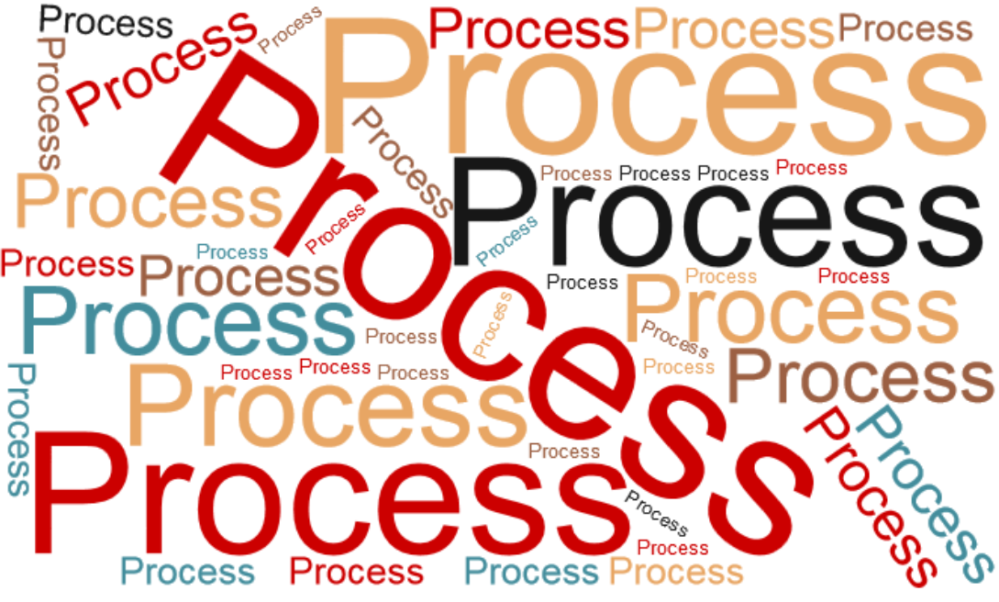
Notes:
Have a discussion about the important of process, shared governance, representation and transparency in higher education decision making. Some discussion about the role of the faculty and the extent to which they should be involved on a particular campus will enter into the discussion.

Slide 54
Elements to change management
Initiative
Process Representation Deliberation
Executive sponsors Mission alignment Project mgmt./timeline
Problem statement Research/environ. scan Ideas for solutions
Interested allies Interest mapping Advocacy from others
Notes:
Each one of these is important to discuss
Upper left quadrant
Process – this will have been discussed already. Should be written down
Representation – very important and should not be underestimated. Ensure stakeholders have a representative at the table. Consider inviting faculty even if their envisioned role or interest may be low
Deliberation – ensure time for discussion and deliberation. Use a flip chart, gather ideas, write up minutes. Don’t short change discussion
Lower left quadrant
Establish a problem statement – what issues on campus are you trying to solve with data governance. Gather and include input on the problem
Gather examples from other universities, preferably similar ones. Most meetings will involve a participant asking “what do they do at [peer institution X]?” Be prepared to answer these questions or convene a subcommittee to gather data. Some of this information exists in this slide deck but may be inappropriate for smaller institutions
Have some ideas for solutions. Discussing these with some participants one-on-one before committee discussions can help insert these ideas into the conversation
Upper right quadrant
Support from executive leadership is almost essential and likely needs at least two VPs (or just the President) to understand and support the need for pursuing data governance
Align problems and solutions with mission (refer to Activity 3)
Develop a timeline to implement the system (project management) but recognize this will transform into a process/cycle after the structure is set up
Lower right quadrant
Identify allies ahead of time
Identify interests and priorities of allies, campus power brokers, and potential opponents
Recruit others with political capital to advocate for effective solutions

Slide 55
Activity 5 – Assemble your group
Data governance requires support of senior leadership and functional leadership
Identify
Senior leaders who will sponsor
Functional leaders and their potential for collaboration (includes available bandwidth, interest, capability, willingness)
Notes:
Activity 5
Have participants complete Activity 5 – this should take about 5-10 minutes. If running short on time, this activity can be skipped. The intent of the activity is to leave the workshop with a roadmap or plan for whom to include when returning to campus to begin discussions about data governance.

Slide 56
Case Study – Stony Brook University
Initiative to strengthen university data infrastructure (Jan 2015-Sept. 2016). Charge to examine:
Data governance
Data quality
Communication
Notes:
Slides 56-60 outline the Stony Brook case study of the process for developing a data governance system and standing it up. This process took 18 months, was sponsored by the VP Strategic Initiatives and the CIO. The steering committee was chaired by the Chief IR Officer and the Director of University Reporting (BI/Analytics).

Slide 57
Charge for data governance (first 9 months)
Examine existing governance structures
Identify and articulate
Draft formal governance structure for data management
Formalize a process for prioritization
active and inactive groups and lines of responsibility
existing processes, practices and procedures that significantly impact data management and stakeholders.
Roles of cross-functional groups
Functional roles in business units (e.g. data owner, data custodian, report owner) will also be identified and articulated.
Principles, mission, and goals
Post on a website to codify roles and responsibilities.
Cross functional review group

Slide 58
Charge for data quality improvement
Examine existing practices for ensuring data quality within
data warehouse
Articulate and publish practices for developing, maintaining, and communicating
data definitions (such as robust data dictionaries)
transparent source information
update schedules
error check practices and
clean-up procedures
other functional systems
PeopleSoft

Slide 59
Charge for training and communication
Develop a communication plan for
How new capabilities for business intelligence go beyond initial reporting functionality
Availability
Use limitations, and opportunities
including needs identification for documentation, training, workshops, etc.
Develop, document, and adopt reporting standards

Slide 60
Example initial process for data collection
With broadly representative planning group (~20 people), conduct focus group with notecards and flipchart
list three current data governance mechanisms at our [INSTITUTION], the systems or applications they cover
list three aspects of data governance that are absent at [INSTITUTION] or need to be strengthened
list three things that data governance at [INSTITUTION] should accomplish
FOCUS GROUP ACTIVITY
list three roles or structures that should be included in [INSTITUTION’S] data governance system.
Notes:
These activities included a flip chart and were moderated by the Chief IR Officer, who had experience running focus groups. Participants wrote three bullets to answer each question on a different colored notecard. The group discussed answers, which were added to a flip chart, and at the end of the meeting, all cards were collected and additional answers compiled. The results were returned to the group to help them understand the problems they were trying to solve and what they collectively wanted to establish in terms of structure and process.

Slide 61
Activity 6 – Draft input for planning process
Using the framework below, draft useful responses to be incorporated into local planning
list three current data governance mechanisms
list three aspects of data governance that are absent
list three things that data governance should accomplish
list three roles or structures that should be included
[Anticipate responses that may be counterproductive]
E.g. “IT should control data governance”
Notes:
Activity 6
This activity should take 10 minutes, and can help participants identify their own interests in data governance. The activity can be cut short if running low on time.

Slide 62
Technological “Solutions”

Slide 63
Technology applications for data governance
Technology
can support data governance
Data dictionary management
Data quality analysis
Master data management
Issue and process management
Technology
will not
Build organizational structures, responsibilities, accountabilities
Mend dysfunctional organizations
Implement organizational or cultural change

Slide 64
Selected Data Governance Applications
Axon (Informatica)
Collibra
Data Cookbook (iData)
Melissa Data
Oracle Data Quality Middleware
SAS Data Governance
Notes:
This is a selection of major players in the data governance applications market as of 2018; costs range low end $15-20k to $150-200k with annual subscription costs. Don’t spend significant time discussing these, since the objective of the workshop is not to lend support for specific technological solutions. If the presenter has experience with one of more of these, it is appropriate to have a sidebar conversation.

Slide 65
Issues to consider when selecting technology
Alignment with DG needs
Initial cost and annual cost
User Community
Ease of implementation and impact on IT
Metadata management
Integration w/ reporting tools
Data quality
Security/user roles

Slide 66
Final Thoughts

Slide 67
Data governance is not a project, it’s a process
Process Model
Cyclical
Ongoing
Project Model
Linear
Implies conclusion
Notes:
Data governance is not a project. Use caution in including a Project Management Office (if you have one) in developing the DG system. Data governance is a new formalized activity that institutions will have to carry out continually. Draw an analogy to physical fitness or healthy diet.

Slide 68
Data governance is only one part of a data strategy
A data strategy is a larger vision for how your organization will work with data.
Data acquisition | Data usage & literacy
Data governance | Data extraction & reporting
Data quality | Data analytics
Data access
Hosch, B. (forthcoming 2019). “Key elements of a data strategy” in K. Powers ed. Data strategy in colleges & universities. New York: Routledge.
Notes:
Emphasize that data governance is not the entirety of a data strategy, but only one piece. This final thought should offer some overview of these concepts (as below), but continue to emphasize this activity is a process, not a project.
Data Acquisition
How the institution obtains its data
Build an inventory of data assets. For each one, establish a written plan for:
Identification
Prioritization
Capture
Storage
Linkage
Curation
Data Governance
How people make decisions and behave with respect to how data will be defined, produced, used, stored, and destroyed
Establish:
Decision-making body and rules
Data dictionaries
Data stewards
Data Quality
How data will be maintained to be complete, valid, consistent, timely, and accurate to make them appropriate for a specific use How authorized individuals can obtain and use data while maintaining privacy and security
Data Access
Establish written plans for:
Accessibility
Security
Data Usage & Literacy
How data users understand and use data
Establish:
Data user responsibilities
Training/education protocols
Usage metrics
Data Extraction & Reporting
How data will be queried and retrieved from storage and delivered to users
Establish protocols for:
Extraction
Reporting
Data Analytics
How data will be used through dynamic and visual deployment for benchmarking, exploratory and causal analysis, and prediction and forecasting

Slide 69
Takeaways
Data governance is more about people than data
All higher ed change management principals apply
Process and written documents are essential
Leadership support
Broad-based consultation, including faculty
Opportunity for consultation
Representation
Software can help, but it won’t fix broken processes or organizations
Starting data governance is hard work; sustaining it is harder
Notes:
Wrap up – begin conclusion with points above. If there is just one take away participants remember is that data governance is more about people than about data.

