Slide 1

SPEED SCIENCE 2022
Session One

Slide 2
Dhivyaa Anandan dos Santos Lab at CSHL
Originally from Palatine, IL near Chicago
Undergrad: Vanderbilt University
  Molecular Cellular Biology, Economics
  Dr. Rachelle Johnson’s Lab – bone metastatic breast cancer and novel dormancy regulators in the bone
Gap year: Dr. Megan McNerney’s lab at The University of Chicago
  Genetics and epigenetics in hematopoiesis and the development of acute myeloid leukemia
Currently: Stony Brook MSTP (2020), Dr. Camila dos Santos’s lab at CSHL

Slide 3
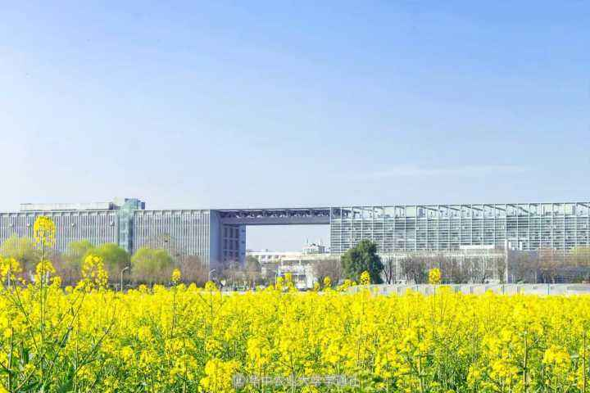
Chenjun(June) He
B.S. in Biological Science from Huazhong Agricultural University in 2022
Rotation: Bruce Futcher
Reaserch Interest: Systems Biology
Other Interests:
Jogging, swimming, badminton, philosophy of science…

Slide 4
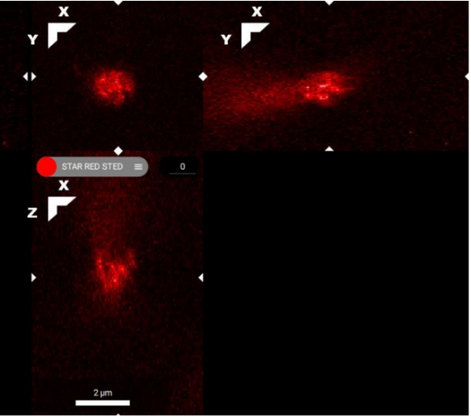
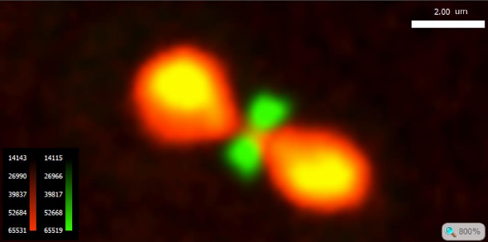
Budding Yeast Nuclear-cytoplasmic Ratio
Spinning Disk Confocal Microscopy
Stimulated Emission Depletion(STED) Microscopy

Slide 5
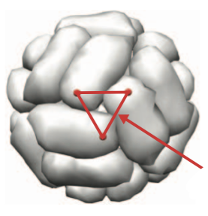
COVID-19 Nanoparticle Vaccine Development
Vehicle Protein
Antigen Tripolymer Location
Schematic Diagram of the Nanoparticle Vaccine

Slide 6

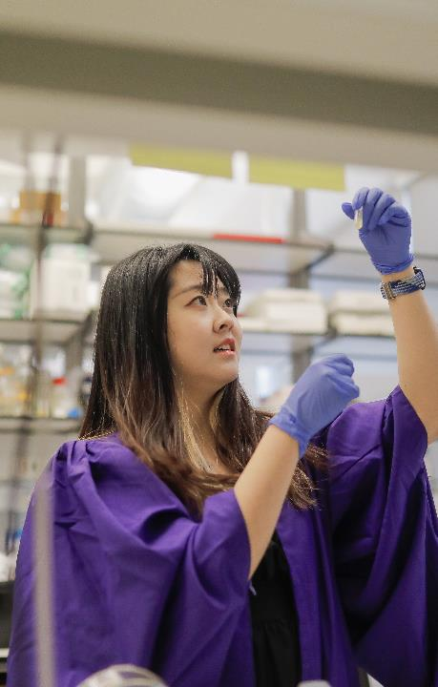
Yujia’s Intro

Slide 7
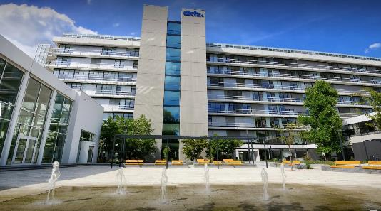
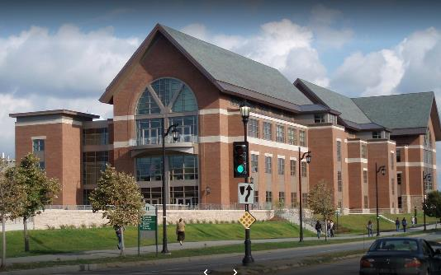
Undergraduate Research
Undergraduate Research
Germany Cancer Research Center(DKFZ)
Heidelberg
UVM:
Discovered the mycorrhizal fungi on floral traits important to pollinators and yield in highbush blueberry
Burlington

Slide 8
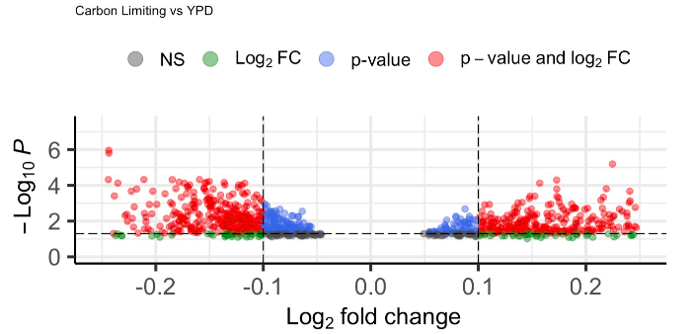
Graduate Research
Master’s Project
Gene expression response of Candida Albicans quiescence induced by nutrient starvation
For PhD……
I want to focus on biomedical research during her PhD training…
Thank you!

Slide 9





TanChun Kuo
Undergraduate: UC Davis
Master’s: Boston University
First Year Student, currently rotating at Dr. Sirotkin’s Lab
Interests: Tennis, Cycling, badminton
Research Experiences: Previously, worked on Follicle stimulating hormone receptor at Mount SinaiFSHR which is a G.P coupled receptor and it’s activation by FSH. In menopausal women, bone loss, increase visceral fat and reduced physical activity occur at this life stage. Many studies have shown the role of FSH in bone resorption, and visceral adiposity, which have enhanced our understanding leading to a novel target for bio-therapeutics. We propose to develop a therapeutic humanized antibody based on blocking the action of follicle stimulatory hormone targeting the13 amino acid long epitope of FSHβ.

Slide 10
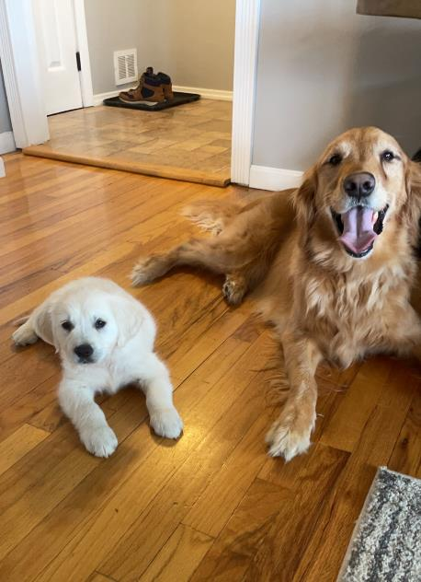
Timothy Maher – GS1 in Beyaz Lab at CSHL
Grew up in Milford, CT
B.S. in Microbiology from Wagner College
During undergrad, conducted research in Dr. Martin Blaser’s lab at New York University School of Medicine
  Studied the relationship between antibiotic-induced perturbation of the microbiome and asthma pathogenesis
2018-2020: Dr. Carrie Lucas’s lab at Yale School of Medicine
  Studied patients suffering from rare genetic immune disorders including deficiencies in PI3Kγ and ELF4
Currently: Stony Brook MSTP and Dr. Semir Beyaz’s lab at CSHL
Interests: Spending time with my dogs and fiancé, football, golf, skiing, and breweries

Slide 11
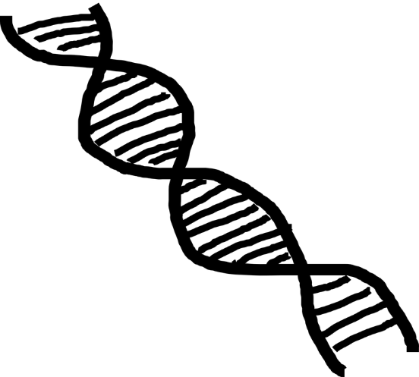

Liam Shanley
First-Year
Academic Experience
Lindenhurst High School (LI born and raised!)
SUNY Binghamton
BS in Biological Sciences, BA in German Studies
Research Experience
GLT-1
SDM of transporter gene cloned into bacterial plasmid, transient transfection, quantification of glutamate uptake and efflux
Thiamine
Environmental toxicity of Metformin, impacts on thiamine levels in wood frog tadpole embryos
BAG-Seq
Single-cell DNA/RNA Sequencing of patient tumor samples
Research Interests
I am excited to explore genomics and multiomics further.
I’m particularly interested in evolutionary theory and would love to work at the intersection of evolutionary biology and molecular biology.

Slide 12

Speed Science
Joanne Saldanha
4th Year Genetics Ph.D. Candidate
Hyungjin Kim Lab

Slide 13
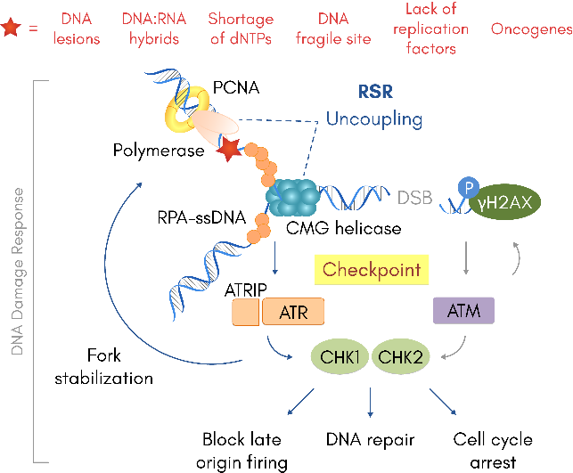
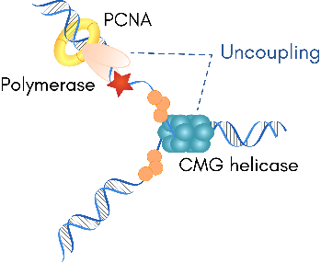

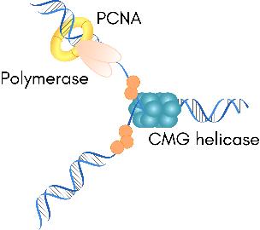


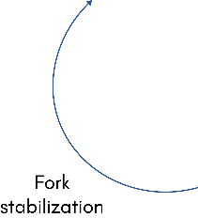
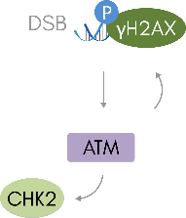





Exacerbating replication stress is a therapeutic opportunity
Therapeutic opportunities: Exacerbate replication stress of cancer cells.
(ATRi, CHK1i, WEE1i)
ATR= Ataxia telangiectasia and Rad3-related
ATM= Ataxia-telangiectasia mutated
Notes:
‘To combat replication stress, cells utilize a regulatory pathway known as the replication stress response. During replication, the replication machinery travels along the fork as it is being unwound. But on occasion, it is possible for the polymerase to become separated from the helicase. This can happen for a variety of reasons, such as physical blocks on the DNA, lack of replication factors, or shortage of dNTPs. If this happens, it is known as ‘uncoupling’, and the polymerase becomes stuck while the helicase continues to unzip the duplex DNA. However, this leaves ssDNA exposed, and ssDNA is fragile and susceptible to nucleolytic attack; therefore it is quickly coated by RPA. RPA-coated ssDNA is the activation signal for the kinase ATR, which then activates CHK1 with the help of ATRIP. A similar pathway exists for activation of CHK2 by double-strand breaks. CHK1 and CHK2 are effector kinases that go on to phosphorylate many downstream proteins in order to arrest the cell cycle, initiate DNA repair, block late origin firing, and stabilize the fork. In recent years, the replication stress response has also received attention as a potential point for therapeutic opportunities, where exacerbation of replication stress in cancer cells, which again, suffer from increased levels of replication stress, can be used to target them specifically.’

Slide 14
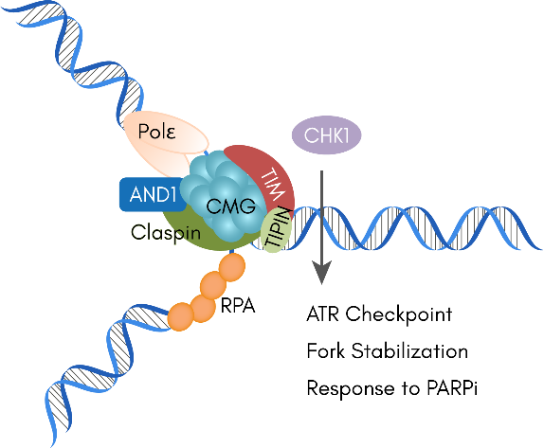

Fork Protection Complex
Fork Protection Complex (FPC): tethers replisome components together
Rageul, Park et al, Nature Comm. 2020
Notes:
‘If we zoom in to take a closer look at the replisome, we see what is called the replication fork protection complex, or FPC. This complex, primarily composed of the heterodimer TIMELESS-TIPIN, is largely responsible for keeping the helicase and polymerase tethered together during unperturbed replication and stabilizing the fork upon fork stalling. Recently, our lab has also shown that the protein SDE2 plays a role in FPC function.’

Slide 15
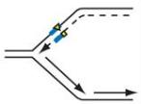
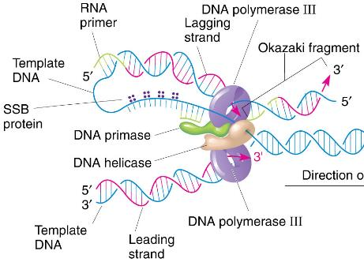
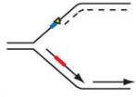
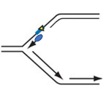
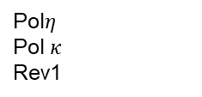
Gap in Knowledge
Pol$η$
Pol $κ$
Rev1
PCNA
RAD18
?
TIM
MUTAGENESIS
Replisome uncoupling
Fork Stalling
P
P
ATR
CHK1
PRIMPOL
Adapted from Pearson Education Inc. 2010

Slide 16
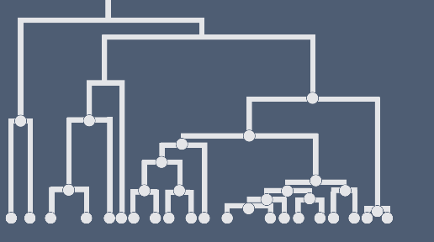
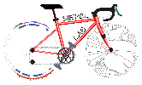
Selection inference from pre-estimated genealogies using a coalescence interval likelihood ratio test
Luiz Carlos de Oliveira

Slide 17
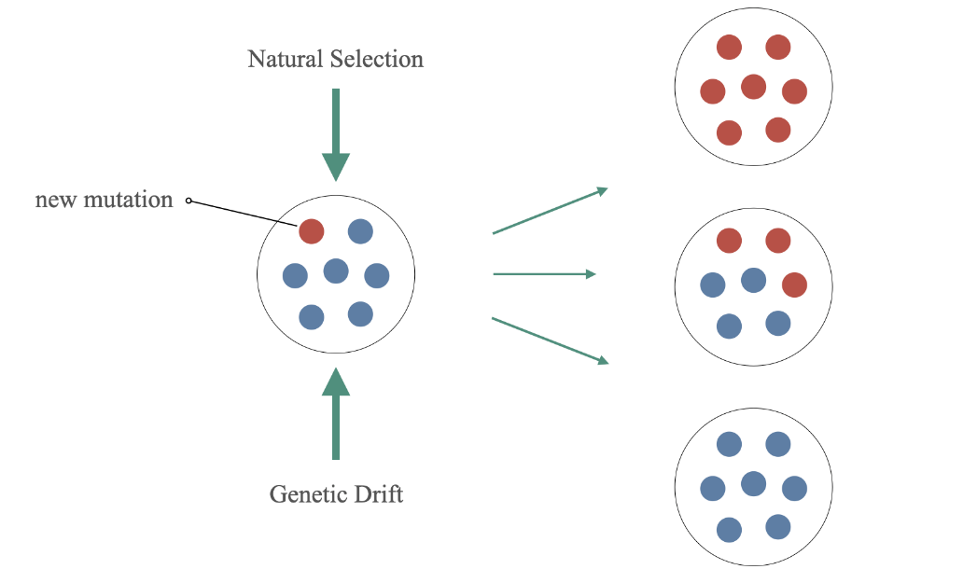

Slide 18
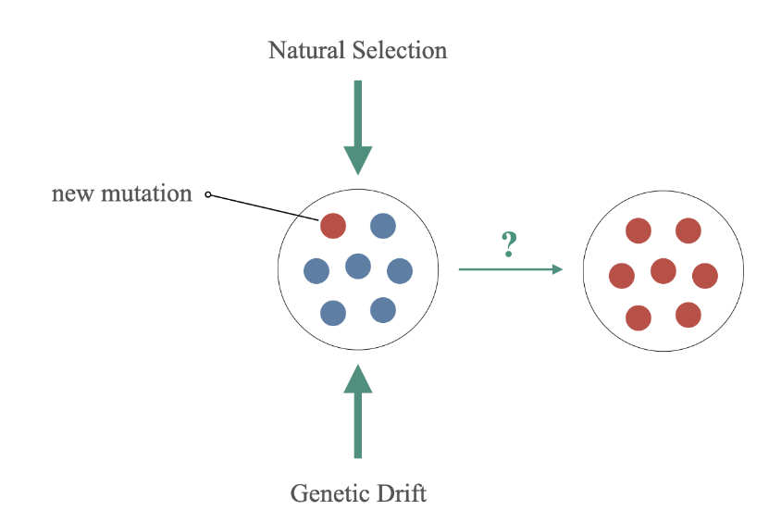
The challenge is to understand whether the signs we see in the genome comes from a selective or demographic process

Slide 19
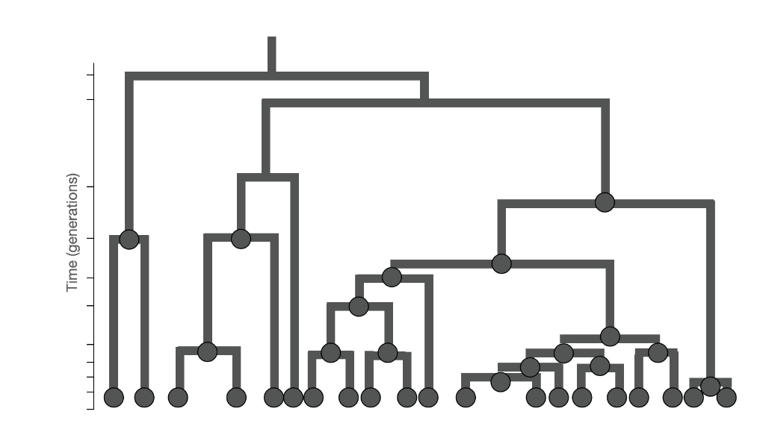
Genealogies offer information about the evolution of a group and is a powerful tool

Slide 20
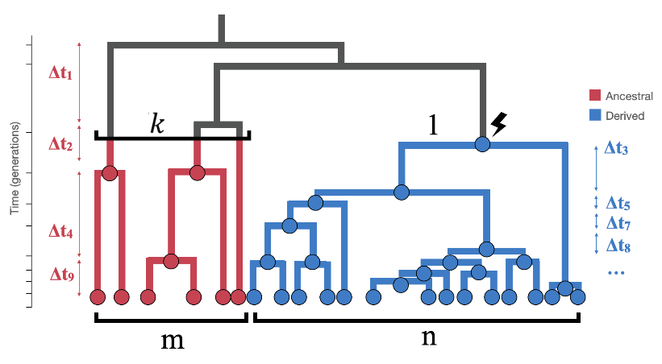
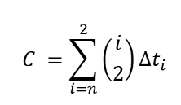
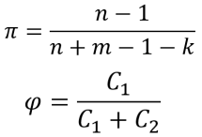
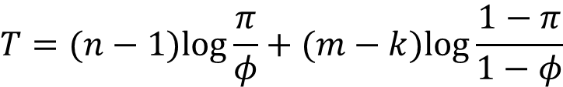
Coalescence Intervals method: based on relate, coalescence rates and LRT
The T statistic for the likelihood ratio test is:
$$T=(n−1)log\frac{π}{φ}+(m−k)log\frac{1−π}{1−φ}$$
\

Slide 21
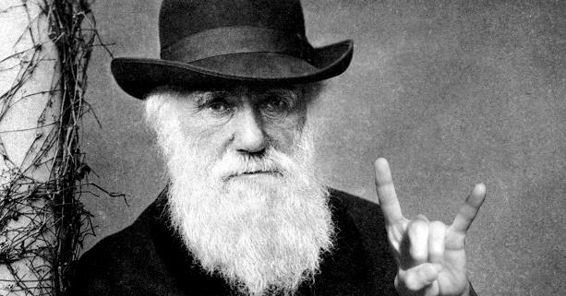
Thank You

Slide 22
Speed Science
Onur Eskiocak
Beyaz LAB-CSHL
8/23/22

Slide 23
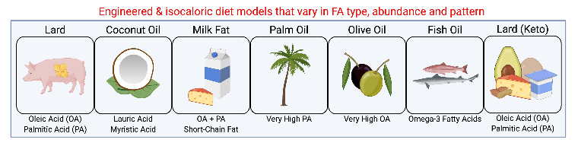
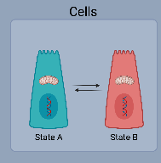
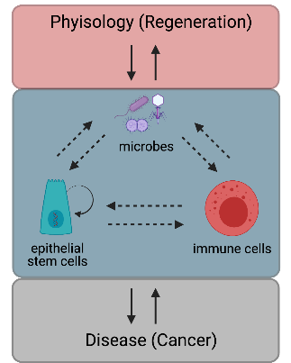
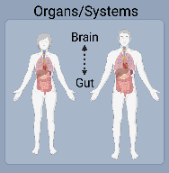
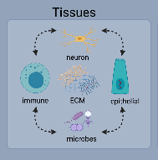
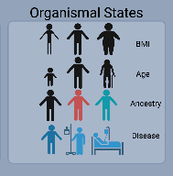
A modular and systematic approach to study causal mechanisms of nutrient – gene interactions in cells, tissues and organisms
Notes:
Using this strategy, despite the setbacks due to pandemic, we have been building a modular and systematic approach to study causal mechanisms of nutrient – gene interactions in cells, tissues and organisms. The conceptual framework is based on the epithelial – immune and microbial circuits that we identified to be perturbed by nutrients such as fatty acids, and have reciprocal interactions with physiology in the context of regeneration and disease states such as cancer.
-We study how nutrients affect cell fate by zooming to individual modules such as stem cells or immune cells
-but also by evaluating the crosstalk between these modules or
-how these modules influence and are influenced by systemic organ interactions and complex organismal states.
We utilize several experimental approaches to answer our questions:
-we developed ex vivo assays to study specific effects of fatty acids in isolation or
-we developed co-culture assays to understand reciprocal interactions between different cellular modules.
-we also heavily utilize genetic models to study cell specificity, necessity, sufficiency and temporal aspects. Click
-we developed engineered and isocaloric diet models that vary in fatty acid type, abundance and pattern to interrogate mechanisms of nutrient perturbations in cells, tissues, organ systems and organismal states.
-and finally we established human biobanks to study nutrient – gene interactions in human physiology and disease. These include studying mechanisms of obesity – cancer association in two cancer types that significantly associate with obesity such as colorectal cancer and endometrial cancer.

Slide 24
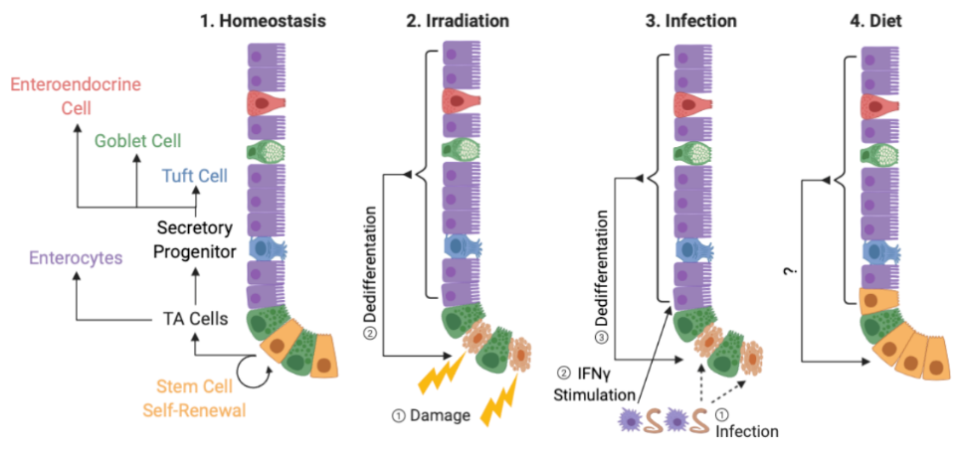
Mechanisms of intestinal regeneration?
Cheng and Leblond 1974, Potten et al. 1977, Barker et al. 2007, Buczacki et al. 2013, Nusse et al. 2018, Ayyaz et al. 2019, Murata et al. 2020, Cheng et al. 2019, Beyaz et al. 2016

Slide 25


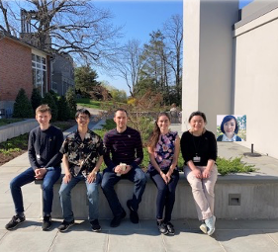
Targeting polyamine pathway in cancer
Qingting Hu
2nd year Genetics program
Dr. Michael Lukey lab
CSHL

Slide 26
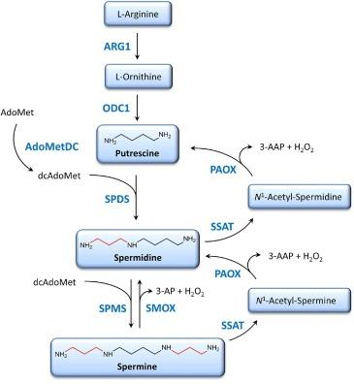
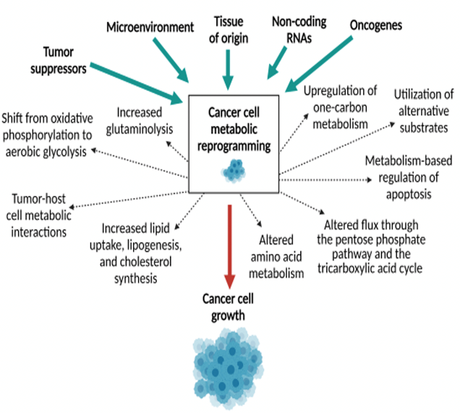
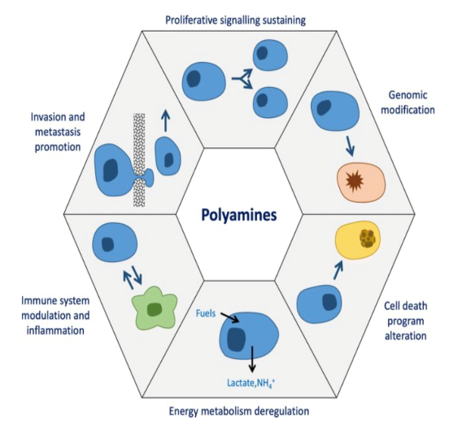
Polyamine metabolism and cancer
Polyamines in mammalian pathophysiology
AMD1
Francisca et al, CMLS, 2019
Proietti et al, Trends in immunology, 2020
Notes:
Cancer cells alter metabolic processes to sustain their characteristic uncontrolled growth and proliferation, one od the metabolic alterations include Polyamines pathway.

Slide 27
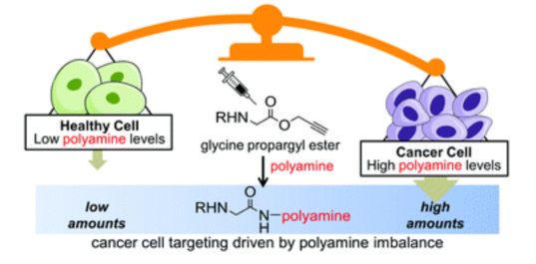
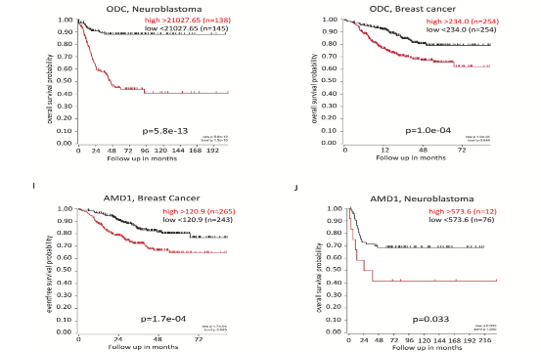
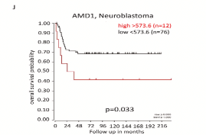
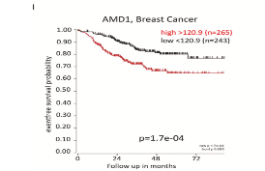
Polyamine metabolism and AMD1
Folate cycle
Nucleotide metabolism
?
Ornithine
Putrescine
Spermidine
Spermine
ODC1
Cellular Methylation
Methyltransferases
SAM
AMD1
SRM
dc SAM
SMS
?
?
Tumor proliferation
invasion
?
Transcription
Translation
RNA stability
Protein function
Transcription
RNA function
Protein function
Specific AIMs:
The potential function of AMD1 in Nucleotide metabolism in Breast cancer model
The mechanism of polyamine pathway in cancer progression
Modified from Ita et al, Cancer Letters, 2021
Modified from Kenward et al, Chemical Com, 2017
Notes:
analyzed the overall survival (OS) rates in patients with various types of cancers using a database from the online genomics analysis
SAM486A/CGP48664, which has lower mitochondrial toxicity, was developed based on the structure of MGBG [154] and evaluated in phase I and II clinical trials against melanoma and non-Hodgkin lymphoma [155,156]. Despite having antitumor activity, SAM486A/CGP48664 remained severely toxic, suggesting that MGBG and SAM486A/CGP48664 not only interfere with polyamine metabolism but also have anti-mitochondrial and other off-target effects
In cancer, polyamine metabolism is frequently elevated, and it’s necessary for transformation and tumor progression
One of the important signal pathway for polyamine pathway in cancer is mTOR pathway.
mTOR complex 1 (mTORC1) can phyospho AMD1 to stabilizes AMD1, leading to increased AdoMetDC and increased polyamine biosynthesis in prostate cancer. And also activated mTORC1 indirectly blocks the proteasom degradation of pro-AdoMetDC and leads to phosphorylation of the proenzyme at S298
Because cancer cells are more sensitive to polyamine depletion than normal cells , so right now there are many inhibitors are target on the Polyamine metabolism in the clinic tril. Also some of them are target on the AMD1

Slide 28
Genetics Speed Science
Jordan Pearson
Fearon Lab
8/24/22

Slide 29
T Cell Exclusion in Pancreatic Ductal Adenocarcinoma (PDA)
T cells are unable to enter cancer cell nests
The cancer is able to grow and thrive
How?

Slide 30
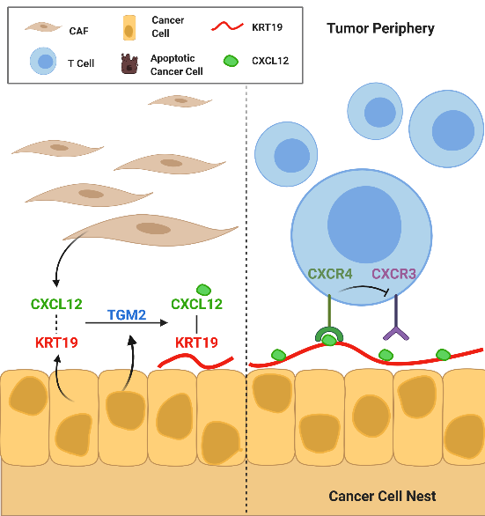
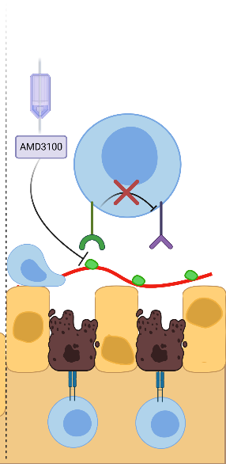
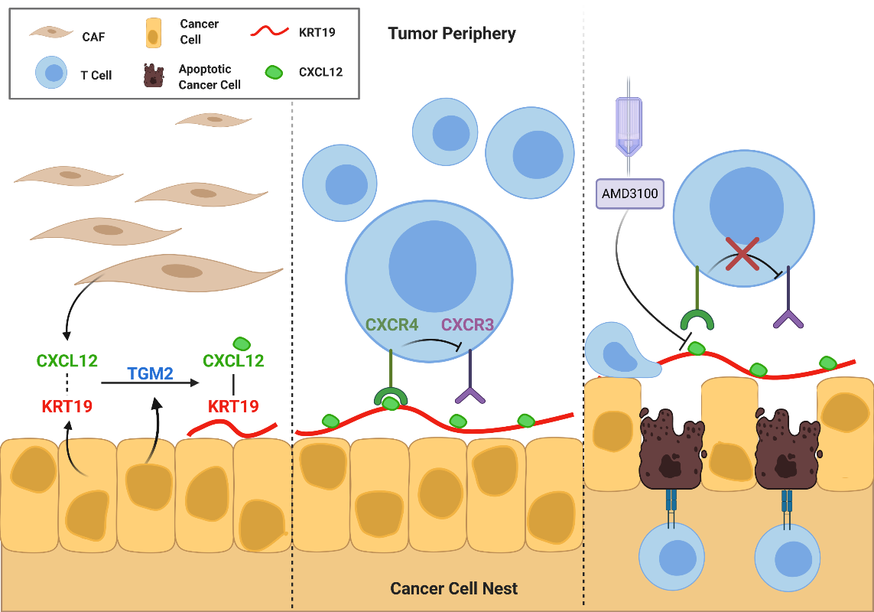
PDA is coated with CXCL12 and Keratin 19
CXCL12 interacts with T cells by binding to their CXCR4 receptors
This interaction inhibits CXCR3, blocking migration into the cancer nest

Slide 31
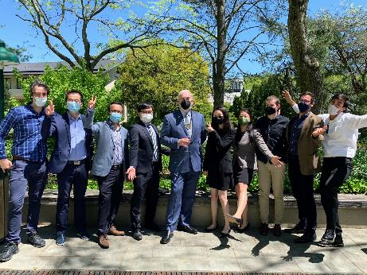


Splice-switching oligonucleotide therapy for diffuse intrinsic pontine glioma
The Krainer Lab is interested in:
Mechanisms of RNA processing, including splicing
Applying this knowledge to the treatment of genetic diseases
Lucia Yang
Speed Science 2022

Slide 32

Histone H3 Mutations
Diffuse Intrinsic Pontine Glioma (DIPG)
Epidemiology
  300 children annually diagnosed
  Five-year survival rate < 1%
Treatment
  Radiation, chemotherapy, surgery
  All options are non-curative
80% of cases have a point mutation H3.3 K27M in the gene H3F3A
  Leads to global loss of H3K27me3 (repressive mark)
  Considered to be the driver of tumorigenesis
No current treatments in trials target H3.3 K27M specifically
Notes:
Histone H3.3 is encoded by the noncanonical genes H3F3A and H3F3B
specifically, the mutation for H3 K27M is in H3F3A is located in exon 2
Exon 2 is the first and only exon to contain a start codon
H3.1 and H3.2 are canonical

Slide 33

Antisense Oligonucleotides (ASOs)
…to knock-down H3F3A
Mutant H3F3A RNA
1
2
3
4
Splicing
1
3
4
Roberts, Langer, and Woods. Nat Rev Drug Disc (2020)
No start codon
Reduced translation
↓ H3K27M mutant protein
↓ DIPG tumorigenesis
↑ neural differentiation
Notes:
Two major methods are employed in RNA medicine: double stranded RNA-mediated interference (RNAi) and antisense oligonucleotides (ASO). Broadly speaking, RNAi operates sequence specifically and post-transcriptionally by activating ribonucleases which, along with other enzymes and complexes, coordinately degrade the RNA after the original RNA target has been cut into smaller pieces³. Antisense oligonucleotides bind to their target nucleic acid via Watson-Crick base pairing, and inhibit or alter gene expression via steric hindrance, splicing alterations, initiation of target degradation, or other events.
1) inhibiting 5’cap formation, 2) steric blocking of protein translation, 3) inhibiting or altering RNA splicing, and 4) activation of RNase H, which degrades the target mRNA

Slide 34



Maryam (Minnie) Azmi
Colognato Lab
Notes:
Hi everyone! My name is Maryam Azmi and I am a 2nd year student in the Colognato lab! I’ll quickly introduce myself and then jump into what I’ve been doing ☺

Slide 35

Let’s play a game!!

Slide 36

Oligodendrocytes aid neurons in survival and transmission efficiency of electrical nerve impulse

Slide 37

Metformin could serve as a potential treatment for hypermyelination.
Normal myelination
Demyelination
Hypo- myelination
Hyper- myelination
Multiple sclerosis
Acute Disseminated Encephalomyelitis
Leukodystrophies
Autism
Schizophrenia
Neonatal Hypoxia
Developmental dyslexia – left auditory cortex
Laminin α2 deficient children
Diseases
Constitutively active Akt in mice results in hypermyelination. Metformin inhibits Akt.
+ Metformin
Metformin accelerates remyelination
?

Slide 38



Genomic architecture changes during a contemporary evolution in three-spined stickleback in Alaska
Alexander Kwakye
Advisor: Krishna Veeramah

Slide 39






Research overview
Marine
Freshwater
344 freshwater adapted loci
Freshwater adapted haplotypes assembling through time
Legend
Red cell: homozygous for marine allele
Yellow cell: heterozygous
Blue: homozygous for freshwater allele
Map of experimental lakes
Rabbit Slough (RS)
Loberg Lake(LB)
Cheney Lake (CH)
Scout Lake (SC)
TN5 library prep
Warfle Lake (WL)

Slide 40
Significance
Explore the role of genetic redundancy and epistasis during local and global adaptation.
Explore the predictability of evolution
Application to predictive/precision medicine

Slide 41
Determining if TDP-43 uses Small RNA Pathways to mediate Transposable Element Silencing
Isobel Bolger
M. Hammell Lab CSHL
4th Year Graduate Student
Student Seminar August 24th 2022

Slide 42





>90% of Sporadic ALS Patients show mislocalisation Wild-Type TDP-43 Protein
Motor Neuron Degenerative Disease: Amyotrophic Lateral Sclerosis (ALS)
What happens when Wild-Type TDP-43 Protein Function is lost?
https://www.als.org/sites/default/files/styles/default/public/2020-06/what-is-als_02.jpg?itok=H5KFC5qi

Slide 43

TDP-43 Promotes Silencing of Transposable Element (TE) Expression
Understanding TDP-43 Biology:
How does TDP-43 normally contribute to Retrotransposon silencing?
TEs account for ~45% of the Human Genome
Surveillance proteins looking for TE transcripts
TDP-43?
Small RNA Mediated Degradation
Protein repressors
DNA methylation
Ågren & Clark (2018) PLOS Genetics
M. Hammell

Slide 44

Joshua Steinberg | Martienssen & Schorn (CSHL)
Speed Science 2022
TE expression
Development
Heard & Martienssen. (2014). Cell.; Adapted Peaston et al. (2004). Developmental Cell.
Adapted Schorn & Martienssen. (2018). Trends in Cell Biology.; Adapted Quesneville (2020). Mobile DNA.

Slide 45

Joshua Steinberg | Martienssen & Schorn (CSHL)
Speed Science 2022
Endogenous retrovirus
TE expression
Development
Heard & Martienssen. (2014). Cell.; Adapted Peaston et al. (2004). Developmental Cell.
Adapted Schorn & Martienssen. (2018). Trends in Cell Biology.; Adapted Quesneville (2020). Mobile DNA.

Slide 46
Joshua Steinberg | Martienssen & Schorn (CSHL)
Speed Science 2022
Endogenous retrovirus
Reverse transcription
TE expression
Development
Heard & Martienssen. (2014). Cell.; Adapted Peaston et al. (2004). Developmental Cell.
Adapted Schorn & Martienssen. (2018). Trends in Cell Biology.; Adapted Quesneville (2020). Mobile DNA.

Slide 47

Endogenous retrovirus life cycle
ERV RNA is exported to the cytoplasm, where translation of viral proteins and VLP assembly occurs.
Created with BioRender | Schorn et al. (2017). Cell.

Slide 48

Endogenous retrovirus life cycle
ERV RNA is exported to the cytoplasm, where translation of viral proteins and VLP assembly occurs.
22 nt fragments (tRF3b) act through PTGS to inhibit translation of viral proteins
16 -19 nt fragments (tRF3a) inhibit reverse transcription at the primer binding site (PBS)
Created with BioRender | Schorn et al. (2017). Cell.

Slide 49




5) Nucleotide modifications
1) Mature tRNA abundance
Adapted Alberti et al. (2018). Nature Methods.
What triggers the production of 3’-tRFs in cancer cells?
4) Subcellular localization
2) Epigenetic regulation
3) Cell cycle

Slide 50

Evolution of Primates
What could explain the pronounced differences in physiology and behavior between our ape cousins and ourselves?
http://siepellab.labsites.cshl.edu/
Lingjie Liu
Adam Siepel Lab – CSHL
Genomics
Computational Biology
Statistics

Slide 51

Detection of
RNA polymerase II
PRO-Seq: Precision nuclear run-on sequencing maps RNAP active sites with base-pair resolution.
It’s not just what you got, it's how you use it.
It’s not just what you got; it's how you use it.
(Adopted from Gaertner and Zeitlinger, 2014)

Slide 52


State-transition diagram for continuous-time Markov model
(Adopted from Siepel, 2021)
Determinants Of Elongation Rates: Epigenomic & Genomic features
Epigenomic features:
Histone marks
DNA methylation
….
Genomic features:
Exon boundaries
GC content
….

Slide 53
Speed Science
Katie Donnelly
van der Velden Lab
8.24.22

Slide 54

Typhoidal Salmonella enterica Typhi can cause persistent infections
Infections occur through the consumption of contaminated food and water
~21.7 million people infected annually with over 200,000 deaths
https://quiplabs.com/salmonella-typhi/#.YwPcyHbMLrc

Slide 55

Persistent Salmonella infection results in the development of granulomas
Granulomas are aggregates of immune cells surrounding a pathogen
Initial immune response’s failure to eliminate the pathogen results in the formation of granulomas

