Slide 1
WolfieONE
Change Leader Network Kickoff
October 16, 2024
Office of Change Management

Slide 2
Agenda
Change Leader Network (CLN) - 20
About the CLN
Expectations from Change Champions
Benefits of this role
Breakout - 5
Networking Activity - 10
About WolfieONE - 25
Why WolfieONE?
Project phases
Entities and Processes in Scope
Next Steps - 20
Getting started as a Champion
Q&A

Slide 3
Change Leader Network (CLN)

Slide 4
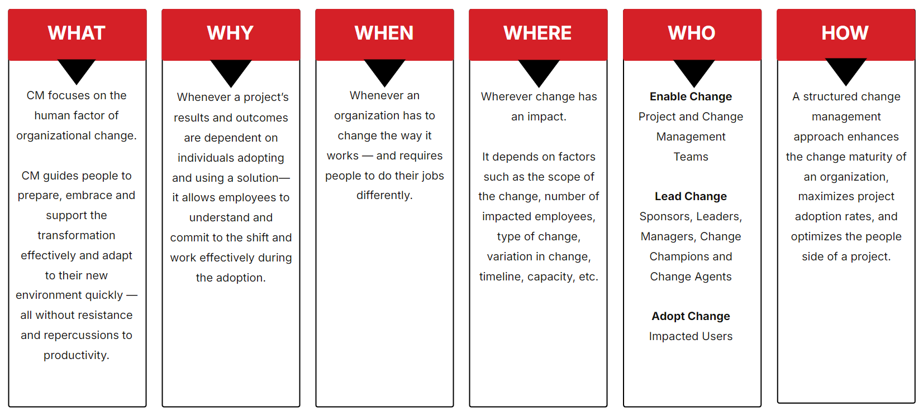
What is a Change Leader Network?
An integral part of the Change Management Methodology at Stony Brook
A peer-led group of influencers and impacted users across Stony Brook who will assist in building awareness, active listening and gathering concerns, promoting buy-in, and providing support to stakeholders impacted by the project
An indispensable asset to drive and support change adoption
Change Management at Stony Brook
Notes:
HINA

Slide 5
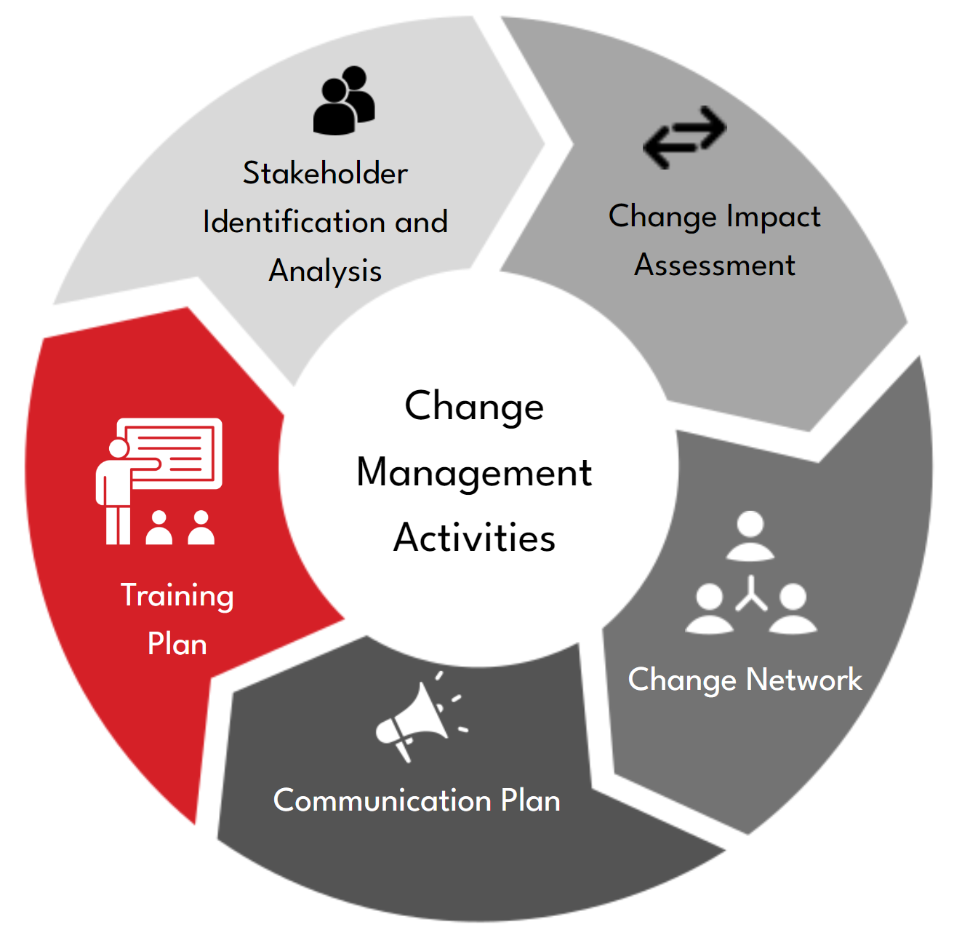
Why is a Change Leader Network needed?
Promote understanding to assist employees in understanding changes, dealing with uncertainty and ambiguity as the program progresses through implementation
Advocate positive change through face-to-face and informal communications that are required to change behaviors and attitudes
Build accountability and ownership by empowering Change Champions to gather feedback from stakeholders, answer questions and resolve concerns without having to wait or rely only on “formal, official” communications
Build a community of early adopters who value the opportunity to try out new technology first and get a chance to demonstrate their leadership skills
Accelerate the adoption of the change by quickly disseminating timely and accurate information and build trust through communication and feedback
Notes:
HINA

Slide 6
Building the Champion Network
Reward & recognition
Define the champions’ role
Select champions
Kick-off
Conduct training for champions
Socialize Network
Leverage for driving change
Gather feedback
Notes:
HINA

Slide 7
Why are we here?
Highly motivated and able to motivate others
Facilitate…
passionate about
facilitating and driving change
throughout the process
Good listener
Translate…
someone who can relate the
Messages so that everybody
understands
Drive…
someone who has a
sense of urgency to make
change happen
Change Champions
People whose deliberate actions drive organizational, social, and behavorial change
Share…
someone who shares information,
lessons learned and
provides feedback
Communicate…
a proactive communicator and
a messenger (two ways) of
SOAR initiatives
Link…
someone who links people,
program, activities, etc.
Strong informal network of peers
Ability to informally influence people
Notes:
HINA
Here are some of the behaviors that we expected Change Champions to exhibit in their role
---highlight behaviors, ask Change Champions how they exhibit these behaviors today. Remind them that leaders have nominated them as they have seen them exhibit these behaviors already!

Slide 8
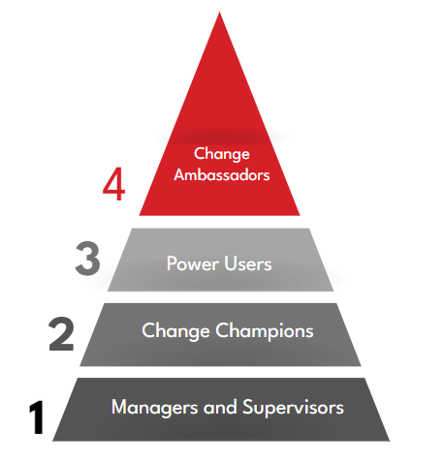
Change Champion Network Structure
The following represents the various “tiers” in the network:
University Leadership
Expected to understand business context, transactions, procedures, systems within their area and end-to-end processes
Active change agents for peer network
Day-to-day support for direct reports
Notes:
HINA

Slide 9
Power Users
SBU’s Power Users collaborate with the project team to ensure the solution meets the business needs. What do Power Users do?
Learn and articulate the shifts from current to future state processes to Change Champions and direct reports. Play a role in process improvement.
Business user at the Unit level who understands the business context, end to end processes, transactions, procedures and systems within their area.
Participate in the “Build” phase Sprints, testing (UAT), validate system functionality; Train-the-Trainer, and Onboarding. Build user proficiency in their process area (post go-live).
High-Level Responsibilities include:
Promotes best practices, continuous improvement and works as a positive change agent for the business.
Gathers feedback from Champions and direct reports; informs the Project Leadership where adjustments and training enhancements should be made.
Works with department and program leadership to design, test, train and provide ongoing employee support to the WolfieONE Change Champions. Front-line support for non-technical issues.
Promote WolfieONE
Inform SBU’s WolfieONE Project Team
Support (post go-live)
Notes:
HINA

Slide 10
Change Champions
SBU’S Change Champions enable the success of our WolfieONE implementation by driving adoption.
What do Change Champions do?
Participate in Champion meetings & assist with rapid change campaigns.
Be a conduit for change, tailored to groups via a two-way communication channel.
Serve as project advocates that play a role in shaping the future of Stony Brook
Disseminate & Amplify the OCM materials/message.
Enable a cross-functional network to execute change campaigns and enable delivery of standardized messaging.
High-Level Responsibilities include:
Promote Stony Brook’s WolfieONE Transformation
Learn about new functionality and processes. Share the benefits using OCM materials to increase awareness and adoption.
Inform SBU’s WolfieONE Team
Provide feedback to the project team as the eyes and ears within SBU to prioritize the needs of the business.
Position the message
Help develop and craft messaging and mitigation plans to proactively drive an authentic and relevant change experience for operating units.
Evaluate operational readiness
Participate in change readiness activities to provide a pulse on the organization, supporting he opportunity to pivot the engagement program and involve leaders.
Notes:
HINA

Slide 11
Benefits of Being a Change Champion
Play a key role in shaping the future of Stony Brook as an institution
Be among the first to see, learn and use new technology and processes
Be seen as the “go-to” person with key information to serve peers
Demonstrate leadership skills and opportunity to upskill
Be valued by the organization / senior leadership
Notes:
HINA

Slide 12
Networking Activity
Notes:
KER

Slide 13
Networking Activity
In Breakouts (groups of 4), WolfieONE Champions are given 10 minutes to network. Prompts:
- Share name and department name
- How long they have been a Seawolf
- Favorite yearly event or activity on campus
- Your “Superpower” – the secret sauce, the thing YOU consider your strength!
- What (if anything, that you learned so far) are you the most excited about in the move towards Oracle Cloud?
Notes:
KER – EXPLAIN ACTIVITY
NICHOLE – BREAKOUT GROUPS

Slide 14
About WolfieONE
Notes:
HINA

Slide 15
WolfieONE Elevator Pitch
Business Transformation Initiative:
WolfieONE is more than just a software update. It is a strategic transformation initiative that will design and implement an Enterprise Resource Planning (ERP) ecosystem at SBU, supported by Oracle, to better support our financial, budget, HR and business operations.
The new, cloud-based software will replace some of our systems but will also seamlessly integrate with many existing systems.
Our WHY: Beyond the business reasons that became apparent during and post-pandemic, there are human capital drivers for this initiative, such as employee morale and institutional reputation.
The industry is moving from on-premise to the cloud in a number of ways. To remain competitive, modernizing archaic systems and processes is essential.
The employee experience and how you spend your time interacting with data is one of our top reasons for this transformation.
Notes:
HINA

Slide 16
Actionable “North Star”
Vision Statement
Drive university-wide strategic initiatives with a transparent, data-driven, and seamless user-focused experience to limit friction and support business continuity for all members of our community.
Notes:
HINA

Slide 17
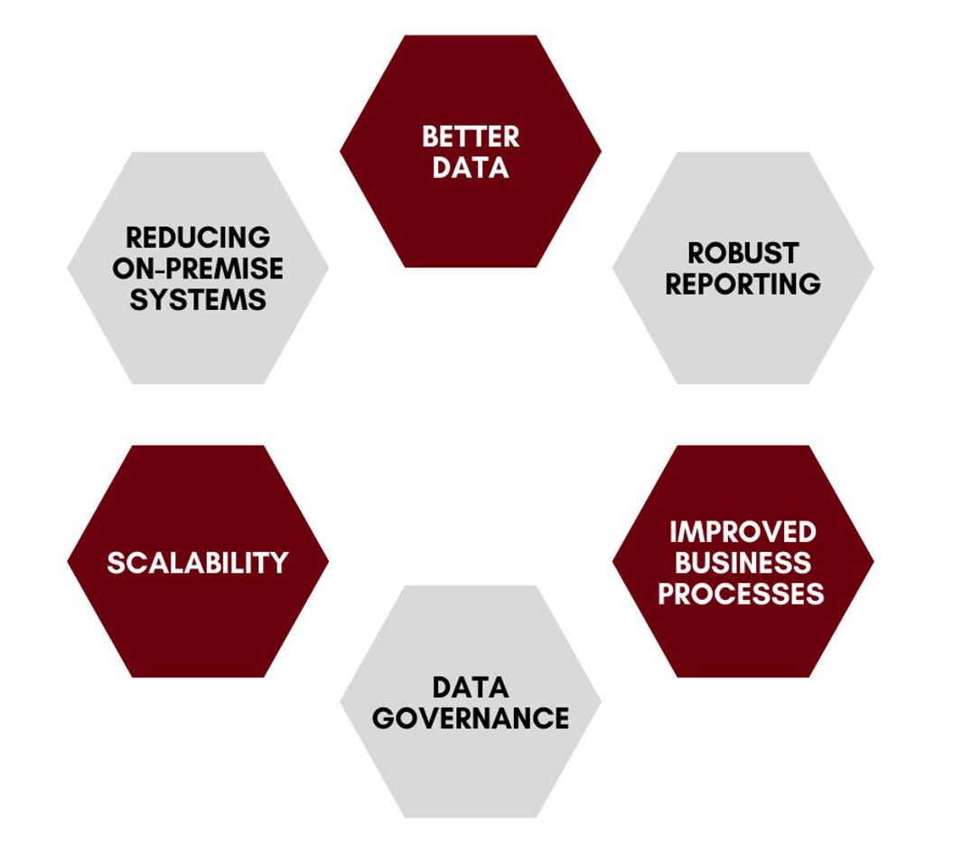
Expected Benefits
Gradual reduction of on-premise (i.e., campus-based) systems, paper-based processes and labor-intensive manual processes​
Better integration across various ERP modules which supports smoother transaction processes and more powerful blended analytics/reports​
Integrated information systems that provide more up-to-date and accurate financial and operational data that increases transparency, and enhances planning and forecasting efforts​
Robust reporting capabilities​ enabling better decision-making as well as managing from a holistic vantage point rather than a siloed view​
​ Increased automation and self-service processes (and fewer human errors as a result)​
Simpler, more intuitive, modern user experiences and enhanced cloud-based ​data security
Notes:
HINA

Slide 18
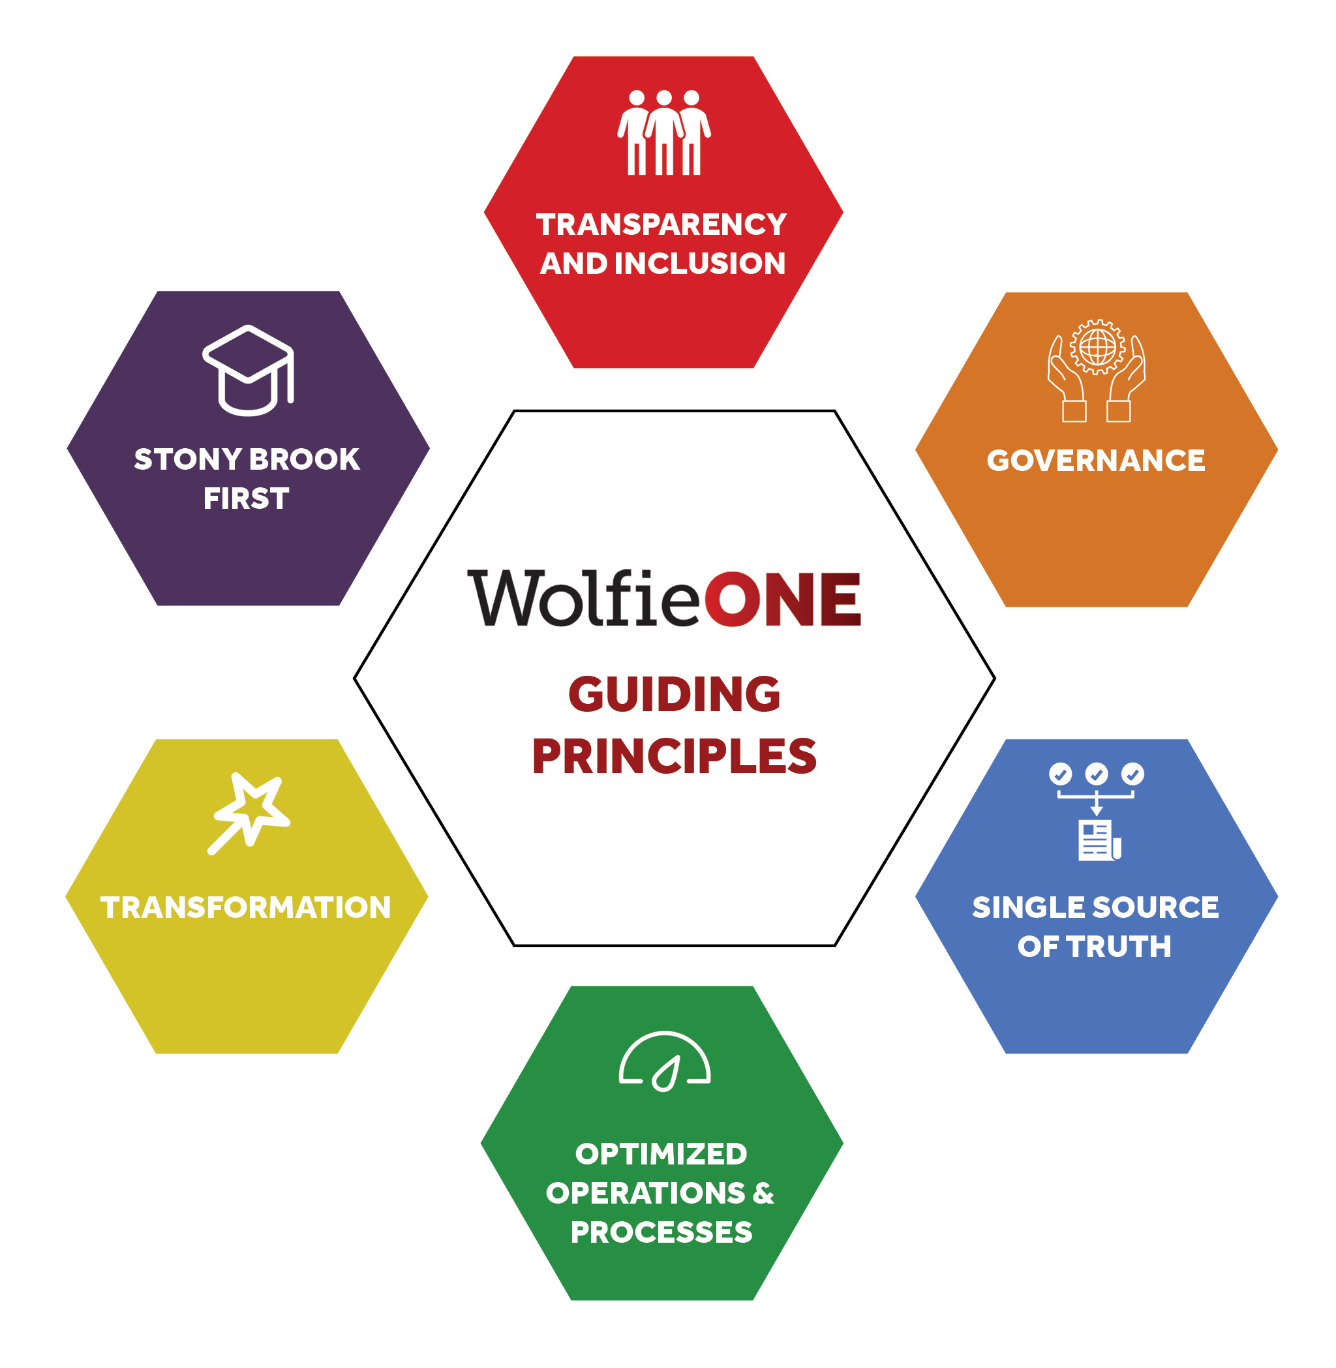
Guiding Principles
Collaborate cross-functionally
Be transparent in decision making
Communicate fully, seeking input and feedback
Put Stony Brook interests above anything else
Make strategic decisions that support the mission of our university and hospitals
Leverage every opportunity to elevate Stony Brook’s reputation
Adhere to the governance structure in place
Respect the authority of the governing bodies
Refer to the guiding principles to guide organizational decision making during day-to-day activities
Self-service
Improve policies and practices
Build for the long-term
Data-empowered decision making
De-siloed and transparent data
Adopt and practice data governance
Develop trust in system data
Streamline workflows
Simplify operations
Redesign processes based on higher education best practices
Notes:
HINA

Slide 19
Project Governance
Stony Brook and Deloitte team members have dedicated escalation channels to the project leadership stakeholders – driving efficiency and consistency in the decision-making process leads to better communication and fewer bottlenecks.
Executive Sponsors
Strategic
Leadership Core Team
Executive Steering Committee
Project (Directional)
Advisory Board
WolfieOne Project Management Office
ENABLEMENT
Workstream
(Operational)
Workstream Leads
Team Members
Notes:
Executive Sponsors
Remove roadblocks around resource conflicts, budget/timeline options, vendor impacts
Meet monthly and as-needed
Deloitte / Stony Brook Leadership Core Team
Provide business input on solution design priorities
Budget or timeline changes
Major business process changes
Business strategy changes
Meet bi-weekly and key decision meetings, as-needed
Executive Steering Committee
Focus on cross-functional decisions, along with user experience impacts
Focus on driving consistency in areas that benefit from cross-project harmonization
Project Management
Responsible for confirmation decisions, determining escalation requirements, rationalizing decisions related to time/budget trade-offs
Change orders that do not impact budget or go live
Issues/risks that span multiple work streams (e.g., Project Resourcing)
Responsible for process, user experience, workflow, and configuration decisions related to functional and technical areas
Team Members
Provide input based on their area of experience
PMO includes Martin Tessler; Leadership Core is: Lyle Gomes, Jed Shivers, Simeon Ananou, Ted Simpson, Nick Candela

Slide 20
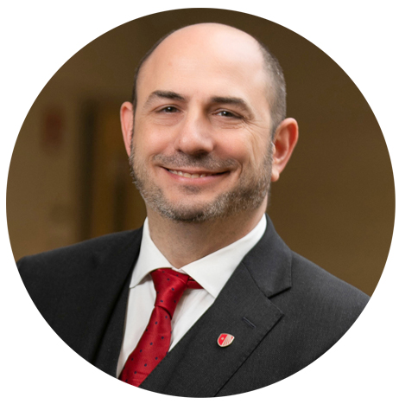
Our Executive Sponsors
Simeon Ananou CIO and VP of the
Division of Information Technology
Carl Lejuez Provost and Executive Vice President
Justin Fincher Chief Deputy to the President and SVP for Government & Community Relations
Jed Shivers Senior Vice President for Finance & Administration
Carol Gomes
Chief Executive Officer, Chief Operating Officer, SB Hospital
William Wertheim
Interim Executive Vice President for Health Sciences and Stony Brook Medicine
Dr. Gerald Kelly
Chief Information Officer, SB Hospital
Notes:
HINA

Slide 21
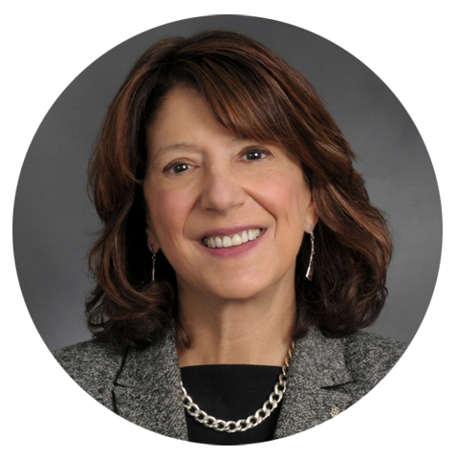
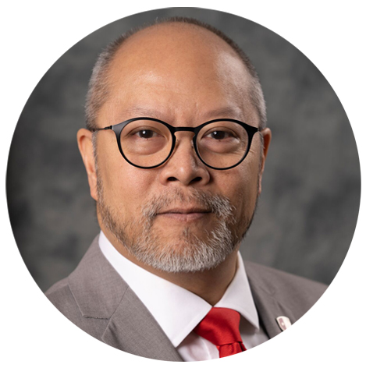
Our Steering Committee
Braden Hosch VP for Educational and Institutional Effectiveness | Cassie Amadio AVP for Accounting and University Controller | Colette Brown Chief HR Officer Stony Brook Medicine | Heather Montague Senior AVP for Budget and Financial Planning | Hina Kausar Director, Office of Change Management
Jim Gonzales AVP Enterprise Applications & Integrations (DoIT) | John Hennessey Chief Applications Officer, Stony Brook Medicine | Lyle Gomes Vice President for Finance | Tracey McEachern AVP HR Operations, Services, and Payroll | Dennis Gallagher CTO, Medical Information System
Notes:
HINA

Slide 22
Entity Scope ERP & HCM
The purpose of this Entity Scope view is to articulate how user populations within the below entities will align with respect to Day 1 Future-state WolfieONE application use and/or data integration. The Legal Entities that will be configured in Oracle is separate from this scope view.
Functional Area | Entity
Functional Area | SB University | SB Foundation | FSA | Research Foundation ³ | SB Medicine
 |  |  |  |  | SBU Hospital ¹ | LISVH ¹ | CPMP | ELI ² | SBSH ² | Other Affiliates ²
ERP (Finance) | Yes | Yes | No | Integrate | Integrate | Integrate | No | No | No | No
HCM (HR) | Yes | No | No | Yes | Yes | Yes | No | No | No | No
Definition
Yes | Populations within this entity will log on to WolfieONE Oracle Cloud to transact and/or perform reporting activities.
No | Populations within this entity will not log on to WolfieONE Oracle Cloud to transact and/or perform reporting activities.
Integrate | Data from this entity will integrate with WolfieONE Oracle Cloud.
Notes
SBUH / LISVH: EPM at summary level - they have their own budget system for daily operations. ERP – integrate for URAS reporting purposes – they have their own GL. Will load audited financial statement data to FCCS for consolidated financial reporting. ELI/SBSH/Other SBM Affiliates: These entities will load audited financial statement data to FCCS for consolidated financial reporting. RF: HCM consideration – RF employees include select CPMP and SBF staff.
Notes:
KER

Slide 23
WolfieONE Workstreams
In our next session, we will deep dive into the 3 main workstreams that lead to change impacts that have the broader reach (ERP, HCM, EPM).
Workstreams relevant to educational campuswide efforts:
Enterprise Resource Management: all things Accounting & Reconciliation!
Human Capital Management: HR processes
Enterprise Performance Management: Budgeting, planning and forecasting.
Technology: Integrations & Reporting
Change Management
* Although other workstreams are performing crucial work, those process areas are expected to directly impact a much smaller group of end users.
Notes:
KER

Slide 24
What’s Changing?
CURRENT STATE SYSTEMS/PROCESS​ | FUTURE STATE SYSTEMS/PROCESS​
Inconsistency across processes and practices​ | Standardize processes and practices (80/20)​
Oracle/Peoplesoft software for Financial​ | Enterprise Resource Planning (ERP), Enterprise Performance Management (EPM)​
Oracle/Peoplesoft software for Human Resources​ | Oracle Human Capital Management (HCM) Cloud​
Campus Budget Module (CBM) for Budget and Planning ​ | Enterprise Performance Management (EPM)​
SOLAR (time and attendance; employee information, NOT the student side)​ | Oracle Human Capital Management (HCM) for reporting time and attendance
Recruiting and onboarding in Taleo​ | Oracle Recruiting Cloud (HCM)​
Notes:
KER

Slide 25
What’s not changing?
CURRENT STATE ​ | FUTURE STATE INTEGRATIONS​
Jaggaer (WolfMART) SUNY system-wide SaaS solution for Procurement​ | Possible retrofit for some fields with the new COA, integration with Oracle, end-user will continue to use Jaggaer in the same way​
Concur for travel & expense reimbursement ​ | End-user will continue to use Concur in the same way as in the current state. ​
Hospital - Finance (Lawson)​ | Hospital finance professionals will continue to use their current COA in Lawson​
Student Information Systems​ | Campus Solutions will integrate with WolfieONE. Students’ employee records will also exist separately from their Academic record in WolfieONE.​
Hospital usage of Kronos | Will integrate with SUNY system for payroll purposes
Notes:
KER

Slide 26
Project Phases
ERP & HCM are in Build/configure, while going through an iterative process to make decisions about certain system components still in Design, before moving those processes and user stories into “Sprinting” mode. Enterprise Performance Management is in Design.
Once we configure the system, we test, make adjustments, test again, then train the trainers, who will in turn train the end users.
Notes:
KER

Slide 27
Next Steps
Notes:
KER

Slide 28
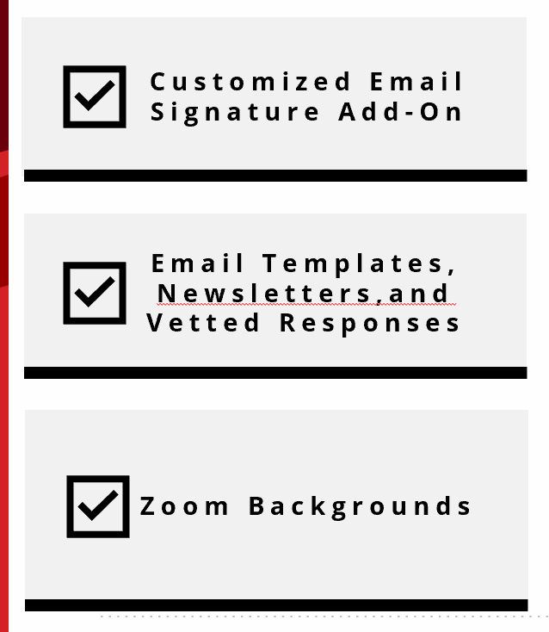
Change Champion Action Plan
Know, Share, Do | Oct- Dec 2024
By 12/02: Review the WolfieONE SharePoint site in detail, including:
Oct: Understand the WolfieONE scope and progress so far
Early Dec: Program Timeline update from OCM
Late Dec: Review Frequently Asked Questions (FAQ)
Jan 2025: Action Plan will be release by the OCM team
Know This!
Identify the department ongoing meetings at which WolfieONE can be an agenda item & identify peers who are “your counterparts”
Find time on agendas of team meetings to share program updates (refer to talking points provided in this month’s Change Leader meeting-in-a-box)
Share This!
Copy/paste THE WolfieONE logo (Appendix) and add to your e-mail signature, along with:
“Proud Change Champion, ask me about WolfieONE!”
Tomorrow: Save the WolfieONE website Resources to your bookmarks (print the QR code that will be provided by OCM and post it in your office!)
Nov 2024: Set reminders to spend just 15 min biweekly on the WolfieONE website
Dec 2024: Share the WolfieONE website, eNewsletter and change survey with colleagues
Jan 2025: Share notable feedback and questions from colleagues
Do This!
2025 Dates are subject to change
Notes:
KER: The resources listed on this slide are meant to ensure that Change Champions have access to resources to invite inquiries about WolfieONE in easy, low-effort ways, like via an email signature add-on or Zoom background
All the below modes of engagement are opt-in!

Slide 29
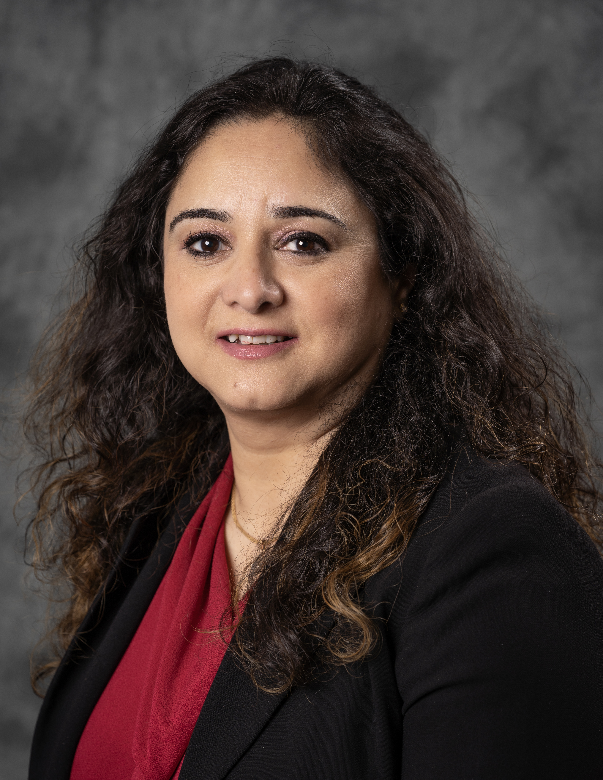
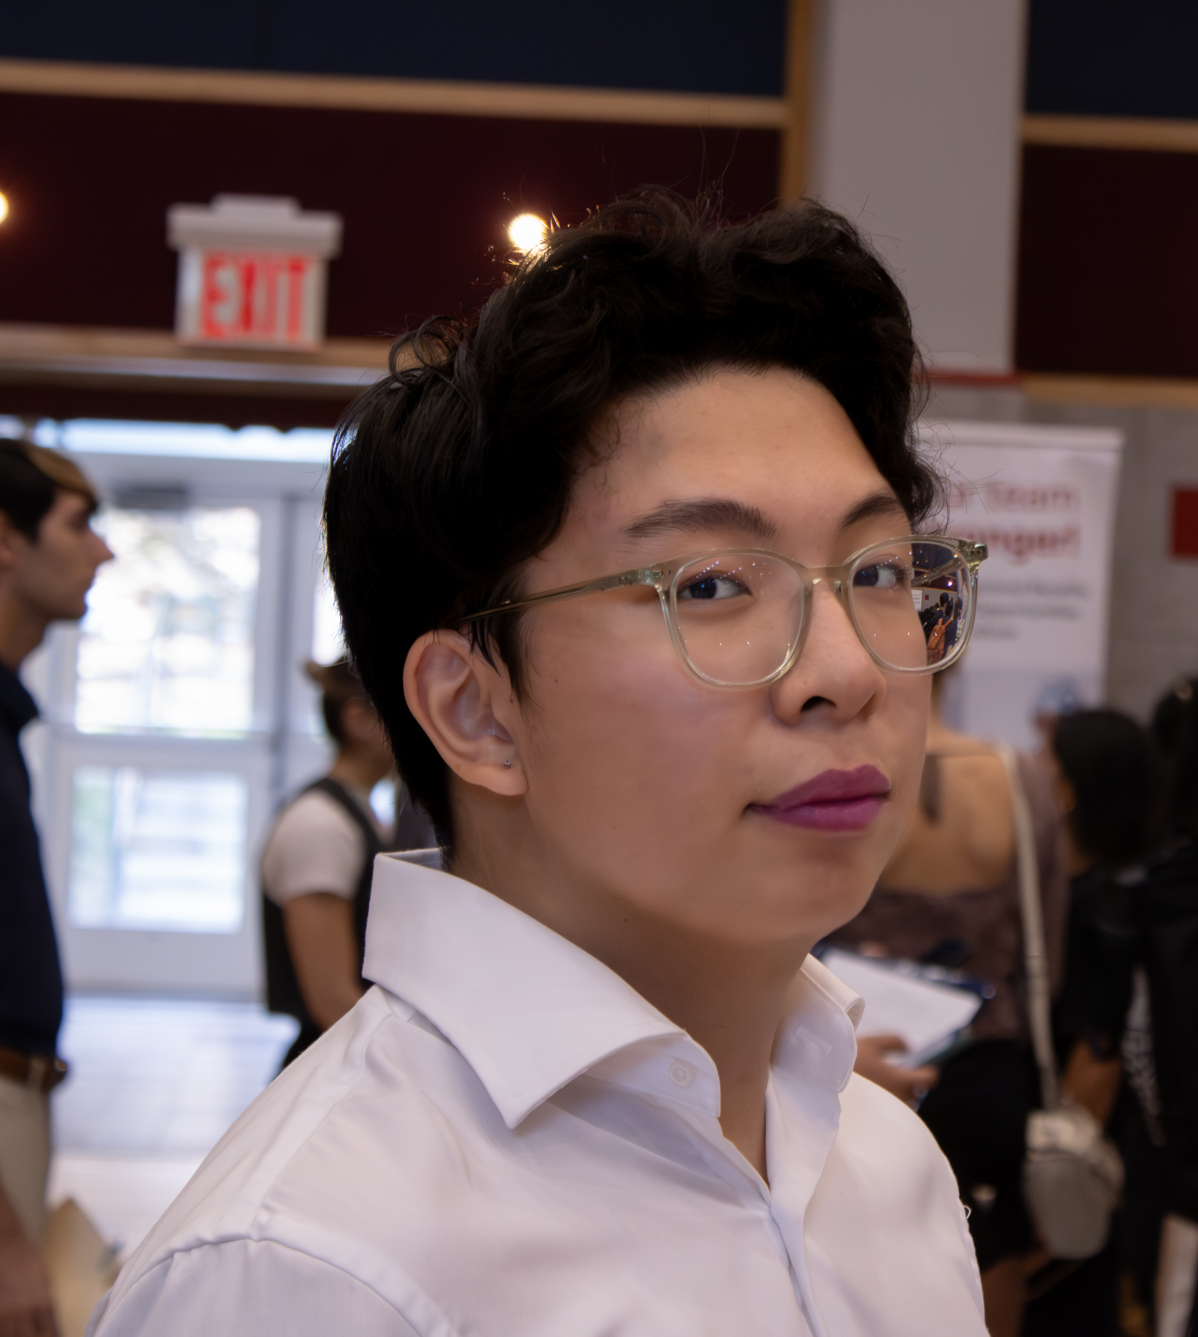
OCM Contacts
Hina Kausar
Director, Office of Change Management
Hina.Kausar@stonybrook.edu
Nichole Gladky
Training Manager, Office of Change Management
Nichole.gladky@stonybrook.edu
Ker Famer
OCM, Deloitte
kariley.famer@stonybrook.edu
OR
kfamer@deloitte.com
Kevin Wong
Intern, Office of Change Management
kevin.t.wong@stonybrook.edu

Slide 30
Appendix

